Slide 1

Equipping the Next Generation for Active Engagement in Science
Vitamin D

Slide 2


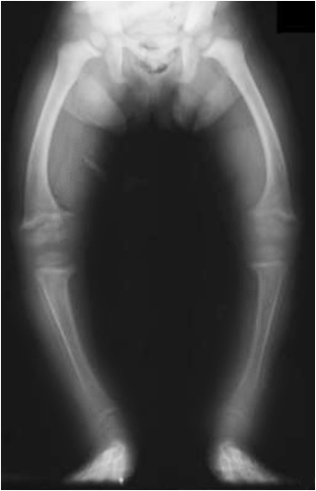
nline
news
400% rise in children with rickets as more stay inside.
Could
you end up like this?
The agonising disease causes brittle bones
and severe deformities.
Engage
Play
Review
Decide
Notes:
Ask student pairs to speculate – what might cause rickets and other bone diseases? Are they at risk?

Slide 3


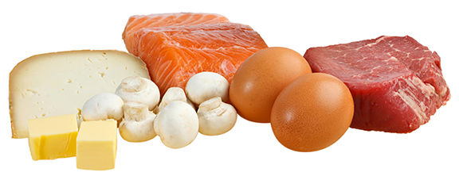
You get vitamin D
from food, and make it using sunlight.
Rickets is caused by a shortage of vitamin D.
But not everyone gets enough.
3
Engage
Play
Review
Decide

Slide 4

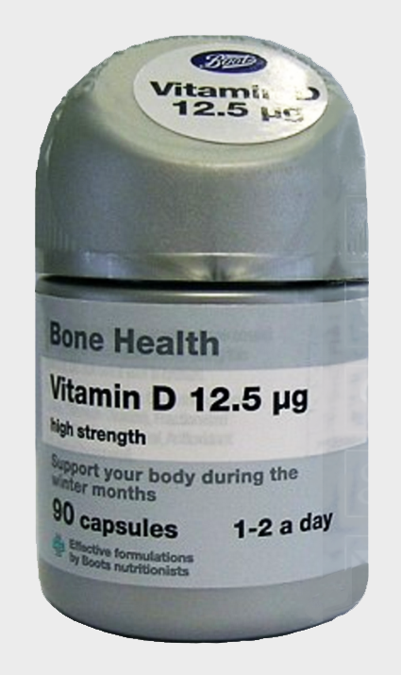
Some scientists think that all under-18s should take a daily vitamin D pill in winter.
Do you need a daily vitamin D pill?
4
Engage
Play
Review
Decide
Notes:
Student pairs briefly tell each other whether they take vitamin tablets. They then discuss whether they think they need a daily vitamin D pill, and share their immediate reactions via a show of hands.

Slide 5


In these lessons you will :
Describe health effects of vitamin D deficiency.
Interpret a line on a graph to suggest the relationship between variables, and read values from
the graph.
Digestion
Analyse patterns
Big Idea
Working Scientifically
Notes:
The lesson objectives

Slide 6

You want to know your vitamin D intake?
You’ve come to the right place.
They call me Data Doctor.
First, let’s see if you can handle tricky tables and challenging charts.
Engage
Play
Review
Decide
Notes:
Tell students that they will now use and develop further their skills in analysing patterns by playing an on-screen game. They will use these skills later to analyse vitamin D data. Give each student a copy of SS1 and start the game.

Slide 7



SS1
Can you identify variables?
Q1
For this question, input data from the class.
Leave the slideshow and double click the chart. From the top toolbar select ‘Edit data’.
Number of people who like this flavour best
vanilla
chocolate
strawberry
ice cream flavour
Engage
Play
Review
Decide
Notes:
Leave the slideshow and double click the chart. From the top toolbar select 'edit data' to input students’ favourite ice cream flavours from the three options given.

Slide 8
SS1
Can you identify variables?
Q1
The independent variable is:
A Number of people who like this flavour best
B Ice cream flavour
C Chocolate
Number of people who like this flavour best
vanilla
chocolate
strawberry
ice cream flavour
Engage
Play
Review
Decide
Notes:
Students choose the answer to the multiple choice question, writing their answer on scrap paper.

Slide 9
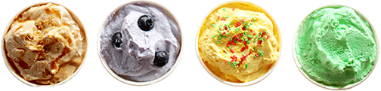
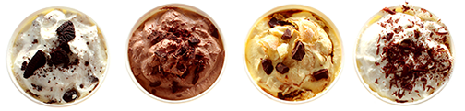
SS1
Q2
The dependent variable is:
A Mean monthly temperature.
B USA ice
cream sales.
C Increasing.
USA ice cream sales
(million litres/ month).
Mean monthly temperature (°C)
Engage
Play
Review
Decide
Notes:
Move quickly through the game, giving students just enough time to decide on their answers. If appropriate, make the game competitive.
Answer = B

Slide 10
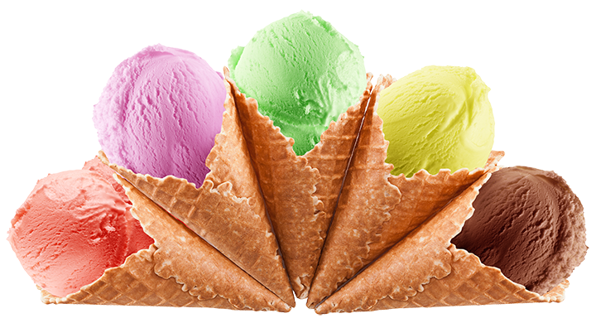
SS1
Can you identify a pattern in data?
Q3
The best description of the pattern shown by the bar chart is:
A Ice cream sales increase and then decrease.
B Ice cream sales are
highest in June.
C Ice cream sales increase
to a maximum in June,
and then decrease.
USA ice cream sales (million litres/
month).
J F M A M J J A S O N D
Month
Engage
Play
Review
Decide
Notes:
Answer = C

Slide 11



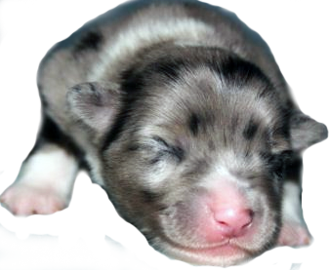
SS1
Q4
Age of puppy (months) | Mass of puppy (kg)
1 | 4
2 | 9
3 | 14
4 | 19
5 | 23
6 | 26
7 | 28
Finish describing the pattern in the data.
As the age of the puppy increases…
its mass increases.
Engage
Play
Review
Decide
Notes:
Answer: As the age of the puppy increases, its mass increases.

Slide 12
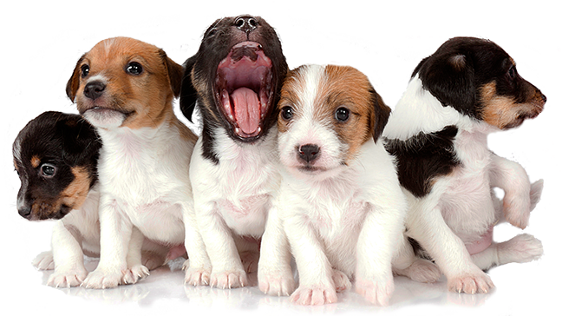
SS1
Can you calculate a mean?
Q5
Name of puppy | Mass of puppy (kg)
Bella | 4
Barney | 5
Bear | 7
Buddy | 4
Beauty | 5
The mean mass of the puppies is:
A 4 kg B 5 kg C 7 kg
Bella Barney Bear Buddy Beauty
Engage
Play
Review
Decide
Notes:
Answer = 5

Slide 13
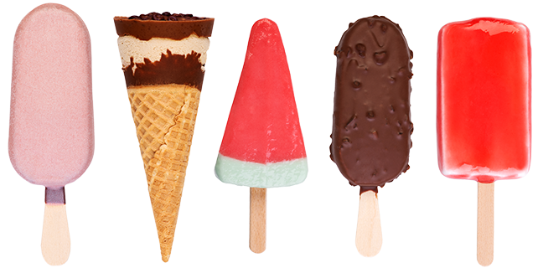
SS1
Can you select data and do calculations?
Q6
You have £12
A How many of ice cream A can you buy?
B How many of ice cream B can you buy?
Price (£)
12
4
Type of ice cream
Engage
Play
Review
Decide
Notes:
Answer: A 12, B 4

Slide 14
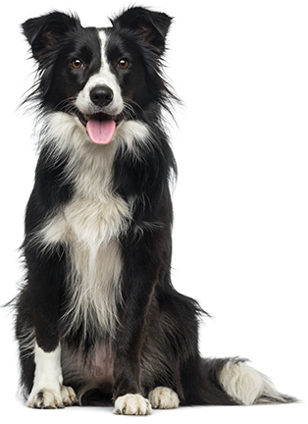
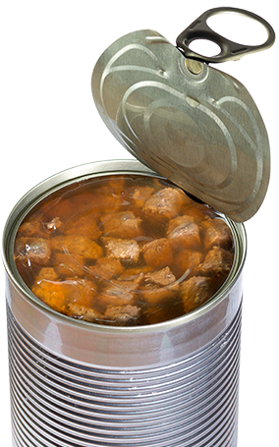



SS1
Q7
You have a tin of
dog food. Its energy content is 2000 kJ.
A How many cans have enough energy for a beagle for a day?
B What fraction of
a can has enough
energy for
a chihuahua
for a day?
Amount of energy needed from food
(kJ/ day).
2
chihuahua pug beagle border collie
¼
Dog breed
Engage
Play
Review
Decide
Notes:
Answer A 2 cans; B ¼ of a can

Slide 15
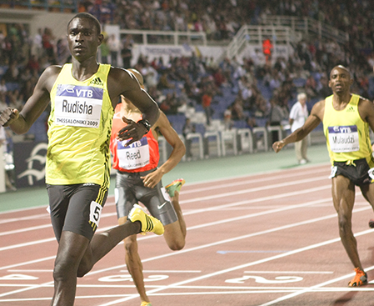
SS1
Can you read values from a graph?
Q8
What was the speed of the 800 m male world record holder?
A 9.2 m/s
B 7.9 m/s
C 7.3 m/s
Speed
of male world record runner (m/s).
Distance (m)
15
Engage
Play
Review
Decide
Notes:
Answer B

Slide 16
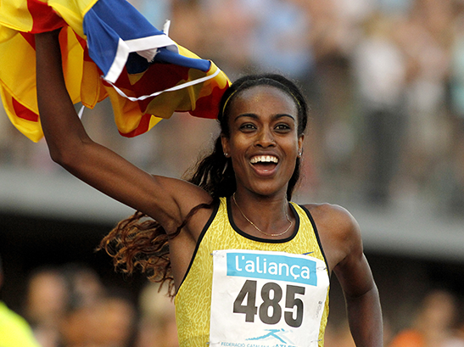
SS1
Q9
Can you estimate values?
What is the best
estimate of the speed
of the 1500 m female world record holder?
A 7.1 m/s
B 6.5 m/s
C 5.9 m/s
Speed of female world record runner (m/s)
Distance (m)
16
Engage
Play
Review
Decide
Notes:
Answer B

Slide 17

SS1
Can you describe a linear relationship?
Q10
Finish describing the pattern in the data.
As the mean daily temperature increases…
Number of crimes in Anycity (number/day).
the number of crimes increases
Mean daily temperature (°C)
Engage
Play
Review
Decide
Notes:
Answer – As the mean daily temperature increases, the number of crimes in AnyCity increases.

Slide 18
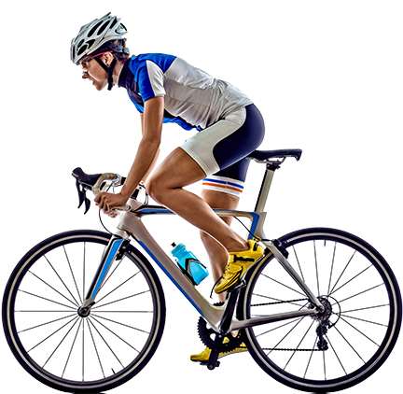
SS1
Q11
Finish describing the pattern in the data.
As the speed of the cyclist doubles, the distance travelled in
15 minutes…
Distance travelled in 15 minutes
doubles
Speed of cyclist (km/h)
How did you do?
Engage
Play
Review
Decide
Notes:
Answer – as the speed of the cyclist doubles, the distance travelled in 15 minutes also doubles.
Quickly go through each question slide again (8-18). Clicking on the question button in the top right corner will reveal the answer. During this, students complete the skill check on SS1.
Once the game has finished, students complete the self-assessment task on SS1.

Slide 19


SS2-3
Estimate how much vitamin D you make
from sunlight. Scientists recommend 10 μg a day
Look in the UV index for today:
  Draw a smooth curve on the graph on SS2. Then use it to estimate how many hours you need to be outside today to make enough vitamin D.
  How many hours will you be outside today?
  Can you make enough vitamin D from sunlight today? Write your answer on SS3.
Engage
Play
Review
Review
Decide
Notes:
Students analyse data on SS2 to work out whether they make enough vitamin D from sunlight. This activity requires students to use the internet to find out the vitamin D index forecast for the day. Alternatively, you could give them this information.

Slide 20
SS2-3
Estimate how much
vitamin D you get from food.
  Choose three foods on SS2 that you eat often.
  Calculate the masses you need to get enough vitamin D.
  Can you get 10 μg of vitamin D from food today? Write your answer on SS3.
Engage
Play
Review
Decide
Notes:
Students analyse data on SS3 to work out whether they get enough vitamin D from food.

Slide 21
SS4-5
Do you need a daily vitamin D pill?
Play Sentence Sorter to help you decide.
1 Make 6 sentences from the cards.
2 Sort the sentences into two groups to:
  explain why you need vitamin D
  describe problems caused by vitamin D deficiency
  3 Make your decision and write it on SS5.
Engage
Play
Review
Decide
Notes:
Student pairs use the facts on the sentence sorter (SS4) to explore in more detail the impacts of vitamin D deficiency and the consequences of vitamin D supplementation.
Students then use (SS5) to guide them in making their individual final decision.
Ask students to share their answers in small groups and make the point that there is no definitive answer here – the answer is a matter for the individual.

Slide 22

Student sheets
Vitamin D
Sheet no. | Title | Notes
SS1 | Data Doctor’s skill check | Not reusable. One per student.
SS2 | Vitamin D line graph and bar chart | Reusable. One per small group.
SS3 | Do you get enough vitamin D? | Not reusable. One per student.
SS4 | Sentence sorter cards. | Reusable. Cut into cards One per small group.
SS5 | Vitamin D decision | Not reusable. One per student.

Slide 23
SS1
Data Doctor’s skill check
Skill | Question number | Do you have the skill?
Identify variables | 1, 2
Identify a pattern in data | 3, 4
Calculate a mean | 5
Select data and do calculations | 6, 7
Read values from a graph | 8
Estimate values of data between known values | 9
Describe a linear relationship | 10, 11

Slide 24
SS2
Vitamin D line graph and bar chart
This bar chart shows the mass of vitamin D in 100 g of different foods.
You need
10 μg of vitamin D daily
This graph shows, for different values of the UV index, the length of time you need to be outside to get enough sunlight to make 10 μg of vitamin D (enough
for one day)
The data assumes you are wearing short sleeves.
If you are wearing long sleeves, you need to be outside for longer.
The data point
for a UV index
of 1 is 75 minutes. This point does not fit on the graph.

Slide 25
SS3
SS3
Do you get
enough vitamin D?
Do you get
enough vitamin D?
Today’s UV index is _____________
Today’s UV index is _____________
The graph shows that, for this UV index, I need to be
outside for ________ hours today to make enough
vitamin D.
The graph shows that, for this UV index, I need to be
outside for ________ hours today to make enough
vitamin D.
I will be outside for ________ hours today, so I do / do not
think that I can get enough vitamin D from sunlight today.
I will be outside for ________ hours today, so I do / do not
think that I can get enough vitamin D from sunlight today.
The bar charts show that, to get 10 μg of vitamin D,
I need to eat:
_________ g of _____________________________ or
_________ g of _____________________________ or
_________ g of _____________________________
The bar charts show that, to get 10 μg of vitamin D,
I need to eat:
_________ g of _____________________________ or
_________ g of _____________________________ or
_________ g of _____________________________
I do / do not think that I will get enough vitamin D from food today.
I do / do not think that I will get enough vitamin D from food today.
Overall, I do / do not think that I can get enough vitamin D from food and sunlight today.
I think this because___________________________________
Overall, I do / do not think that I can get enough vitamin D from food and sunlight today.
I think this because___________________________________

Slide 26
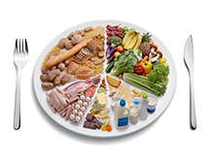
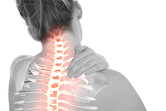


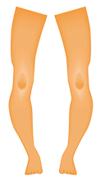
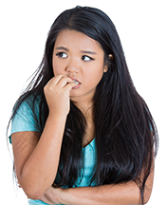

SS4
Sentence Sorter cards
1
2
3
4
You need a balanced diet, including vitamins…
Vitamin D deficiency
may cause…
Vitamin D keeps your bones healthy by…
Vitamin D pills may improve muscle…
5
6
… bone and muscle pain in adolescents and
adults.
7
You can get vitamin D from some foods…
8
… for your cells’
energy, growth
and maintenance.
… regulating the amounts of calcium and phosphate in your body.
9
10
11
12
Children who do not have enough vitamin D may get…
… and sunlight helps to make vitamin D from substances in your skin.
… strength in adolescents
and adults.
… rickets.

Slide 27
SS5
SS5
Vitamin D decision
Vitamin D decision
I need vitamin D because…
I need vitamin D because…
Not having enough vitamin D can cause these problems:
Not having enough vitamin D can cause these problems:
I need a total of ________ μg of vitamin D daily.
I do / do not get enough vitamin D from food and sunlight.
I need a total of ________ μg of vitamin D daily.
I do / do not get enough vitamin D from food and sunlight.
I do / do not need a daily vitamin D pill.
I think this because…
I do / do not need a daily vitamin D pill.
I think this because…

Slide 28

Get students talking and thinking

Slide 29














Equipping the Next Generation for Active Engagement in Science
TRACES

