Slide 1

Equipping the Next Generation for Active Engagement in Science
Two degrees (2 of 2)

Slide 2
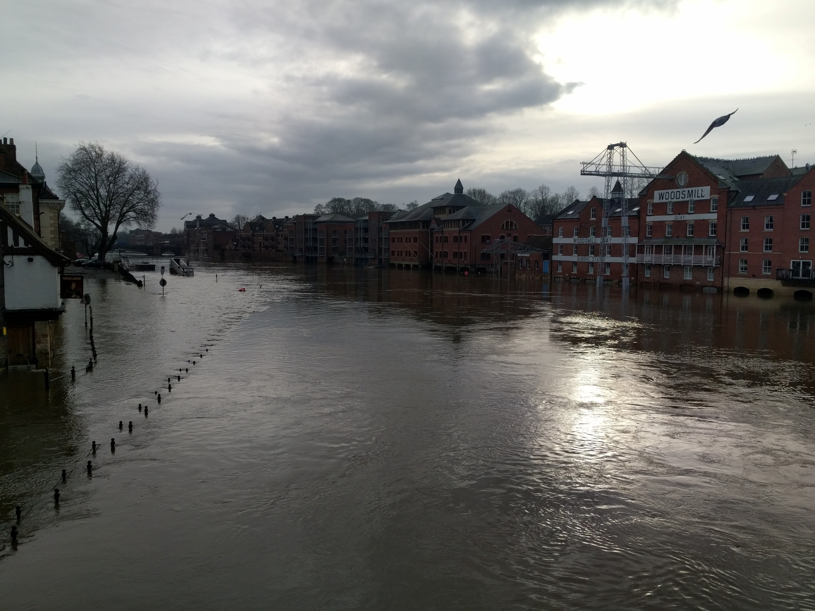

What will save the world from getting more than 2 degrees hotter?
December 2015 wettest month on record.
Climate change blamed for extreme weather
2
Engage
Play
Decide
Notes:
Remind students about the dilemma.

Slide 3

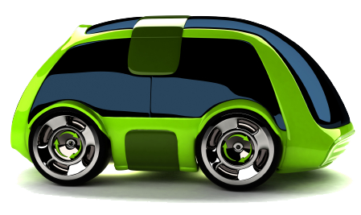

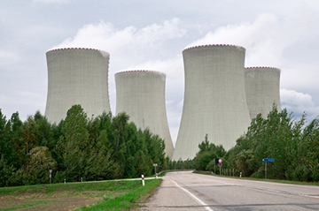

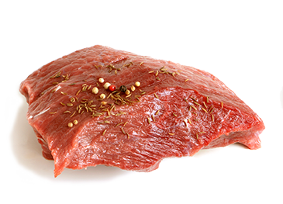
There are actions we can take.
Cut aeroplane travel
Develop electric cars
Shut down fossil fuel power plants
Use more renewable energy resources
Plant more forests
Recycle resources
Fewer cars on the road
Make appliances more energy efficient
Eat less meat
Engage
Play
Decide
Notes:
Ask them to name some actions that will reduce greenhouse gases and reveal examples.

Slide 4


describe how global warming can impact on climate and local weather patterns
Consider the impacts of carbon emission actions on the environment, people and money
In these lessons you will :
Lesson 1
Climate
Lesson 2
Examine consequences
Big Idea
Working Scientifically
Notes:
A breakdown of how the students will use scientific evidence in lesson 1 and examine consequences in lesson 2 to help them to make a decision.

Slide 5




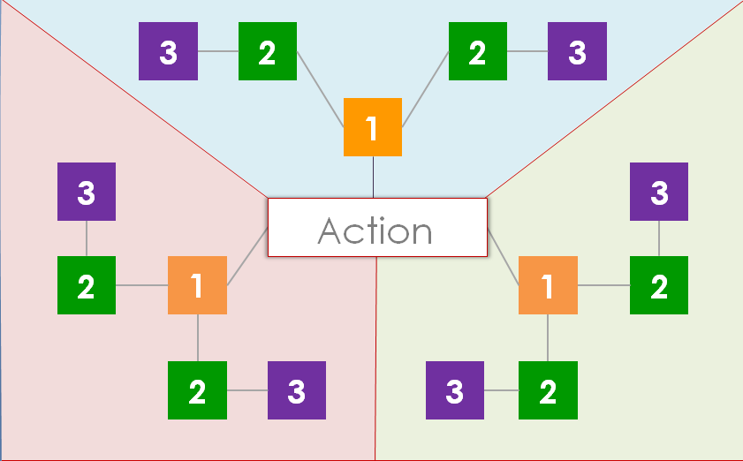
How can we decide if an action is a good idea?
One way is to think of all the possible consequences.
SS1-3
Should...
Play ‘a game of consequences’
Work in a group of 3.
Cut out the blank cards (SS1)
Read the rules (SS2)
Play the game on the board (SS3)
Decide if you think the action is a good idea
5
Engage
Review
Consider
Engage
Play
Decide
Notes:
Introduce the idea that to choose which action is best you must examine the consequences of each. Make sure students understand what we mean by a consequence i.e. an effect of an action which could be negative or positive.
Students are introduced to 'a game of consequences' which will help them to decide if an action is a good idea. They work in a group of 3 and follow the instructions on the slide and SS2. To make the game more competitive an extra option is to allow students only 20 seconds to come up with a consequence when filling the 2 and 3 boxes. If they fail to do this, they miss their turn. The player with the most cards on the board at the end is then the winner.
Spend some time going round each group asking them if they found that the action had more negative or positive consequences and examples of some of the consequences they came up with. They should then remove the game cards from the board.

Slide 6



To make a scientific decision
it is important to consider the consequences on:
SS4
people
money
environment
How might different groups of people be affected?
Who might gain or lose money?
How might habitats be affected?
6
Engage
Review
Consider
Engage
Play
Decide
Notes:
Introduce the fact that consequences can be classed as affecting people, money or environment. Give each group a copy of the cards from SS4 which outline these. They should be placed around the playing board.

Slide 7

SS5
What should we do to stop the rise?
Examine the consequences and decide:
Should the UK:
Each group takes one action.
Use the game board to think of
consequences for people, the environment and the economy.
Present your consequences to the class
A: Use nuclear
B: Go vegan
C: Ban cars
Engage
Review
Consider
Engage
Play
Decide
Notes:
Explain that they will now be examining the consequences of some climate change actions. Assign each group one action and give them the corresponding version of SS5. Ask groups to spend time reading through the information and ask you any questions about the action if they wish.
Groups then play the 'game of consequences' again using their action. This time, each third of the board corresponds to either people, money or environment and they should only place consequences affecting these in each area. They may find they can't fill the entire board - this is fine. In order for students to listen to the consequences of each action and make a choice, use a teacher-led class discussion or a specific format like a ‘Fishbowl’ : ask one person from each group to join up and discuss the consequences of their action. The rest of the class can watch and enter the fish bowl if they wish by tapping a person on the shoulder. As a class discuss the fact that the actions used in the game were radical that there is no one good action but a series of actions to take.

Slide 8


In the UK our action to save
the world is...
Which action did you choose?
Explain why
We need to take action now because...
This action is the best option because...
8
Engage
Review
Consider
Engage
Play
Decide
Notes:
Students now consider the scientific evidence from lesson 1 and consequences from lesson 2 to come to a personal decision on which action they would choose and why. They could present it in a persuasive manner as a politician convincing the public of their decision.

Slide 9

Student sheets
Two degrees
Sheet no. | Title | Notes
SS1 | Game cards | Consumable, one per group, printed onto card
SS2 | Game rules | Reusable, one per group
SS3 | A game of consequences | Reusable, enlarge to A3, one per group
SS4 | People, money, environment | Reusable, cut into cards, one per group
SS5a-c | Actions | Reusable, one action (A, B or C) per group

Slide 10

SS1
Game cards

Slide 11
SS2
Game rules
You will need:
A game of consequences board
Blank cards cut up
A consequence is an action that has an effect that can be negative or positive
Red and green pen/pencil
3 players
Instructions
1 Write the action on the large card and place in the centre of the board.
2 Place the other cards in a pile.
3 The first player thinks of one consequence of the action and shares it with the other players. If they agree that it is
a consequence then the player takes
a small card from the pile and writes on the consequence along with their initials. This is placed on one of the boxes marked with a 1. Take it in turns so all the ‘1’ boxes are filled up.
4 Now, you must fill up the boxes marked with a 2 only. These are consequences
of the suggestions in the ‘1’ boxes.
5 Continue until all the ‘2’ boxes are filled. Then move onto the ‘3’ boxes.
6 When all boxes are filled, go through each
of the ‘2’ and ‘3’ boxes and decide if it is
a negative or positive consequence
(some might be both). Mark all the negative consequences with the red pen and positive with the green pen.
7 Then, count up how many consequences are negative and how many are positive.

Slide 12
SS3
A game of consequences
3
2
2
3
1
3
3
Action
2
1
1
2
2
3
3
2
Student sheets

Slide 13

SS4
SS4
People, money, environment
People, money, environment
Consider people
Consider people
Identify groups who could
be affected by the action
Describe how each group
could benefit or be harmed
Predict the views that different
groups will take on the action
Describe how the issue could affect you
Identify groups who could
be affected by the action
Describe how each group
could benefit or be harmed
Predict the views that different
groups will take on the action
Describe how the issue could affect you
Consider money
Consider money
Identify individuals or organisations who
may gain or lose money from the action
Describe how it would affect
each group financially
Identify individuals or organisations who
may gain or lose money from the action
Describe how it would affect
each group financially
Consider the environment
Consider the environment
Identify possible consequences to particular habitats
Describe possible consequences to
animals dependent on these habitats
Describe possible consequences
to local air quality
Describe potential impacts further afield
Identify possible consequences to particular habitats
Describe possible consequences to
animals dependent on these habitats
Describe possible consequences
to local air quality
Describe potential impacts further afield

Slide 14
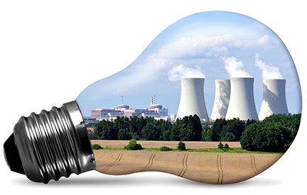
SS5a
Action A: Use nuclear
Action: Replace all fossil fuel powered power plants with nuclear power plants.
The facts
Nuclear power plants do not produce any greenhouse gases but a lot are produced as they are built.
They use a non-renewable resource called uranium. This will eventually run out.
They are very expensive to build.
They can generate electricity 90% of the time, even when the sun does not shine or the wind does not blow.
The waste produced by nuclear power plants is highly radioactive and needs to be stored deep underground for thousands of years before it is safe.
There is a risk of a meltdown which releases dangerous, radioactive chemicals into the air.

Slide 15
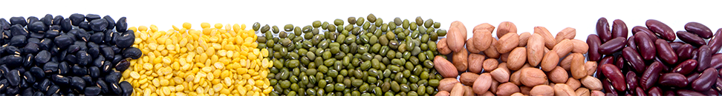
SS5b
Action B: Go vegan
Action: Stop the farming of animals. People must go vegan.
The facts
A diet with no animal fat is healthy, reducing the incidence of heart disease and some cancers.
Currently an area the size of a football pitch can be used to produce 250 kg of beef or 15,000 kg of fruit and vegetables.
If people ate no meat, there would be
no animal farms.
People might struggle to eat
a balanced diet.
Land used for farming animals could be replanted as forest or used to grow biofuels (plants that can be used to generate electricity or make fuels for cars).
The meat and dairy industry is responsible for 14.5% of global greenhouse gas emissions. That's more than is produced by all cars, trains, planes and ships in the world.

Slide 16

SS5c
Action C: Ban cars
Action: No one is allowed to own a car – you
have to walk, cycle or use public transport instead
The facts
Cycling and walking are good exercise.
Air pollutants from cars have a damaging effect on the health of people, animals and plants.
Road transport accounts for
22% of total UK emissions of carbon dioxide.
For many people, travelling by car is often the only practical way to travel.
With no cars to make or sell, car manufacturing plants and garages would shut down.
Noise from road traffic affects 30% of people
in the UK.
Banning cars altogether will stop the development of electric or hydrogen powered cars.
Student sheets

Slide 17

Get students talking and thinking

Slide 18














Equipping the Next Generation for Active Engagement in Science
TRACES

