Slide 1

Equipping the Next Generation for Active Engagement in Science
Two degrees (1 of 2)

Slide 2
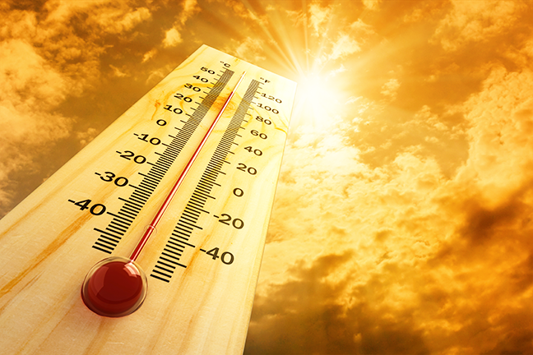

We are warming up the planet.
If temperatures rise by more than 2 degrees then we will face...
...catastrophic consequences
2
Engage
Review
Consider
Notes:
Display the issue (2). Explain that this rise means that average global temperatures will have increased by more than 2 degrees since pre-industrial times.

Slide 3
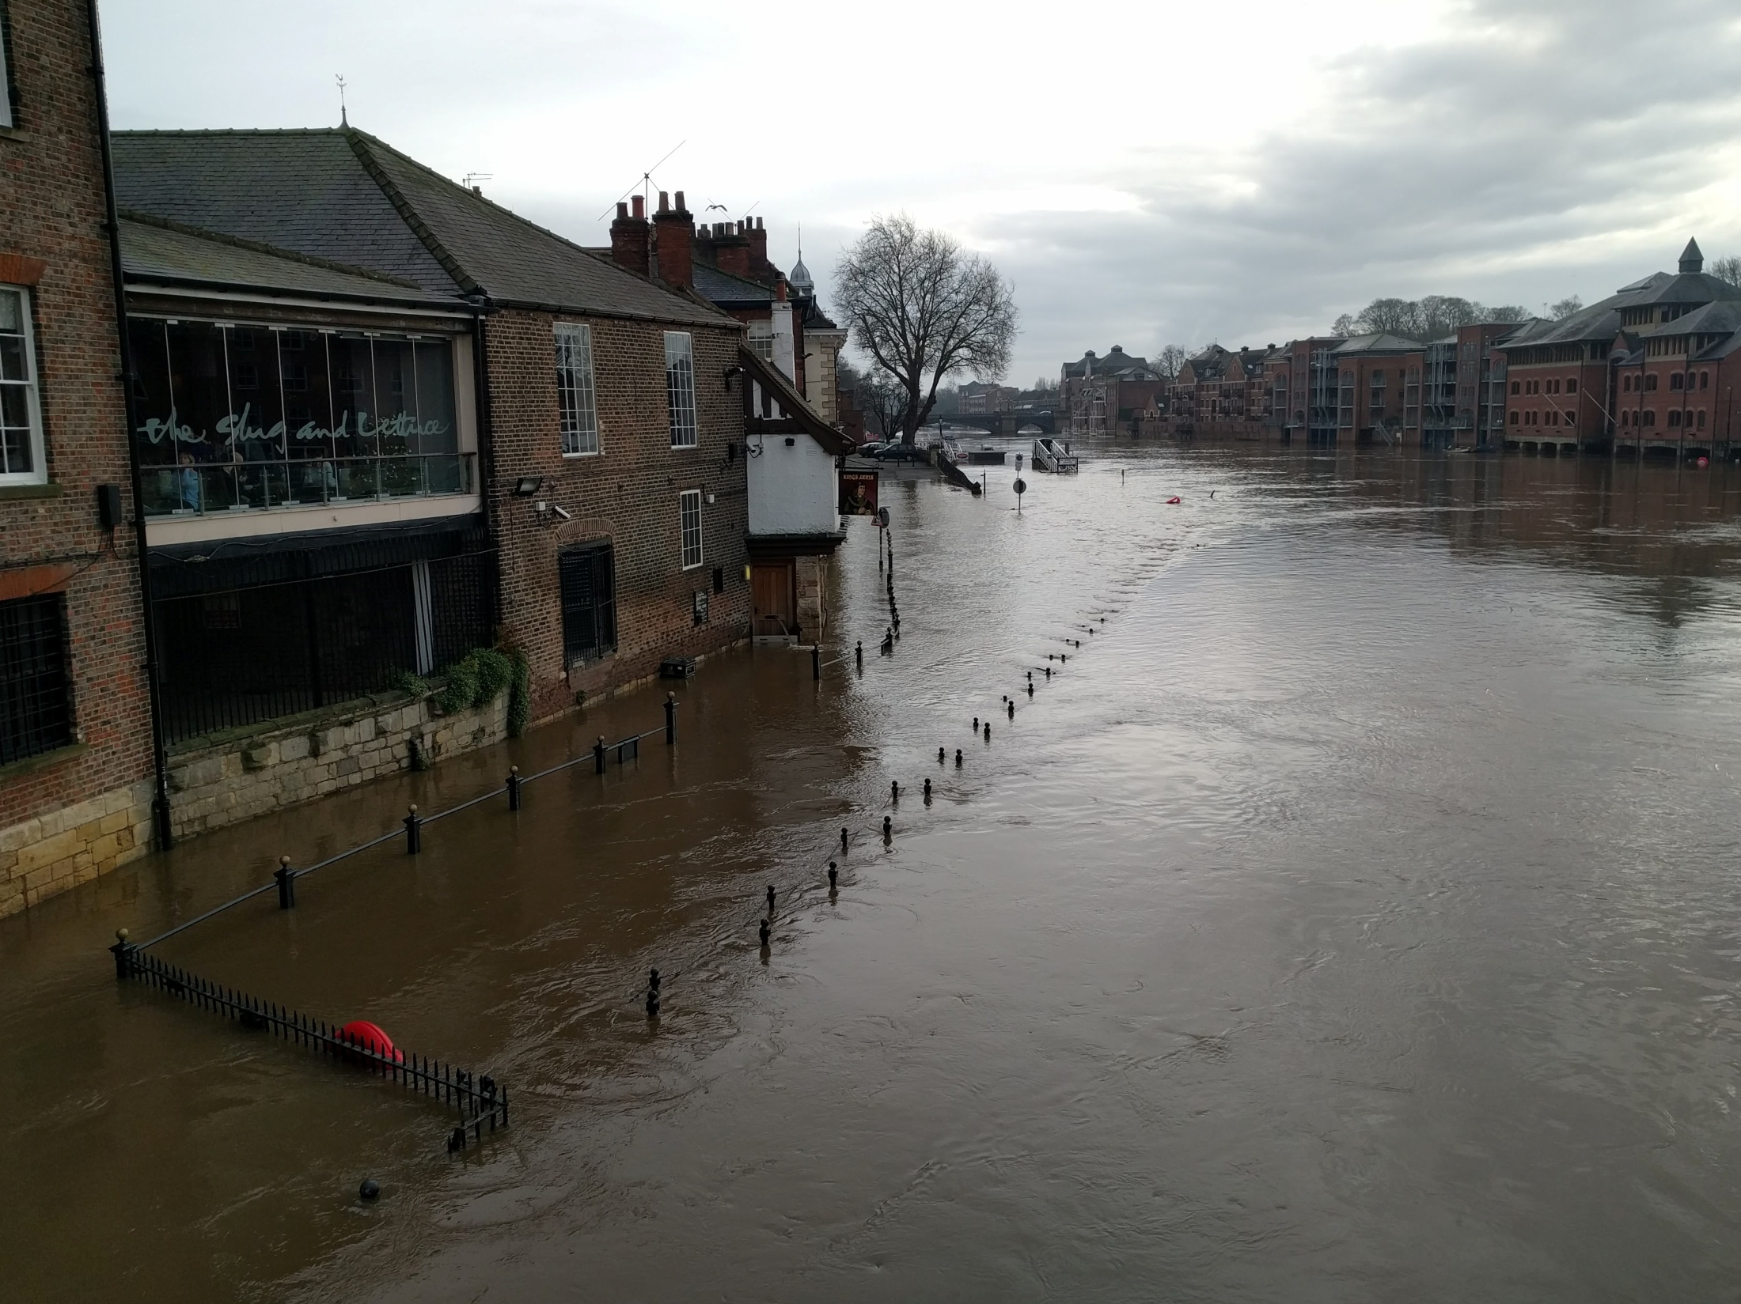
December 2015
Storms cause devastating floods in the UK
3
Engage
Review
Consider
Engage
Review
Consider
Notes:
Remind students about the floods that affected the north in 2015. Talk about whether they think this is an effect of global warming and whether it could happen again.

Slide 4
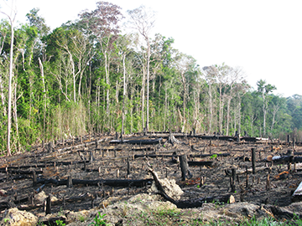
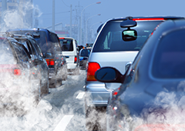
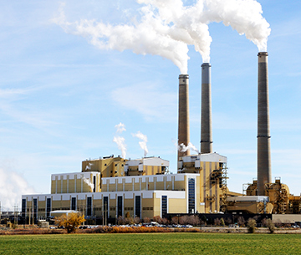
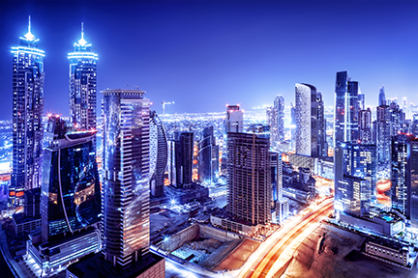

How are we warming the planet?
4
Engage
Review
Consider
Notes:
Ask students to discuss in pairs their previous knowledge of why temperatures are rising.

Slide 5
If we do nothing we will reach the two degrees threshold by...
5
4
3
2ºC
1
0
What will save the world from getting more than two degrees hotter?
Global average surface temperature increase above pre-industrial levels (ºC)
1900 1950 2000 2050 2100
Engage
Review
Consider
Notes:
Ask students to use the data to predict when we will pass the 2 degrees threshold if human behaviour does not change. Clicking will reveal the projection. The dilemma is introduced.

Slide 6


In these lessons you will:
Lesson 1
describe how global warming can impact on climate and local weather patterns
Climate
Lesson 2
Consider the impacts of carbon emission actions on the environment, people and money
Examine consequences
Big Idea
Working Scientifically
Notes:
The objectives for the lesson.

Slide 7

How are you going
to make a decision?
Lesson 1
Lesson 2
Use scientific evidence
Examine consequences
to answer
to answer
How will a rise of more than two degrees affect us?
What we should do
to stop the rise?
What will save the world?
Engage
Review
Consider
Engage
Review
Consider
Notes:
A breakdown of how the students will use scientific evidence in lesson 1 and examine consequences in lesson 2 to help them to make a decision.

Slide 8

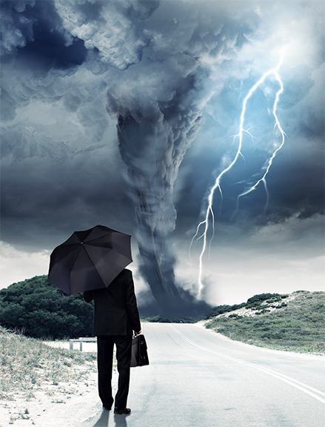
SS1–3
Make a disaster weather report
Look through the effects (SS1)
Use the weather symbols (SS3)
to create the weather report on the map (SS2)
Explain how serious the effects will be
8
Engage
Review
Consider
Notes:
Ask students to work in small groups and give each group copies of SS1-3. They read the information on SS1 about the effects on different regions. They then cut out the weather symbols from SS2 and use them to create a weather report on the map (SS2). You may wish students to look at all areas, just their local one or assign each group a different area. They should also explain how serious the effects will be. Groups can show their reports to each other or the whole class.

Slide 9
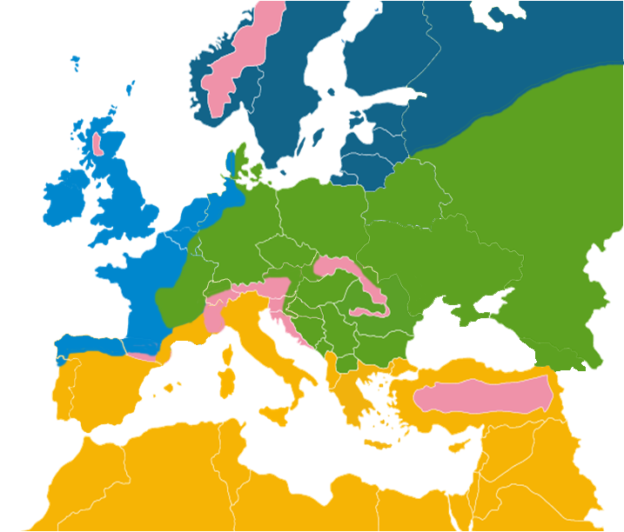
Describe life in 2050
Think of some ways that your life would change if we fail to meet the two degrees target
Describe what it is like to live in the UK in 2050
9
Engage
Review
Consider
Engage
Review
Notes:
Discuss how the changes to weather and climate will affect people and wildlife e.g. farming, food production, loss of housing through flooding and coastal erosion, migrants, increase in tropical diseases, loss of biodiversity (see weblinks for further information). Ask students to describe what it could be like to live in the UK in 2050 if we fail to meet the two degrees target. This could done by describing to a partner, writing down bullet points or a longer activity such as writing a diary entry or acting out a vlog.

Slide 10

Student sheets
Two degrees
Sheet no. | Title | Notes
SS1 | The effects of a more than two degrees rise | Reusable, one per group
SS2 | Map | Consumable, enlarge to A3, one per group
SS3 | Weather symbols | Consumable, one per group, print onto card

Slide 11
SS1
The effects of a more than two degree rise
Mediterranean region
Central and eastern Europe
Decrease in rainfall all year round
Decrease in river flow and risk of drought
More forest fires
Heat waves
Risk of desertification (areas turning to desert which cannot be used for farming)
Less rain in summer
Risk of drought
More river floods in winter
Increased forest fire damage
North-western Europe
Northern Europe
Mountain areas
More rain in the winter
Increased river flow
Higher risk of flooding along rivers
Flooding along the coast due to polar ice caps melting
Melting ice and snow leading to increased river flow
Higher risk of flooding along rivers
More winter storms
Warmer summer temperatures
Warmer temperatures
Melting glaciers and increased river flow
Higher risk of flooding in the valleys

Slide 12
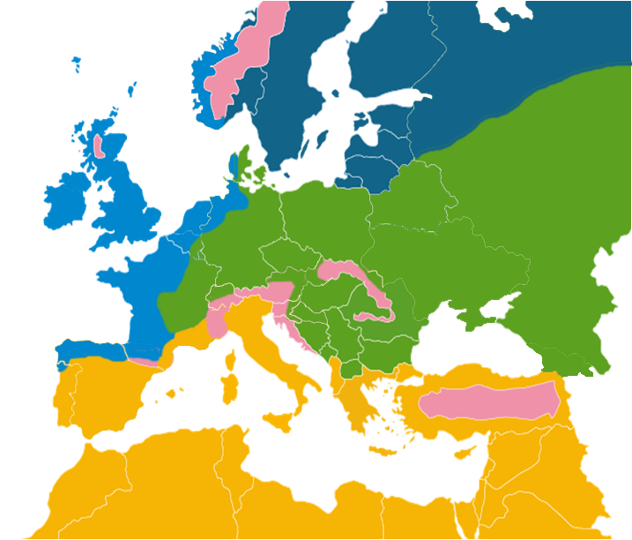
SS2
Sweden
Norway
Finland
Estonia
Latvia
Russia
Denmark
Lithuania
United Kingdom
Ireland
Poland
Belarus
Netherlands
Belgium
Germany
Czech Rep
Slovakia
Ukraine
Austria
Hungary
Moldova
France
Switzerland
Romania
Croatia
Serbia
Italy
Bulgaria
Portugal
Spain
Greece
Turkey
Tunisia
Syria
Lebanon
Morocco
Israel
Jordan
Student sheets

Slide 13

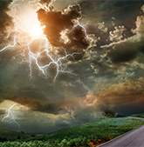

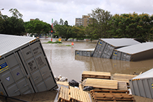
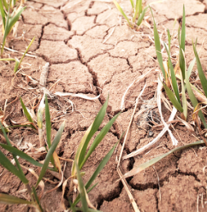

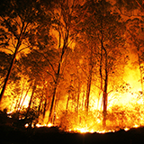
SS3
Weather symbols

Slide 14

Get students talking and thinking

Slide 15














Equipping the Next Generation for Active Engagement in Science
TRACES

