Slide 1

Equipping the Next Generation for Active Engagement in Science
To frack or not to frack? – 2

Slide 2

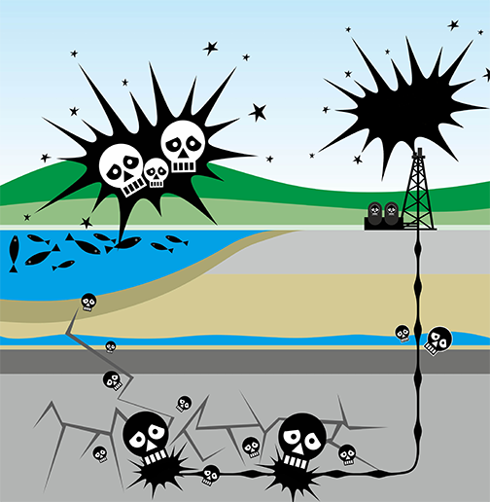

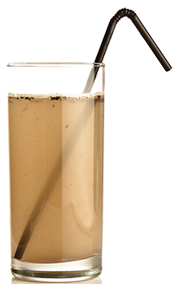

Should England ban fracking?
Engage
Play
Decide
Notes:
Review the dilemma (2). Remind students of the evidence from lesson 1 indicating that it is possible that fracking fluid can get into water in certain circumstances, and that it is possible that substances from fracking fluid can harm humans.

Slide 3

I’m against fracking. It causes earthquakes.
Fracking is fine. They do it near
my aunt in Canada, and she’s never had any problems.
Fracking means cheaper fuel, so more money for us to spend on other stuff. Go for it!
All my friends support a ban, so I do too.
My uncle works in fracking. He earns good money and never gets ill.
Fracking fluid sometimes gets into water and makes people sick. Ban it!
Normal gas supplies
are running out. We need gas from fracking to generate electricity.
Engage
Play
Decide
Notes:
This slide makes the point that different people have different opinions about fracking.

Slide 4

Should we ban fracking?
It’s so complicated.
Even when I know what my opinion is, how will I justify it?
Engage
Play
Decide
Notes:
Show this slide to make the point that, if you have an opinion, it is important to justify it.

Slide 5


In these lessons you will :
Lesson 1
Earth structure
Explain why a rock has a particular property based
on how it was formed
Lesson 2
State your opinion, present your evidence and explain your reasoning
Justify opinions
Big Idea
Working Scientifically
Notes:
These are the objectives for this lesson. Point out that students will use evidence gathered last lesson, as well as new skills in justifying opinions, to state and justify an opinion about fracking.

Slide 6



SS1–2
Learn to justify opinions by playing
JUSTIFY!
Give out the opinion cards
Collect evidence cards
JUSTIFY! your opinion
Engage
Play
Decide
Notes:
Groups of three students now play a game to learn how to justify opinions .
In their groups, students set up the game by giving opinion cards to the players indicated (SS1b) and placing shuffled evidence cards face down in a pile (SS2a – c).
They then follow the instructions on SS1a to play the game.
There are no ‘right answers’ in the game. The purpose of it is for students to learn how to use evidence to justify their opinions.

Slide 7



JUSTIFY
To your opinion you need to:
Give your opinion
Present your evidence
Explain your reasoning
Explain how each piece of evidence supports your opinion.
Explain why each piece of evidence does not support other opinions.
List the facts, data and science ideas that support your opinion.
Identify the most important piece
of evidence.
State what you need to decide.
Give your opinion.
7
7
Engage
Play
Decide
Notes:
This slide summarises learning from the game.

Slide 8


SS3-4
SS3-4
A fracking company wants to drill in your area. There is a public meeting.
Use what you know about justifying opinions to plan and give
a 1-minute talk: should England ban fracking?
  State your opinion
  Present evidence that supports your opinion.
  Explain how the evidence
  supports your opinion
  Explain why the evidence does not support other opinions.
8
Engage
Play
Decide
Notes:
This slide sets up the next task. Ask students to work alone or in pairs.
They read the fracking evidence cards (SS4) and make a decision about whether or not there should be a fracking ban.
Students then plan a one-minute talk to justify their opinion, following the guidance on (8).
Next, students give their talks to another student or pair. Having listened to a talk, they give feedback on how closely students have followed the structure below, and comment on the quality of each of these aspects:
State your opinion
Present your evidence
Explain your reasoning (how the evidence supports your opinion)
Finish the lesson by taking a show of hands to see those who are for and against a fracking ban.
Whose opinions have changed since the start of lesson 1? Who now holds their opinion more strongly?
Ask students to consider how the need to justify their opinion has contributed to these changes.

Slide 9

Student sheets
To frack or not to frack? – 2
Sheet no. | Title | Notes
SS1a | How to play | Reusable, one per group of 3
SS1b | Opinion cards | Reusable, cut into cards, one set per group of 3
SS2a – c | Evidence cards | Reusable, cut into cards, one set per group of 3
SS3 | Should England ban fracking? | Consumable, one per student
SS4 | Fracking evidence cards | Reusable, cut into cards, one set for each student
JUSTIFY
JUSTIFY
JUSTIFY

Slide 10
SS1a
How to play
JUSTIFY!
Round 1 – Collect your evidence
1 Each player picks up two evidence cards.
  If it shows evidence
  for your opinion, keep it
  If it shows evidence against your opinion, or is not relevant, pass it to
  the player on your left.
2 Continue until each player has six evidence cards.
How to play
Set up the game
1 Give each player a number – 1, 2 or 3.
2 Give each player their two opinion cards.
3 Shuffle the evidence cards and place them face down in a pile.
Round 2 – Justify your opinion
1 The youngest player starts. Read out one opinion and give
a reason for it using your strongest evidence card.
2 The player with the opposite opinion reads it out, and gives
their strongest evidence.
3 The two players use all their evidence to try to demolish each others’ arguments.
4 The third player decides who justified their opinion better,
and awards them a point.
5 Repeat for the other opinion cards, with different players going first.

Slide 11



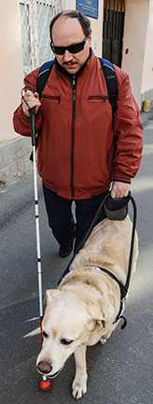


SS1b
Opinion cards
JUSTIFY!
OPINION
Player 1
Computer gaming
should be on the school curriculum.
OPINION
Player 2
Computer games should be banned.
OPINION
Player 3
Everyone should cycle to school.
JUSTIFY!
JUSTIFY!
JUSTIFY!
OPINION
Player 4
Cycling to school should be banned.
OPINION
Player 5
Every household should own a dog.
OPINION
Player 6
It should be illegal to own a dog, unless you need an assistance dog.
JUSTIFY!
JUSTIFY!
JUSTIFY!

Slide 12

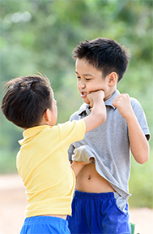
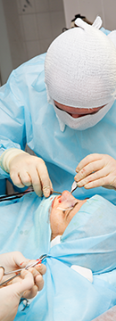
SS2a
Evidence cards
JUSTIFY!
EVIDENCE
Source: Franceschini et al, 2013
Reading test scores of children with dyslexia improved after 12 hours of video game play.
EVIDENCE
Source: Anderson and Dill, 2000 and others
The more time a student spends gaming, the poorer their
performance
in school.
EVIDENCE
Source: Anderson and others, 2010; Green and others, 2012; Colzato and others, 2014
Playing action video games improves peoples’ ability to switch rapidly between different tasks.
JUSTIFY!
JUSTIFY!
JUSTIFY!
EVIDENCE
Source:
Schlickum,
2009
Young surgeons
who were also
keen gamers outperformed experienced
surgeons in the
operating
theatre.
EVIDENCE
Source: Anderson and Bushman, 2001 and others
Children who play violent video games are more likely to think and behave aggressively.
EVIDENCE
Source:
Christakis,
Seattle
Children’s
Research
Institute
Young people who see
violence in video games
get used to violence and
think that it is normal.
JUSTIFY!
JUSTIFY!
JUSTIFY!

Slide 13
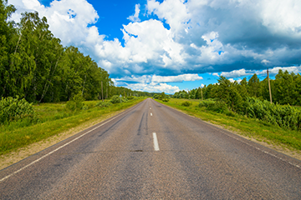



SS2b
More evidence cards
JUSTIFY!
EVIDENCE
Source: Report in the Journal of Clinical and diagnostic research
People scored higher on memory and reasoning tests after 30 minutes of cycling.
EVIDENCE
Source: British Heart Foundation, 2015
Regular cycling can cut your risk of heart disease by 50 percent.
EVIDENCE
Some students live too far away to cycle to school.
JUSTIFY!
JUSTIFY!
JUSTIFY!
EVIDENCE
Source: J Blumenthal, professor of behavioural medicine, Duke University
Cycling for 20 minutes
a day can prevent depression because it boosts the production of feel-good substances such as serotonin.
EVIDENCE
Source: Royal Society for the Prevention of Accidents, 2015
In 2014 in the UK, 6 child cyclists were killed in road accidents, and 273 were seriously injured. In the same year, 107 adult cyclists died on the road.
EVIDENCE
Source: Guardian newspaper, 2014
Cycling can make you hot and sweaty. Most schools do
not have
enough
showers for
everyone.
JUSTIFY!
JUSTIFY!
JUSTIFY!

Slide 14
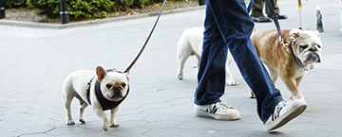
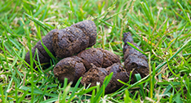
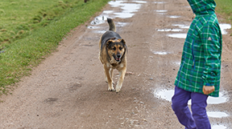
SS2c
More evidence cards
JUSTIFY!
EVIDENCE
Source: American Heart Association, 2013
People who own dogs, and walk them regularly, have a lower risk of heart disease than non-dog owners.
EVIDENCE
Source: Gardom, police inspector, 2016
A barking dog can frighten off burglars, so improving home security.
EVIDENCE
Source: UK National Health Service, 2015
Dog faeces (poo) spread toxocariasis. The disease can cause coughing, fever and stomach ache, and – occasionally – fits and blurred
vision.
JUSTIFY!
JUSTIFY!
JUSTIFY!
EVIDENCE
Source: Handlin et al, University of Skovde, Sweden and others
Blood pressure and heart rate decrease when stroking dogs, benefiting owners’ health.
EVIDENCE
Source: Various newspapers
In 2010, 15 people, including 8 children, were killed in dog attacks in Europe.
EVIDENCE
Source: B and R Vale, Victoria University,
New Zealand, 2009
Feeding and looking after a dog for a year causes the emission of the same amount of greenhouse gases as driving a big
car 30 000 km.
JUSTIFY!
JUSTIFY!
JUSTIFY!

Slide 15
SS3
SS3
Should England ban fracking?
Should England ban fracking?
My opinion is YES / NO
The most important piece of evidence that supports my opinion is...
This piece of evidence supports my opinion because...
Two other pieces of evidence that support my
opinion are...
They support my opinion because...
An opinion that others have is...
The evidence does not support this opinion because...
My opinion is YES / NO
The most important piece of evidence that supports my opinion is...
This piece of evidence supports my opinion because...
Two other pieces of evidence that support my
opinion are...
They support my opinion because...
An opinion that others have is...
The evidence does not support this opinion because...

Slide 16
SS4
Fracking evidence cards
FRACK?
EVIDENCE
Source: B. Argetsinger, Environmental Law Review, 2012 and many others
In badly-run fracking sites, fracking fluid may pollute water supplies.
EVIDENCE
Source: R. Howarth,
Nature, 2011
Most fracking wells use diesel powered pumps to inject
water underground.
Burning diesel leads to dangerous levels of volatile organic compounds (which can cause cancer) and particulates (which can cause heart and lung disease).
EVIDENCE
Source: US Energy Information Administration, 2011
Scientists assessed fracking sites in 32 countries and concluded that ‘a vast amount’ of natural gas could be obtained by fracking, especially in the EU, China, and the USA.
Since other fossil fuels are running out, fracking could be vital in the future.
EVIDENCE
Source: E. J. House, Wyoming Law Review, 2013
Fracking creates new jobs.
For example, in Texas,
100 000 people were employed in fracking in 2011.
These people might otherwise be jobless.
FRACK?
FRACK?
FRACK?
FRACK?
EVIDENCE
Source: D. Rahm, Energy Policy, 2011
Inspections in Quebec and Texas showed that half of fracking sites leak methane gas.
In 2009 a pipeline connected to a fracking site exploded. The flame was 60 m high.
EVIDENCE
Source: W. Ellsworth et al, Siesmological Research Letters, 2012 and others
Since 2008, fracking has caused a sevenfold increase in the number of earth tremors in central USA.
EVIDENCE
Source: J. Deutch, Massachusetts Institute of Technology, 2012
In the USA, natural gas from fracking is about half the price of natural gas from normal gas wells.
This means that people will spend less on fuel and have more money to spend on other things.
EVIDENCE
Source: A. Burnham, Argonne National Laboratory, 2012 and others
There are environmental and health benefits of burning natural gas from fracking instead of coal to generate electricity in power stations.
Burning gas results in lower emissions of sulfur dioxide (which can cause asthma attacks) and greenhouse gases.
FRACK?
FRACK?
FRACK?
FRACK?

Slide 17

Get students talking and thinking

Slide 18














Equipping the Next Generation for Active Engagement in Science
TRACES

