Slide 1

Equipping the Next Generation for Active Engagement in Science
Eat insects

Slide 2

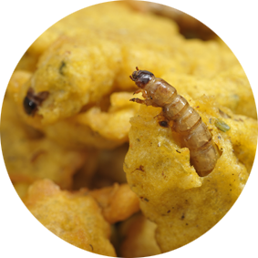
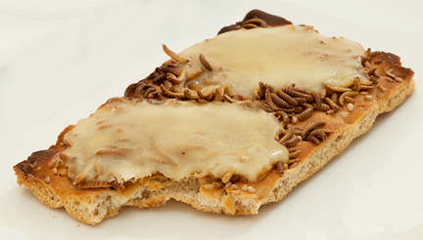

At Brussels University canteen...
Buffalo worm and cheese on toast
Mealworm nuggets
...they serve insects!
2
Notes:
Ask students for their initial thoughts on this.

Slide 3
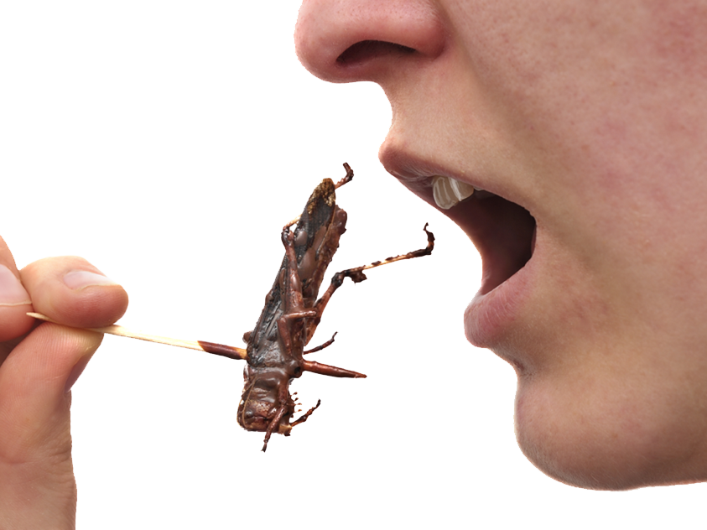

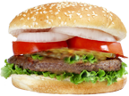

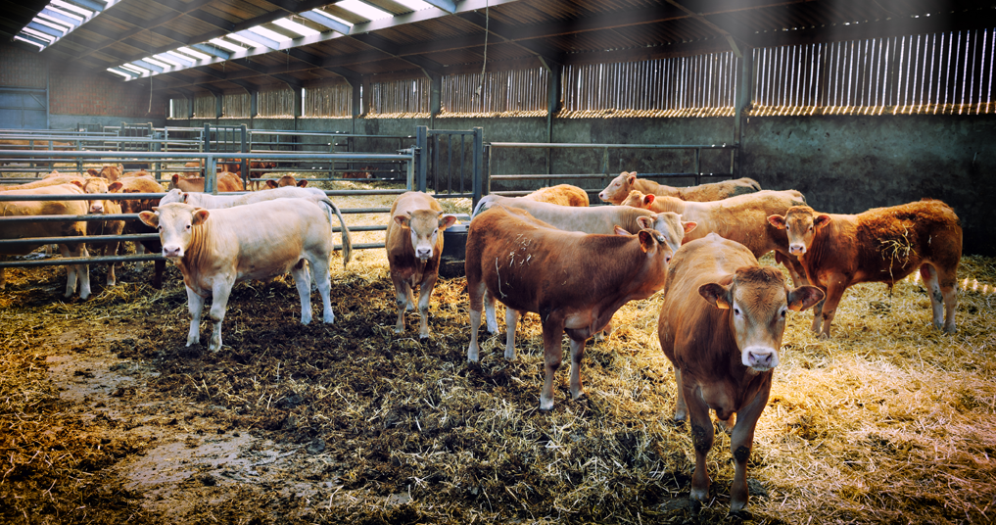
Farming large animals uses up natural resources and creates waste
Can we persuade people to swap meat for insects?
We need
to produce more food
The human population is growing
3
Notes:
Some information about the problems of farming large animals.

Slide 4


In this dilemma, you will
analyse a science issue using
Earth: how Earth’s resources are limited and need to be conserved
Communicate ideas: express your opinion using evidence and persuasion
Big Idea
Working Scientifically

Slide 5
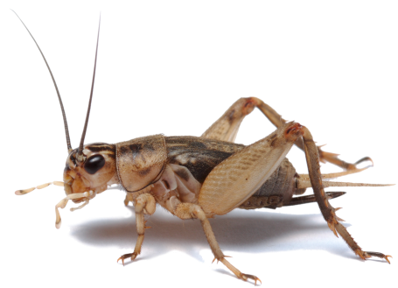



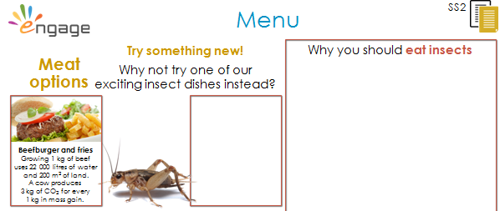
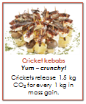
Your school canteen
is running ‘insects week’.
SS1-4
Design a menu with a difference
Read the arguments about meat vs. insects.
Use data to choose insect dishes.
Write a paragraph
to persuade people.
5
Notes:
Ask students to read through the information on SS1. Ask a few students who they think would win for the best food resource between meat and insects with one reason why.
Students work alone to design a menu for a Christmas dinner during 'insects week'.
Each student will need a copy of the menu (SS2), the insect dishes (SS3) and checklist for persuasive writing (SS4). Students choose two insect dishes and a dessert for the menu. They cut out their chosen dishes and stick them on the menu. When questioned they should be able to justify their choices.
Students then use the information they have gathered to write in the 'why eat insects?' box using persuasive language. They can use the checklist on SS4 to help them with this.
Ask students to peer assess each other's persuasive argument by using the checklists on SS4. They should also comment on the science content.

Slide 6

Student sheets
Eat insects
Sheet no. | Title | Notes
SS1 | Meat vs. insects | Reusable, one per student
SS2 | Menu | Consumable, one per student
SS3 | Insect dishes | Consumable, one per student
SS4 | Persuasive writing checklist | Consumable, cut into four and use one per student

Slide 7
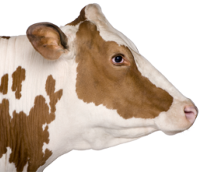
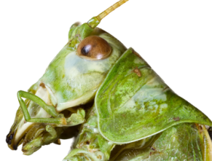
Meat insects
SS1
Vs
Earth is rapidly running out of resources
Which uses fewer resources?
Meat consumption could double within 50 years.
Round 1: Land
We use 70% of our farmland for animals. The only way to increase space is deforestation (cutting down trees).
To get 1 kg of beef a cow needs 10 kg of food. They eat plants which require more land.
The food that cows eat could feed humans instead
18% of greenhouse gas emissions come from farming animals.
These gases, such as carbon dioxide and
methane, are responsible for climate change.
Farming uses around 70% of worldwide water supplies.
A cow drinks a lot of water and you also need to water the plants they eat.
Animals produce ammonia in their waste, a pollutant that can enter water supplies.
Insects reproduce quickly. They take up little space.
With 10 kg of feed you get 9 kg of cricket meat.
Insects can eat waste which we can’t use.
Processing insects makes less rubbish. You can eat 80% of a cricket,100% of a worm but only 55% of a cow.
The farming of insects produces less carbon dioxide.
Most species produce no methane at all.
Insects need very little water. They get most of what they need from their food.
They don’t produce much ammonia.
Round 2: Air
Round 3: Water
Notes:
Ask students to read through the information. Ask the class to use a show of hands to vote on which uses less of Earth's resources: insects or large farm animals. Select a few students to explain why they think this.

Slide 8
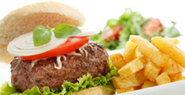

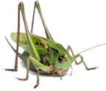
Menu
SS2
Why you should eat insects
Meat options
OR why not choose an insect dish instead ?
Beefburger and fries
Growing 1 kg of beef uses 22 000 litres of water and 200 m² of land.
A cow produces
3 kg of CO₂ for every
1 kg in mass gain.
Chicken salad
Growing 1 kg of chicken meat uses 2 300 litres of water and 50m² of land.
Notes:
Students read the information about the meat dishes which contains data on resources and pollution caused by each farm animal.
They cut out their chosen insect dishes from SS3 and stick them on the menu. When questioned they should be able to justify their choices.
They use the information they have gathered to write in the 'why you should eat insects' box using persuasive language. They can use the checklist on SS4 to help them with this.

Slide 9
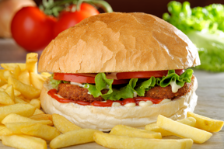

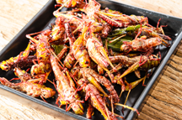
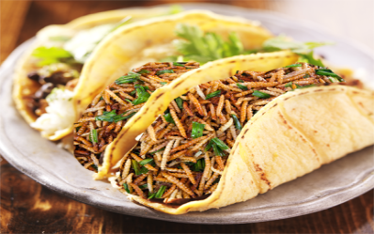
SS3
SS3
Insect dishes
Insect dishes
Buffalo worm burger
High in protein, and taste!
Growing 1 kg of worms requires 25m² land.
Cricket kebabs
Yum – crunchy!
Crickets release 1.5 kg CO₂ for every 1 kg in mass gain.
Buffalo worm burger
High in protein, and taste!
Growing 1 kg of worms requires 25m² land.
Cricket kebabs
Yum – crunchy!
Crickets release 1.5 kg CO₂ for every 1 kg in mass gain.
Stir fried locusts
Hot and spicy
Locusts release 0.7 kg CO₂ for every 1 kg in mass gain.
Mealworm tacos
Insects with
a Mexican twist
Mealworms release
1 kg CO₂ for every 1 kg in mass gain.
Stir fried locusts
Hot and spicy
Locusts release 0.7 kg CO₂ for every 1 kg in mass gain.
Mealworm tacos
Insects with
a Mexican twist
Mealworms release
1 kg CO₂ for every 1 kg in mass gain.
Notes:
Insect dishes to cut out and stick onto the menu on SS2.

Slide 10
Persuasive writing checklist
SS4
Did you
Did you
Get the reader’s attention?
Create an emotion like fear or hope?
Try to solve a problem for the reader?
Use hard evidence – facts or numbers?
Use ‘you’ and ‘we’ to make it personal?
Include real-life examples?
Get the reader’s attention?
Create an emotion like fear or hope?
Try to solve a problem for the reader?
Use hard evidence – facts or numbers?
Use ‘you’ and ‘we’ to make it personal?
Include real-life examples?
Did you
Did you
Get the reader’s attention?
Create an emotion like fear or hope?
Try to solve a problem for the reader?
Use hard evidence – facts or numbers?
Use ‘you’ and ‘we’ to make it personal?
Include real-life examples?
Get the reader’s attention?
Create an emotion like fear or hope?
Try to solve a problem for the reader?
Use hard evidence – facts or numbers?
Use ‘you’ and ‘we’ to make it personal?
Include real-life examples?
Notes:
Checklist to help students write the 'why you should eat insects' box using persuasive language. Also used for the peer assessment plenary task.

Slide 11

Get students talking and thinking

Slide 12














Equipping the Next Generation for Active Engagement in Science
TRACES

