Slide 1

Equipping the Next Generation for Active Engagement in Science
Death to diesel?

Slide 2

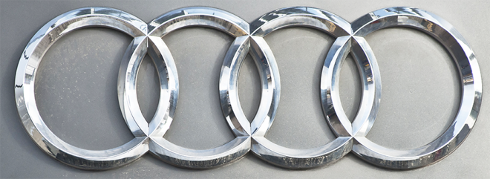


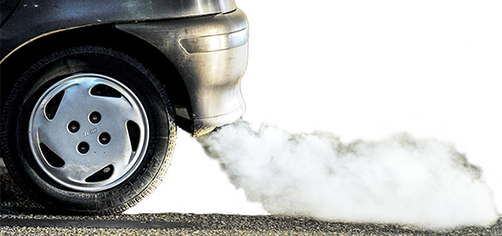
Drivers duped as VW, Audi, Seat
and Skoda cheat exhaust fume tests
Millions of diesel cars with sneaky software emit up
to 40 times more pollution than
legal limits allow.
2
Engage
Review
Consider
Decide
Notes:
The cars have software that detects when the engine is being tested and changes the car’s performance to improve results

Slide 3
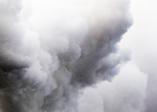

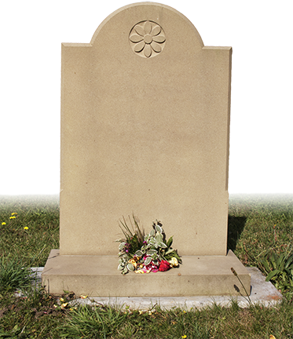
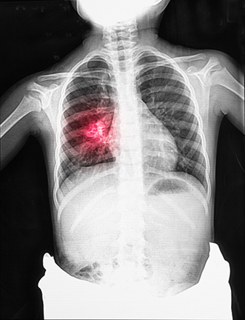
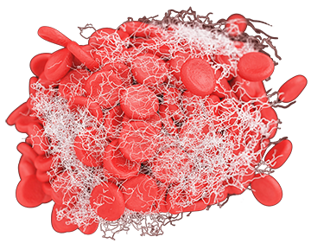
Pollution from burning diesel kills 1.3 million every year
Tiny pieces of solid in diesel exhaust cause blood clots, leading to heart attacks
and strokes.
In some European cities, air pollution knocks two years off life expectancy.
Pollutant gases damage
lung cells, causing deadly breathing difficulties, especially in under-18s.
Your life is at risk
3
Engage
Review
Consider
Decide
Notes:
Outline the health impacts of exhaust emissions from diesel cars.
Sources:
Deaths from air pollution http://www.who.int/ceh/risks/cehair/en/
Life expectancy: Aphekom, reported here http://www.theguardian.com/environment/2011/mar/08/air-pollution-life-expectancy-dupont
Heart attacks – Edinburgh university research reported by the BBC

Slide 4

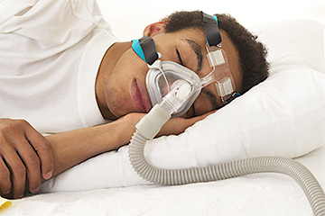
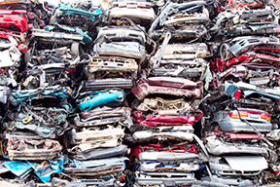

THE DAILY POST
Mum: “This is what diesel did to my son. Scrap your diesel car and buy a petrol
one instead.”
Can you persuade car buyers to boycott diesel cars?
diesel
Engage
Review
Consider
Decide
Notes:
Introduce the task for the lesson – to persuade car buyers not to buy diesel cars.

Slide 5


In this lesson you will :
Predict the products of the combustion of a given reactant and show the reaction as a word equation
Use the four Cs of effective communication: making it clear, concrete, correct and coherent
Reactions
Communicate ideas
Big Idea
Working Scientifically

Slide 6
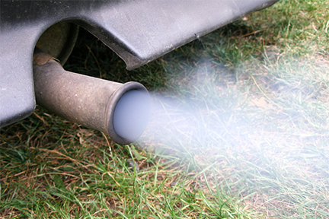


SS1
What comes out of an exhaust pipe?
Study the information on the next three slides.
Predict the products, and complete the equations, for the chemical reactions that happen in a diesel engine.
6
Engage
Review
Consider
Decide
Notes:
Ask student pairs to suggest answers to the question in the blue box. Draw attention to the tasks beneath.

Slide 7
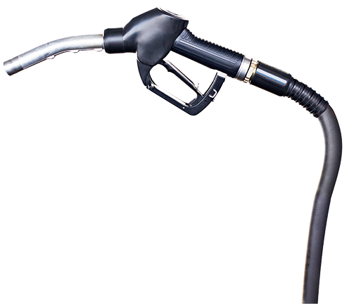
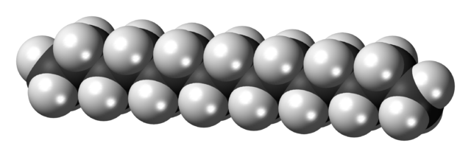
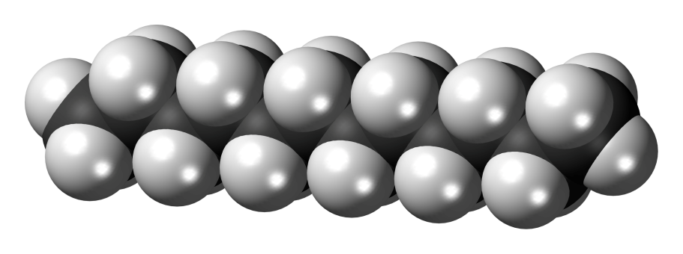
SS1
Diesel is a mixture of compounds
The compounds are made up of atoms of carbon and hydrogen only. They are hydrocarbons.
hydrogen atom
pentadecane
C₁₅H₃₂
carbon atom
dodecane
C₁₂H₂₆
Engage
Review
Consider
Decide
Notes:
Use this slide to explain what diesel is.

Slide 8
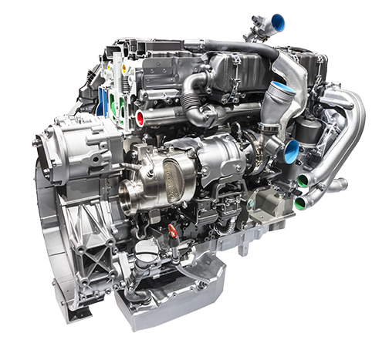
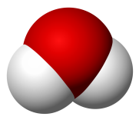




In a diesel engine, hydrocarbons burn in air. Their reactions with oxygen make two main products – carbon dioxide and water.
One hydrocarbon in diesel is dodecane
water, H₂O
dodecane + oxygen → carbon dioxide + water
oxygen, O₂
carbon dioxide, CO₂
Engage
Review
Consider
Decide
Notes:
Identify the main products when diesel burns in air in a car engine.

Slide 9



The temperature in a diesel engine reaches 550 °C.
At this temperature, nitrogen and oxygen from the air react together.
oxygen, O₂
nitrogen, N₂
There are two products – nitrogen monoxide (NO) and nitrogen dioxide (NO₂)
These gases cause disease
and death.
nitrogen monoxide, NO
nitrogen
dioxide, NO₂
Engage
Review
Consider
Decide
Notes:
Point out that oxides of nitrogen (No_{x}) form at the high temperature of a diesel engine.
Students now complete the word equations on SS1 to reinforce their previously-learnt skill of writing word equations to represent chemical reactions.
Answers:
decane + oxygen → carbon dioxide + water
pentadecane + oxygen → carbon dioxide + water
tridecane + oxygen → carbon dioxide + water
hexadecane + oxygen → carbon dioxide + water
nonadecane + oxygen → carbon dioxide + water
nitrogen + oxygen → nitrogen monoxide
nitrogen + oxygen → nitrogen dioxide

Slide 10
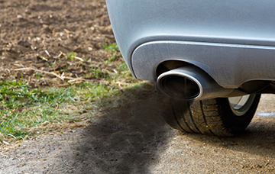


SS2-4
Can you persuade car buyers to
boycott diesel cars?
diesel
Make a 2 minute vlog for a social media campaign to persuade
drivers not to buy diesel cars
Use the four Cs of effective communication:
make it clear, concrete, correct and coherent
Use the backgrounds and characters supplied.
Include equations, science words and examples.
10
10
Engage
Review
Consider
Decide
Notes:
Student groups then tackle this task, using the further guidance on SS2 and SS3.
They can use the backgrounds on SS3 and characters from SS4 in their vlogs.
They will need to select and cut out characters, stick them on card and then stick the cards onto lollipop sticks in order to use them to ‘act’ in their vlogs.

Slide 11

SS2
Watch another group’s vlog,
and assess it using the checklist
for effective communication.
Then decide: will the vlog persuade car buyers to boycott diesel?
11
11
11
Engage
Review
Consider
Decide
Notes:
Each student group looks at a vlog made by another group and assesses it using the checklist for effective communication on SS2.
They then make – and justify – decision: will the vlog persuade car buyers to boycott diesel?

Slide 12

Student sheets
Death to diesel?
Sheet no. | Title | Notes
SS1 | Predicting products and writing equations | Consumable, one per student
SS2 | Planning your vlog | Consumable, one per group
SS3 | Information for your vlog | Reusable, one per group
SS4a | Vlog backgrounds | Reusable, one per group
SS4b | Vlog characters | Consumable, one per group. Students cut out the characters and stick on card and lollipop sticks to ‘act’ in their vlogs

Slide 13
SS1
Predicting products and writing equations
The combustion reactions below happen in a diesel engine. Complete the word equations.
The ending –ane in the name of a substance shows that it is
a hydrocarbon, made up of atoms of hydrogen and carbon only.
decane + oxygen → + water
pentadecane + oxygen → carbon dioxide +
tridecane + → carbon dioxide + water
hexadecane + → carbon dioxide +
nonadecane + oxygen → +
In a diesel engine, nitrogen and oxygen from the air react together.
There are two reactions. The product of one of the reactions is nitrogen monoxide.
The product of the other reaction is nitrogen dioxide. Nitrogen monoxide
and nitrogen dioxide cause death and disease.
Write word equations for the two reactions of nitrogen with oxygen.

Slide 14
Planning your vlog
SS2
Use the boxes to draw and describe what happens in each scene.
Checklist for effective communication
1
2
Have you made it clear?
Does the style fit your
purpose and audience?
Is the script easy to understand?
Have you made it concrete?
Does it include examples?
Have you used vivid words?
3
4
Have you made it correct?
Have you included
word equations?
Have you used and explained the science words?
5
6
Have you made it coherent?
Does each scene make
one main point?
Are the scenes in a logical order?
Are the scenes linked together?

Slide 15



SS3
Information for your vlog
NO_{x} emissions
Legal limit in Europe = 0.08 g/km
Make of car | Average mass of NO_{x} emitted when driving (g/km)
Audi | 0.36
BMW | 0.45
Mazda | 0.49
Mercedes | 0.42
VW | 0.41
The combustion of diesel
Diesel is a mixture of compounds, called hydrocarbons.
Hydrocarbons burn
to make two main
products – carbon
dioxide and water.
The word equation for the combustion of one of the compounds in diesel, nonane, is:
nonane + oxygen → carbon dioxide + water
Carbon dioxide is a greenhouse gas.
The water forms as a vapour.
Oxides of nitrogen
At the high temperature of a diesel engine,
nitrogen and oxygen from the air react together.
The reactions produce two substances:
nitrogen monoxide (NO) and nitrogen dioxide (NO₂ ). Together, the oxides of nitrogen are called NO_{x}.
Air pollution and life expectancy
Scientists have estimated that pollution reduces life expectancy by 2 years in Bucharest and
6 months in Paris.
Particulates in different cities
Oxides of nitrogen and health
In the air, oxides of nitrogen take part in chemical reactions with ammonia and water. The products include tiny pieces of solid substances, called particulates. Particulates penetrate deeply into
the lungs and cause respiratory diseases such as emphysema and bronchitis. They also cause blood clots, heart attacks and strokes.
Oxides of nitrogen also take part in reactions which form ozone. Ozone makes asthma worse and leads to early death.
City | Particulates (microgram/m³)
Athens | 29
Barcelona | 27
Bucharest | 38
London | 13
Paris | 16

Slide 16
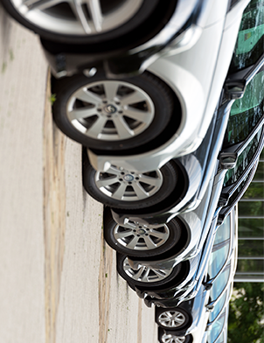
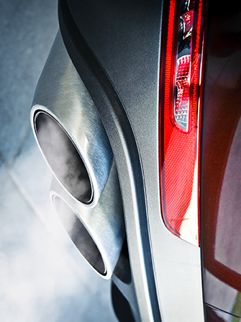
SS4a
Vlog backgrounds
Choose from these backgrounds

Slide 17








SS4b
Vlog characters
Choose your characters
Cut them out
Stick them on a lollipop stick
Use them in your video

Slide 18

Get students talking and thinking

Slide 19














Equipping the Next Generation for Active Engagement in Science
TRACES

