Slide 1

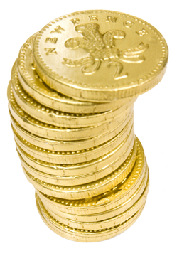
Equipping the Next Generation for Active Engagement in Science
Chocolate money

Slide 2

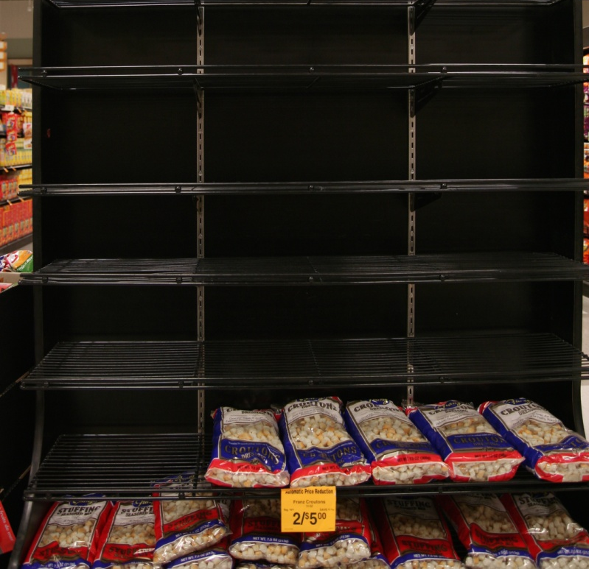
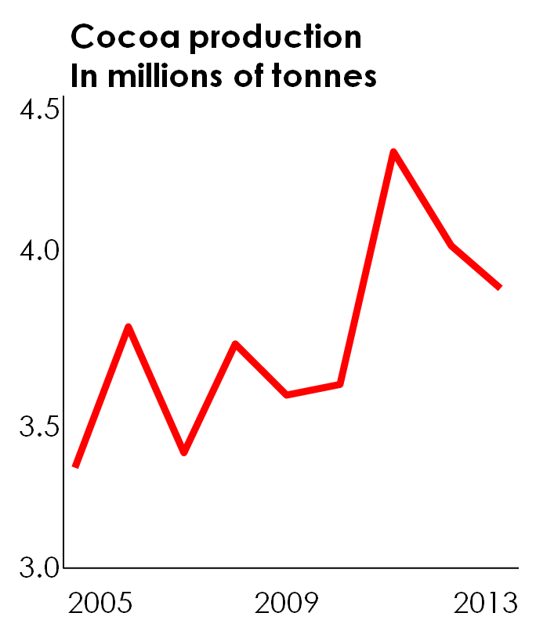
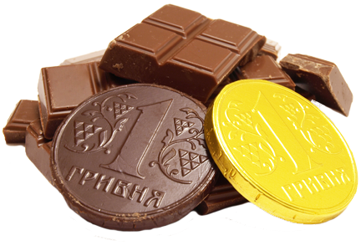
Is this the end for chocolate?
Europeans eat half the world’s chocolate.
But the world is growing less cocoa. People eat more chocolate than can be produced.
Soon chocolate could run out!
2
Starter
Main
Plenary
Notes:
The news story. Ask students for their initial thoughts on this.

Slide 3
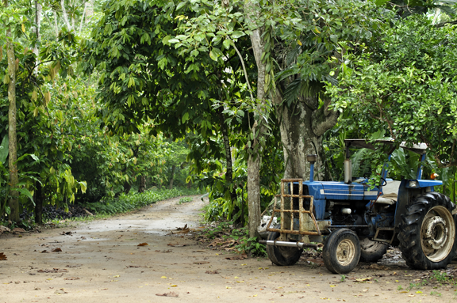
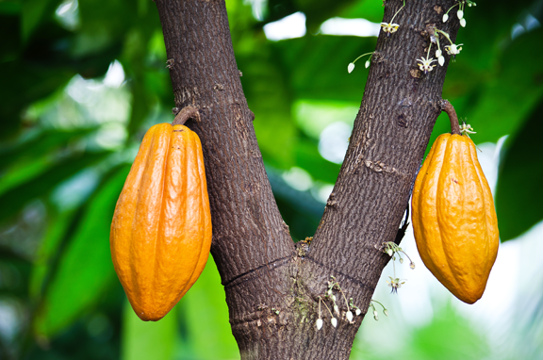
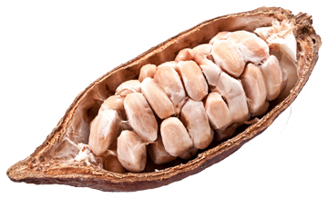
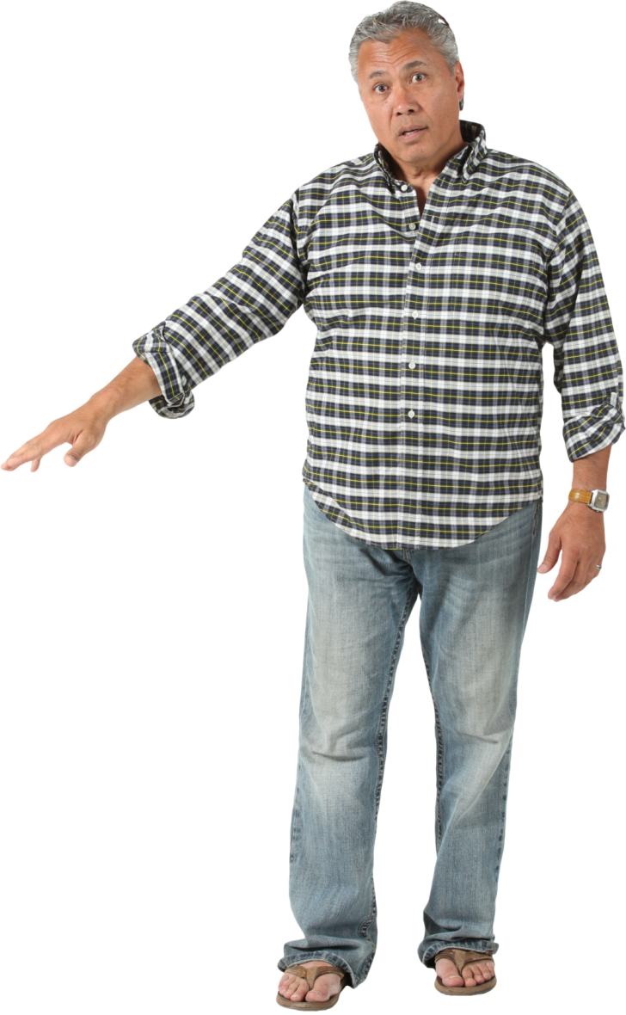
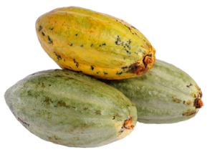
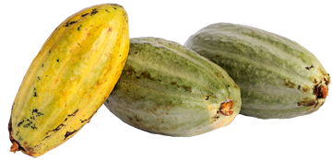
You work for a small chocolate company.
cocoa tree
cocoa seeds
cocoa pod (fruit)
‘We’re in trouble.
Our trees aren’t producing enough cocoa pods.
Why are yields decreasing and how can we solve this problem?
3
Starter
Main
Plenary
Notes:
Highlight the seriousness of the situation for them - if cocoa yields keep decreasing then they will not be able to produce chocolate, profits will suffer and they could lose their jobs.

Slide 4


In this activity, you will
Consider solutions to the issue of decreasing cocoa yields using:
Ecosystem: why insect pollination is important in producing our food
Science in society: understand who funds scientific research
Big Idea
Working Scientifically

Slide 5

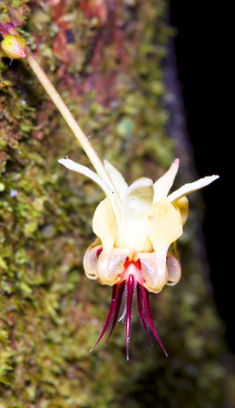
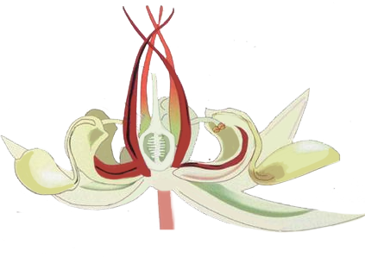
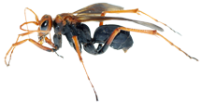
What questions could we ask to find out why there is a lack of pods?
On your plantations, on average
only 3 out of 1,000 flowers form pods.
Cocoa flower
staminodes produce scent that attracts the flies
style
stamen
outer part of petal
sepal
flower stalk
ovary
Tiny flies that live in the rainforest are the only insects small enough to enter the flower.
They land on the staminodes, crawl down
to the stamens and eat pollen.
Starter
Main
Plenary
Notes:
Ask students to work in pairs. They use the information about cocoa flowers and their knowledge of pollination to come up with questions they could ask to find out the possible reasons for the lack of pods.
Examples could be: Is there enough flies? (This could be an issue because the plantation is too far away from the rainforest). Are flies not attracted to the scent? Is pollen not sticking to flies? Are the stamens producing enough pollen? Is fertilisation occurring?
Listen to questions from the pairs and discuss if they could find out the answers. Remind them that a small company would have to employ specialist scientists to carry out the research.

Slide 6

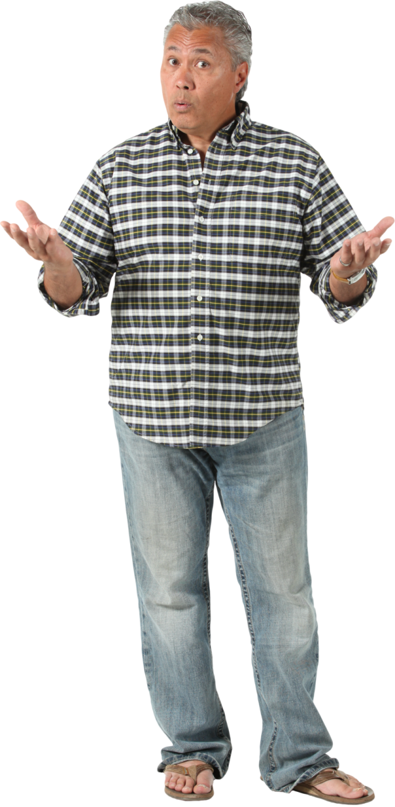

‘Let’s research answers to your questions.
We will need scientists from different fields...
SS1-2
...and lots of money’
Role-play a funding meeting
Work in a team of six.
Three people are fundraisers and three are funders.
Funders: Decide whether to fund | Fundraisers: Try to raise funds
Write three questions to ask the fundraiser | Prepare answers to possible questions
Meet in pairs: one funder and one fundraiser.
Decide how much money to give, with reasons | Add up the funding – can the research go ahead?
Starter
Main
Plenary
Notes:
To each group of six, assign three students to be fundraisers and give them SS1 to plan for the meeting. The other three are funders; assign one to each group. They use SS2.
Plenary: Ask students to write down two sentences stating why scientific research is so expensive. Discuss these as a class and talk about why scientific research is never carried out by just one person.

Slide 7

Student sheets
Chocolate money
Sheet no. | Title | Notes
SS1 | Fundraiser meeting preparation | Consumable, one per fundraiser (half the class)
SS2 | Funder meeting preparation | Consumable, one per funder (half the class)

Slide 8
SS1
Fundraiser meeting preparation
You work for the chocolate company.
You need funders to give you £2 million for research. The funders will ask you questions. The amount of money they give you will depend on the quality of your answers.
Funder priority:
Charity: Helping local people in need
Government research council: making the country richer and healthier.
Big company: making a profit
Background information
This research project aims to increase pollination of cocoa flowers. We will employ scientists in the following research areas:
Ecologists to study where the pollinating flies live and what affects their population
Chemists to analyse the chemicals in the cocoa flower scent
Entomologists (insect biologists)to study the lifecycle of the flies and how to breed them.
We think this research will increase cocoa yields because...
How it will help the charity
How it will help the government
How it will help the big company
Funds raised:
Charity £ Government £
Big
company £ Total £
Research can go ahead Yes No
Notes:
Allow 10 minutes for students to complete their preparation and fill in the top box on their student sheet.
During the meeting the fundraiser should use their notes to answer the funder’s questions.
Groups then get back together. Fundraisers add up how much their raised to find out if the research can go ahead.

Slide 9
SS2
Funder meeting preparation
A chocolate company wants you to give them money to carry out research. You will only give them money if it will help you.
Funder priorities
Charity: Your donors want to know their money is doing good. You need to see how the project will help local people.
Government research council: You need to justify your spending to voters. You need to see how the project will make the country richer or healthier.
Big company: You need to justify spending to your shareholders. You need to see how the project will make money.
Background information
The research project aims to increase pollination of cocoa flowers. They will employ scientists in the following research areas:
Ecologists to study where the pollinating flies live and what affects their population
Chemists to analyse the chemicals in the cocoa flower scent
Entomologists (insect biologists)to study the lifecycle of the flies and how to breed them.
I work for...
Questions about the science behind the research
Question about how it will help us
Amount of money given:
£1 million £0.5 million £0
Reason:
Notes:
Allow 10 minutes for students to complete their preparation and fill in the top box on their student sheet.
During the meeting the funder should ask their questions and fill in the bottom box on their student sheet.
Groups get back together and the funders reveal how much money each will give with their reasons.

Slide 10

Get students talking and thinking

Slide 11














Equipping the Next Generation for Active Engagement in Science
TRACES

