Slide 1

Equipping the Next Generation for Active Engagement in Science
Car Wars

Slide 2


Objectives
To use what you know about atmospheric carbon dioxide
in a new context.
To evaluate solutions to the problem of increasing carbon dioxide emissions from cars.

Slide 3
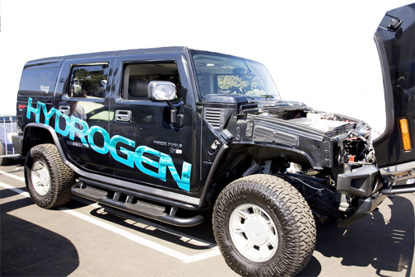
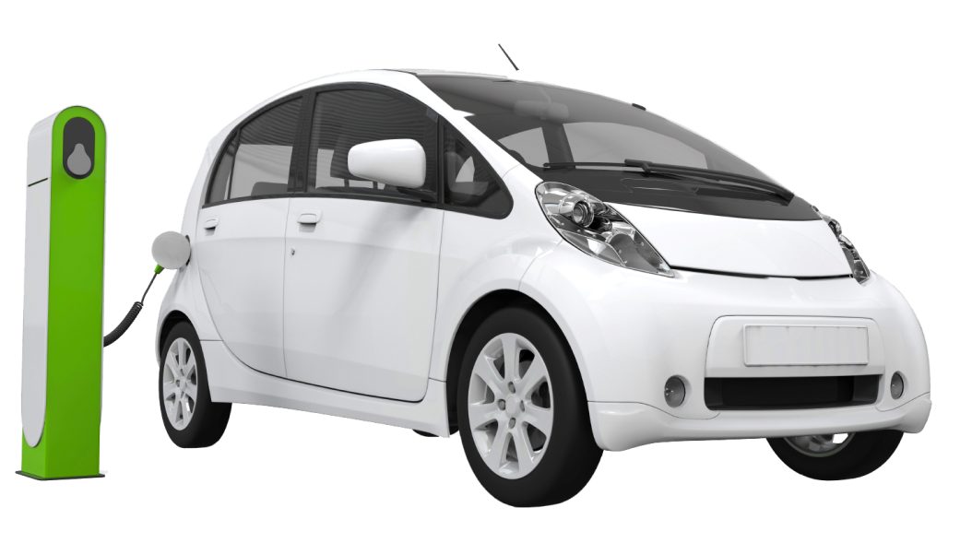

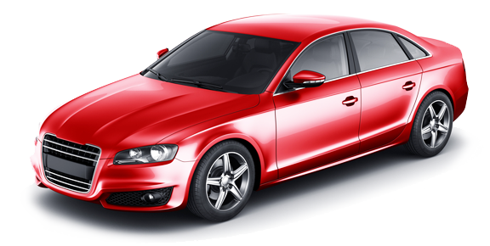
It’s 2020.
Which car will you buy?
hydrogen fuel cell
electric
biodiesel
diesel/petrol
How will you choose?
STARTER

Slide 4


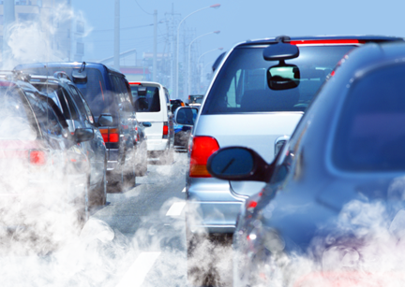

June 2014
A new United Nations report tells the world to cut CO₂ emissions
and move to renewable alternatives.
CO₂ from cars
24%
All other CO₂
Click for answer
What percentage of CO₂ emissions comes from cars?
STARTER

Slide 5



Which is the best alternative energy source for cars?
Biodiesel
Hydrogen fuel cells
Electricity
CORE TASK
5

Slide 6



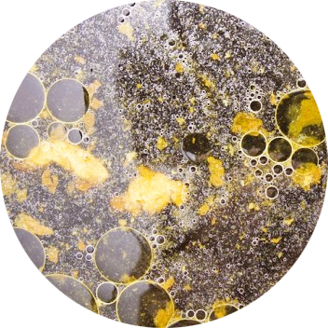
How it works
biodiesel
Made from
oil seed crops,
like sunflowers
and rape
or
waste materials, like used
cooking oil.
In car engines, biodiesel burns like normal diesel.
CORE TASK
6

Slide 7

How it works
Hydrogen fuel cell
Made from
methane (from natural gas or waste)
Water out
or
water
Hydrogenin
Oxygen in
In a car, hydrogen enters the fuel cell.
It reacts with oxygen to generate electricity. Electricity powers a motor to make the wheels turn.
Energy out
CORE TASK
7
Notes:
In the hydrogen fuel cell, hydrogen molecules flow in, and a catalyst breaks them down into hydrogen ions (protons) and electrons. The hydrogen ions move through a membrane to the other side of the cell, where they join with oxygen to make water. The electrons flow through an external circuit, providing electricity to make the motor turn.

Slide 8
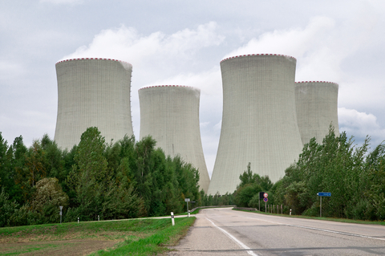
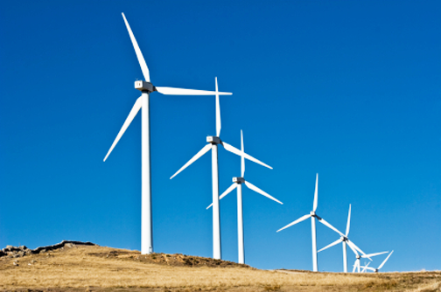
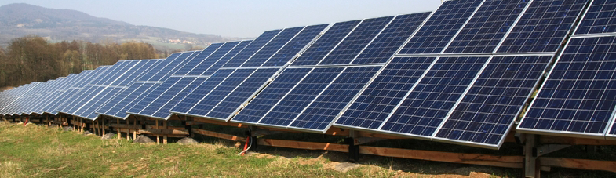
How it works
electricity
Generated by
burning coal or gas
or
wind turbines or solar panels.
In a car, mains electricity charges big batteries when the car is not in use. Electricity from the batteries powers a motor to make the wheels turn.
CORE TASK
8

Slide 9


SS1
Play the game to identify some pros and cons of each energy source.
Do you have enough evidence to make a decision about the best solution to the problem of increasing carbon dioxide emissions from cars?
CORE TASK AND PLENARY 1
9

Slide 10



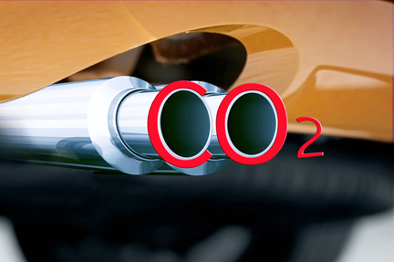
SS2
What are the criteria for choosing the best energy source for cars?
Which is your winning energy source? Why?
EXTENSION
10
Notes:
Amend none
Linda – around the top question, picture to illustrate carbon dioxide coming out of exhaust pipe – like this above, but better (34295572 )
Flammable symbol (it must be exactly the same as this one here), with the red border and then in black and white (shutter stock 90317200)
Gas under pressure symbol (it must be exactly the same as this one here), with red border and then in in black and white
Electricity safety symbol (the arrow, but please find one (or draw one) on a red and white diamond, like the other safety symbols – I couldn’t find one – sorry)
Also, please, Linda, around the bottom question The three symbols you created for slide 5 again (biodiesel, electric, and hydrogen)

Slide 11
SS2
Decide again
It’s 2020. Which car will you buy?
hydrogen fuel cell
electric
biodiesel
diesel/petrol
How will you choose?
PLENARY

Slide 12

Get students talking and thinking

Slide 13














Equipping the Next Generation for Active Engagement in Science
TRACES

