Slide 1

Student sheets
Car wars
Sheet no. | Title | Notes
SS1 | Car wars game | Reusable – laminate if possible. One per group of three.
SS2 | Car wars game counters | Reusable – cut out equal numbers of each counter and laminate if possible. Each student needs one counter.
SS2 | Argument grid | One per group of three. Not reusable.
SS3 | Argument cards | Cut into cards. One per group of three. Not reusable.

Slide 2

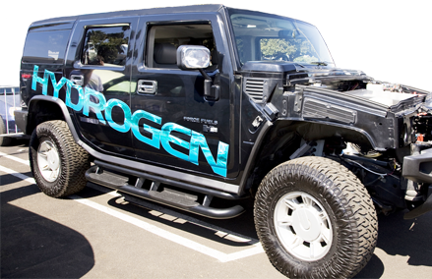

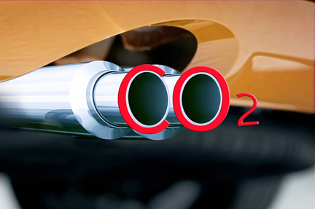

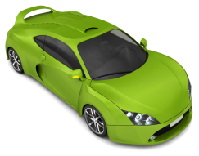

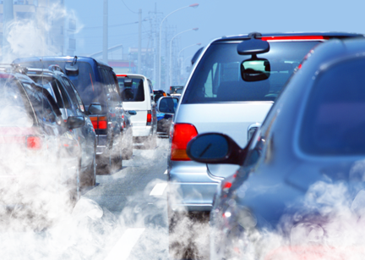
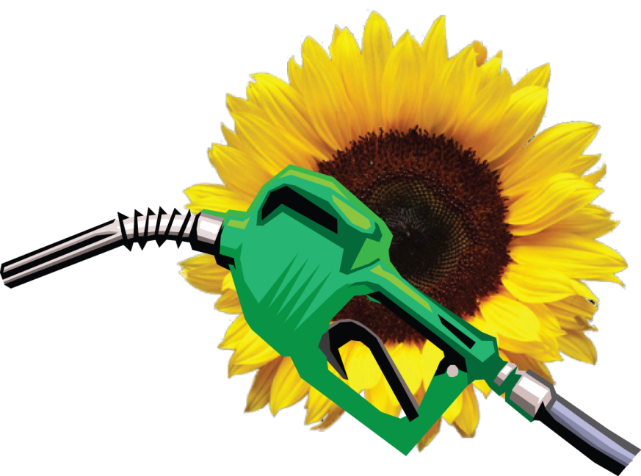
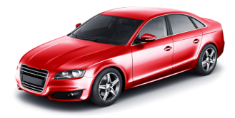

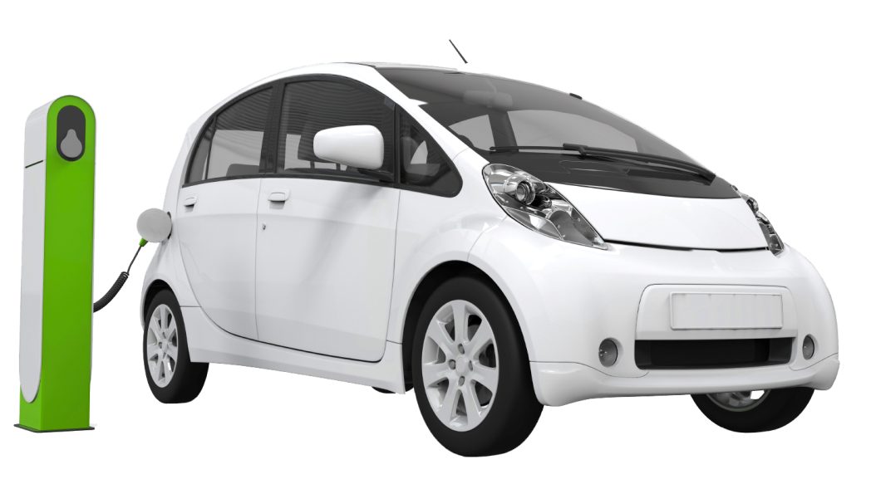
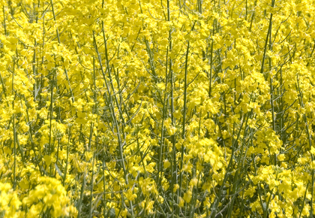
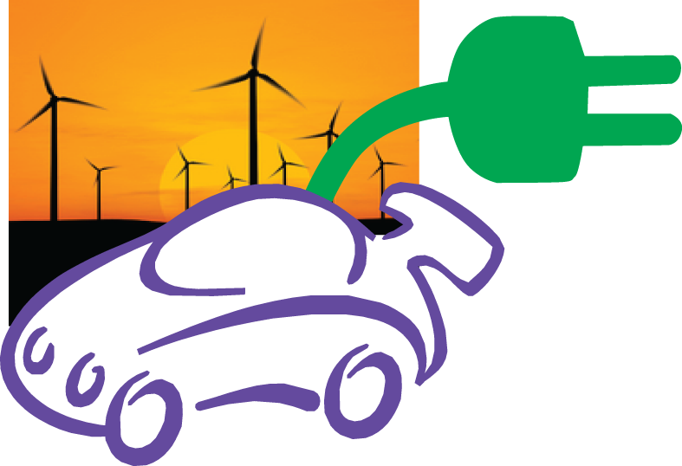
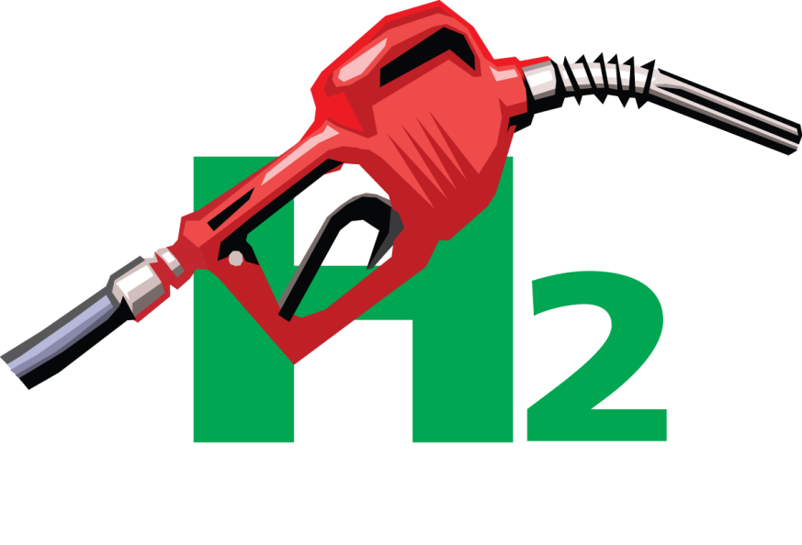
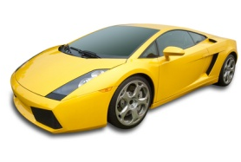
SS1
31
31
30
30
29
Car wars game
Deaths from
collisions increase.
You are too nervous
to drive.
29
Finish test drive
All cars on the board reverse to 19
26
28
25
26
23
25
23
24
24
27
27
28
28
Extra hydrogen
filling stations open.
An extra tax is introduced for all cars that produce carbon dioxide when in use.
A report shows that biodiesel storage is safer than petrol storage.
Hydrogen throw again
Biodiesel reverse to 21
Biodiesel drive to 31
21
21
20
22
20
22
19
19
18
18
17
The government subsidises cars that produce no carbon dioxide when in use.
17
Hundreds of new
wind farms generate clean electricity.
Protesters close
filling stations.
They say land should
be used for food crops, not fuel.
Electric and hydrogen cars drive to 25
Electric car drive to 24
Biodiesel miss a turn
15
12
15
12
14
14
16
11
16
11
13
13
You suddenly need
to go on more long journeys.
New battery
technology developed. Electric cars travel further between recharging.
Scientists develop
a new nanomaterial
for safe hydrogen storage.
Hydrogen and electric cars reverse to 9. Biodiesel drive to 18.
Hydrogen drive to 18
Electric car drive to 18
10
10
9
9
8
8
7
7
6
6
5
Many more
filling stations now
supply biodiesel.
Bumper rape seed
crop means the growing plants removed more carbon dioxide from the atmosphere.
Scientists discover
a profitable way of extracting hydrogen from water. The method makes no carbon dioxide.
5
Tough new fire
safety regulations close hydrogen storage facilities.
To reduce carbon dioxide emissions, petrol , diesel and biodiesel cars must now drive every other day only.
Biodiesel throw again
Biodiesel drive to 12
Hydrogen drive to 12
Hydrogen reverse to 1
Electric and hydrogen cars drive to 10
1
1
2
2
3
3
4
Throw 6 to choose an energy source and get going.
Start test drive
A shortage of
gas and coal causes power cuts.
All cities now have recharging points.
4
Electric car
miss a turn
Electric car drive to 7

Slide 3
SS2
Car wars game counters

Slide 4

Argument grid
SS3
Decide which criteria are most and least important.
Use numbers to rank the criteria
(5 = most important and 1 = least important)
Energy source
Criteria
Criterion rank
biodiesel
hydrogen
electricity
The energy source is safe during use and in storage.
The energy source does not produce carbon dioxide emissions
during production.
The energy source does not produce carbon dioxide emissions when the car is in use.
The energy source is available whenever and wherever it is needed.
The car can travel long distances between refuelling or recharging.
Notes:
Linda The three columns on the right must be as wide as possible please. Please decorate the column headings with the symbols for each fuel from the presentation powerpoint. There is no point decorating the blank boxes since they will have things stuck over them.
Tony I will suggest teachers elicit criteria from students first, but then they will get this which already has criteria. The ranking should generate some discussion, at least. I have purposely avoided cost since I think it muddies the water when the main point of the activity is linked to the UN report saying we must reduce carbon dioxide emissions. best to say you’ve deliberately avoided cost in T guide, as it is clearly important

Slide 5
SS4
Argument cards
1 Cut out the argument cards
2 Decide which card goes in which box on SS3. Glue each card in its box on SS3.
3 Award each glued-down argument card a mark. Write the mark in the space on the card:
  +1 if the energy source
  fully meets the criterion
  0 if the energy source
  partly meets the criterion
  –1 if the energy source does not meet the criterion at all
4 Multiply the mark in each box by the criterion rank number for that row.
5 Then add together all the numbers for each energy source.
6 The energy source with the highest mark is the winner.
Most hydrogen is made from methane. The process makes waste carbon dioxide
The car can travel
480 km before it needs refilling with hydrogen.
If used correctly, there is no danger of electric shock from the battery. Electricity is not stored.
Electric cars do not make carbon dioxide when in use.
If used correctly, biodiesel is unlikely to catch fire in storage.
Very few filling stations supply hydrogen.
Biodiesel makes carbon dioxide when it burns in car engines.
A hydrogen fuel cell makes one product, water.
Biofuel crop tractors make carbon dioxide. But the growing plants take in carbon dioxide.
Generating electricity from fossil fuels makes carbon dioxide. Generation from solar, wind and water do not.
Some cities and filling stations have recharging points, but many do not.
About one third of filling stations supply biodiesel.
A car can travel
1000 km before it needs refilling with biodiesel.
A mixture of hydrogen and air may explode if there is a spark.
The car can travel
160 km before its battery needs recharging.

