Slide 1

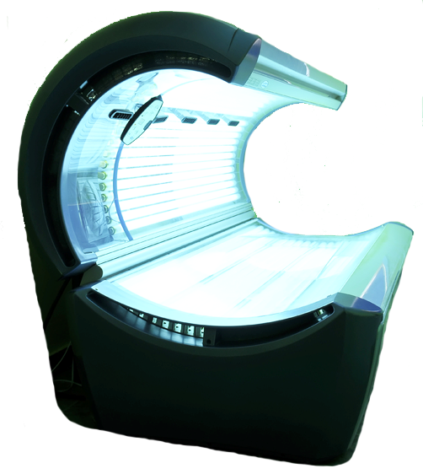
Equipping the Next Generation for Active Engagement in Science
Ban the beds

Slide 2


Objectives
To use knowledge about UV light to explain the link between sunbeds and skin cancer.
To understand how scientific evidence can support a claim.

Slide 3
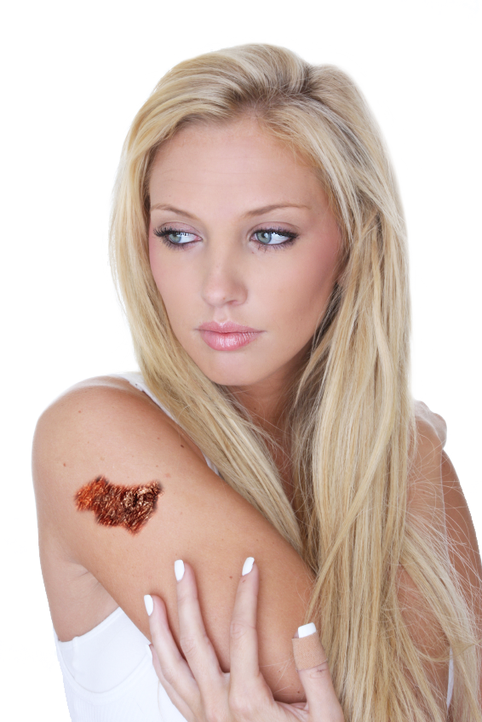

THE DAILY REPORT online
Scientific news
Educational
Investigations
Health issues
Weird
World health
Tanning addict diagnosed with skin cancer at just 19 years old
Hayley Thompson first used sunbeds at age 13.
She thought she looked healthier with a suntan.
Now she has an aggressive form of skin cancer.
Melanoma can spread quickly through the body.
Thinks sunbeds are killers and should be banned.
What do you think? Should sunbeds be banned?
STARTER

Slide 4


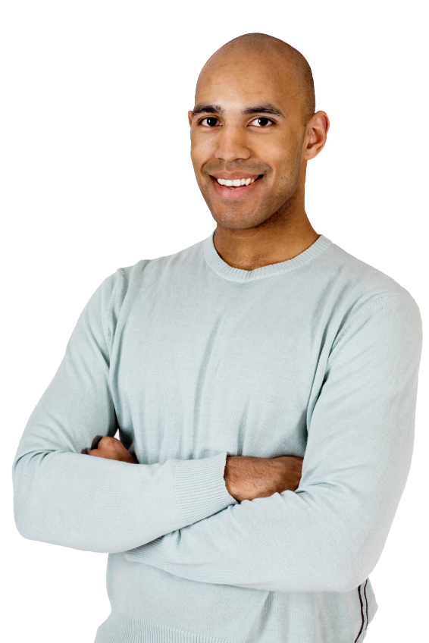
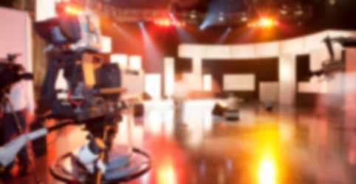
You’re a researcher on
A TV news show.
We’re going to interview Hayley.
We want to follow with a report on ‘should sunbeds be banned?’
It must start with a strong claim.
Producer
STARTER

Slide 5
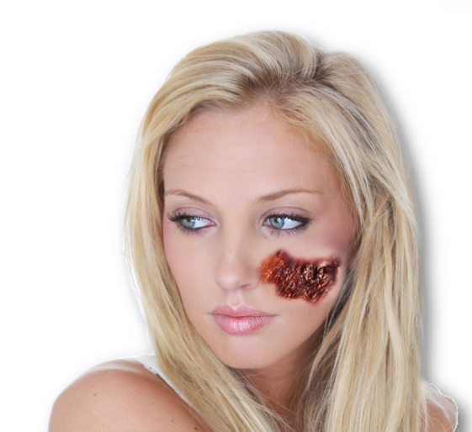
What does this graph show?
Number of people with skin cancer
Number of sunbed salons
STARTER

Slide 6

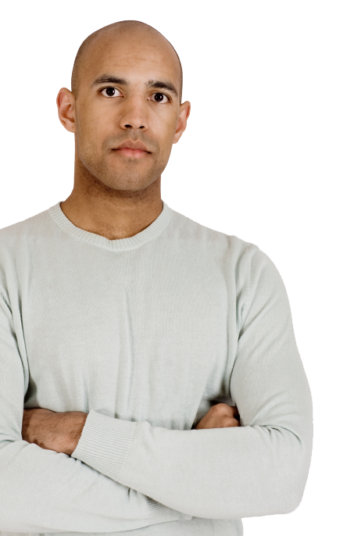



SS1-2
So you think our claim could be: Sunbeds cause skin cancer?
I need more scientific evidence before I can use this in the report.
Read the information.
Find out:
Which objects give off UV light
If UV can be harmful
How sunbeds are linked to skin cancer
Producer
Write the intro for the report.
CORE TASK

Slide 7
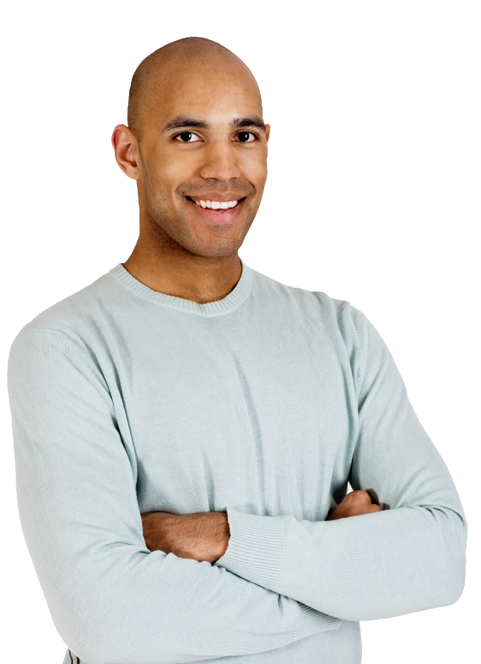
SS2-3
To make the claim believable we need more evidence.
Choose one piece that best supports our claim.
Work in a group.
Study the evidence and discuss what each shows.
Producer
Choose the one that best supports our claim.
Describe what the evidence shows.
Explain how it supports our claim.
EXTENSION TASK

Slide 8
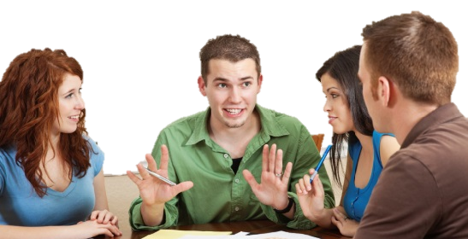
Get students talking and thinking

Slide 9





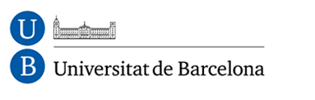








Equipping the Next Generation for Active Engagement in Science
TRACES

