Slide 1

Student sheets
Ban the beds
Sheet no. | Title | Notes
SS1 | Science of UV light | Reusable, one per pair, can be projected
SS2 | Programme outline | Consumable, one per student
SS3 | Evidence | Reusable, one per group

Slide 2

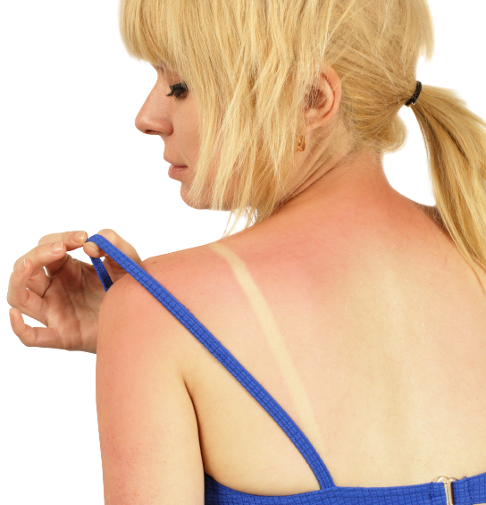

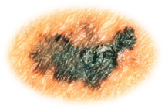

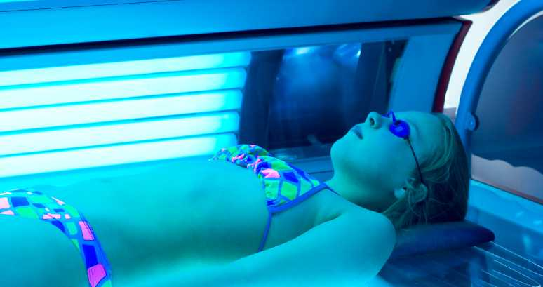
SS1
Science of UV light
Ultraviolet (UV) light is an invisible wave – a type of electromagnetic radiation.
It has a higher frequency than visible light.
The sun gives out UV light.
You may get a tan when your skin absorbs UV light. Too much gives you sunburn.
UV damages your DNA. This can build up over many years and lead to skin cancer.
The sun’s rays contain 3 types of UV:
UVA makes up most of sunlight and makes skin age. It can also cause skin cancer.
UVB is what makes your skin burn and is the main cause of skin cancer.
UVC is mostly filtered out by the Earth’s atmosphere.
Sunbeds give off UVA and UVB rays like the sun
The ozone layer blocks 97-99% of UV radiation from the sun from reaching the Earth’s surface.

Slide 3


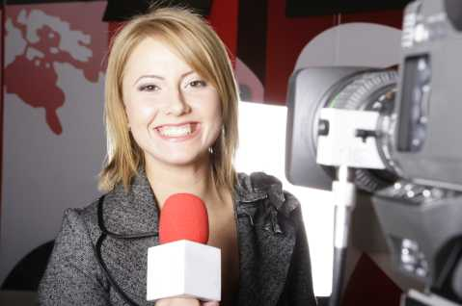
SS2
Programme outline
Researcher: .................................................................. Claim: Sunbeds cause skin cancer
Introduction: Abigail will explain the science of UV light.
The evidence: She will describe the evidence which supports our claim.
The evidence shows that...
This supports our claim because...

Slide 4
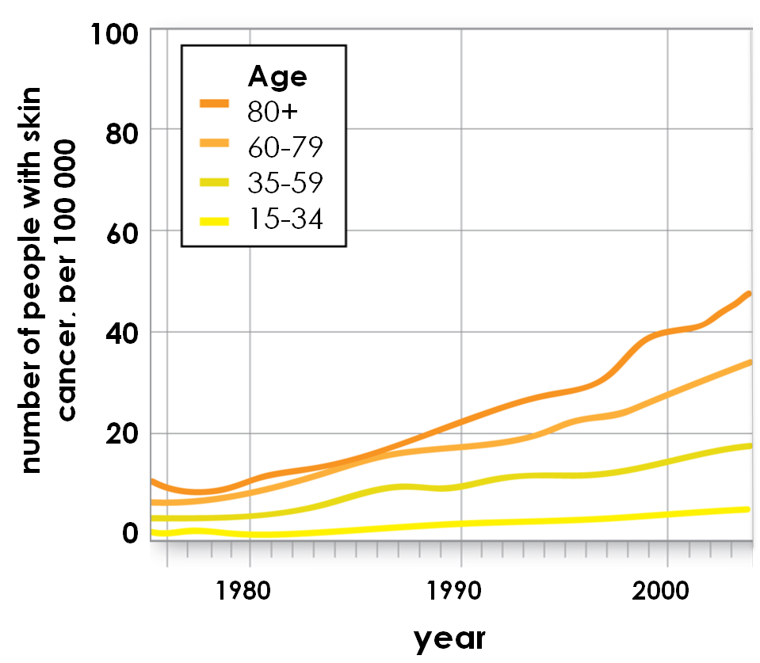
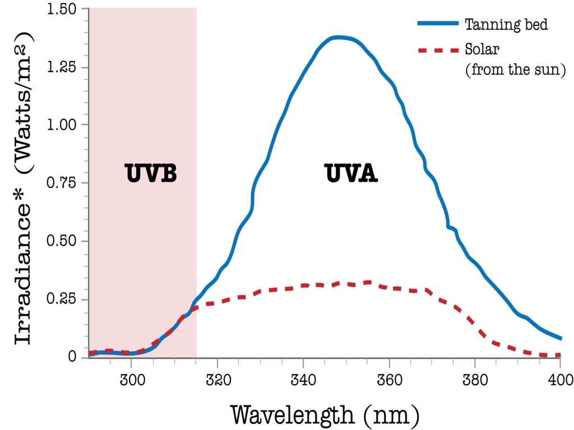
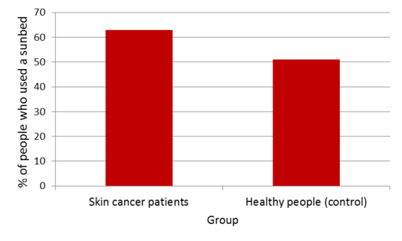
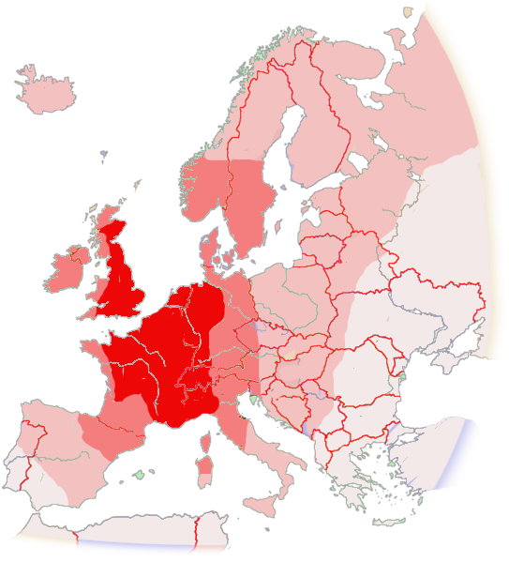
SS3
Evidence
1
2
* Irradiance is a measurement
of how strong radiation is.
3
4
Increase in natural UV levels from the sun 1980-1997
Increase in yearly UV dose
11-13%
8-10%
5-7%
0-4%

