Slide 1

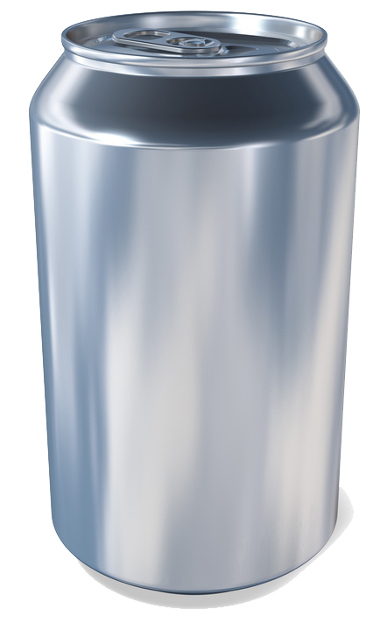

Equipping the Next Generation for Active Engagement in Science
Ban Cola?
fizzy
drink

Slide 2


Objectives
To use what you know about food and health in a new context.
To decide whether there is enough evidence to show that a factor causes a disease.

Slide 3

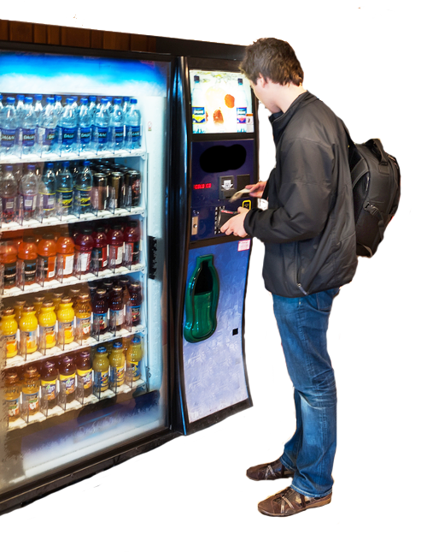
Sugar is an addictive drug. It causes obesity. Obesity is linked to heart disease and diabetes.
Should we ban sugary drink sales to under–18s?
STARTER

Slide 4
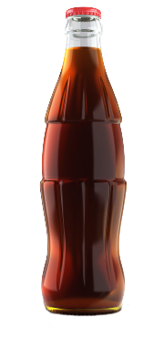
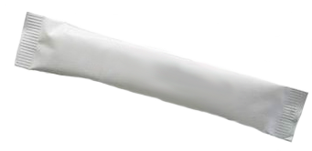

How much sugar is in a cola bottle?
39 g
(10 packets)
sugar
STARTER
4

Slide 5
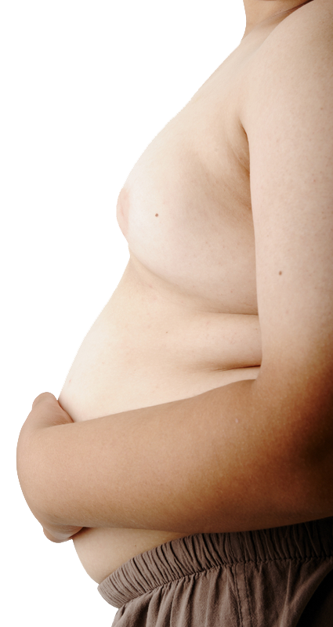
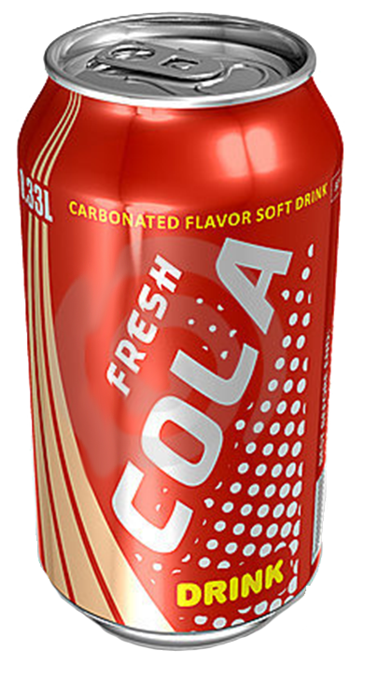
Jed drinks lots of sugary drinks. He becomes obese.
Big question
So do sugary drinks cause obesity?
CORE TASK
5

Slide 6


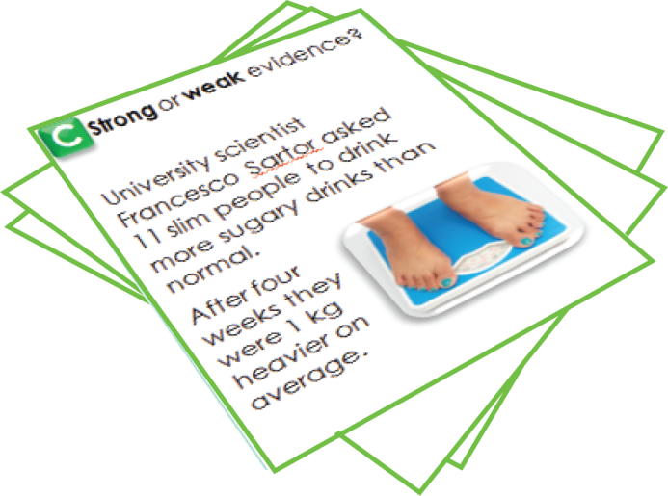
SS1
Sort the evidence that sugar causes obesity:
weak evidence
strong evidence
Is there enough evidence to ban sugary drink sales to under–18s?
CORE TASK

Slide 7


What’s the conclusion?
It’s uncertain. Not all scientists agree.
Will they ever agree?
Scientists will be more confident that sugary drinks cause obesity if they can explain how.
PLENARY 1
Plenary
7

Slide 8
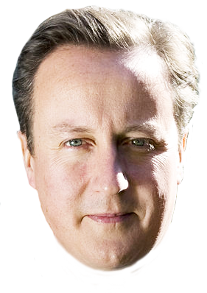


SS2
David Cameron, Prime Minister
We are considering a ban on fizzy drink sales to under-18s. What do you think?
Weigh up the pros and cons.
Do you support
a ban?
EXTENSION

Slide 9
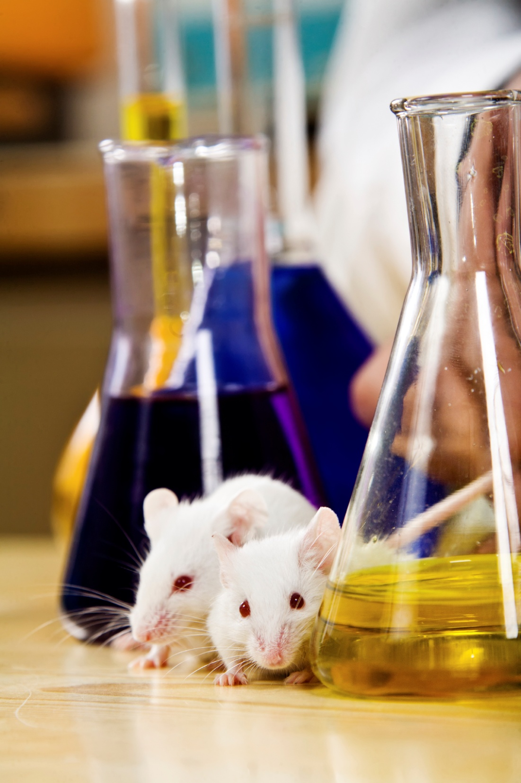

Were all your reasons scientific?
What else did you think about when making your decision?
PLENARY 2
9

Slide 10

Get students talking and thinking

Slide 11














Equipping the Next Generation for Active Engagement in Science
TRACES

