Slide 1

Student sheets
Ban cola
Sheet no. | Title | Notes
SS1 | Evidence cards | Reusable, cut into cards, one per group
SS2 | Argument cards | Reusable, cut into cards, one per group

Slide 2

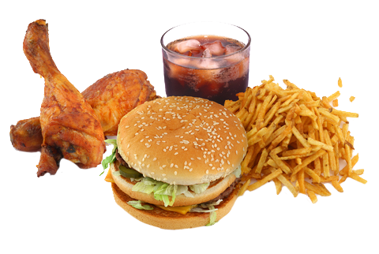
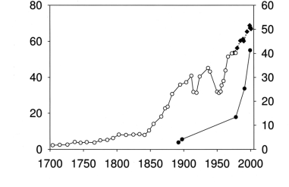
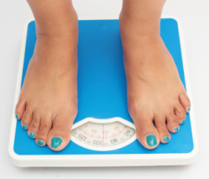
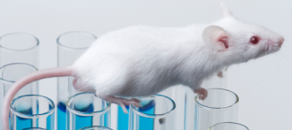
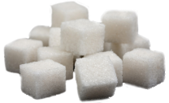
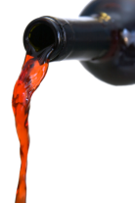

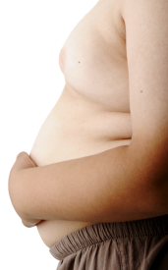
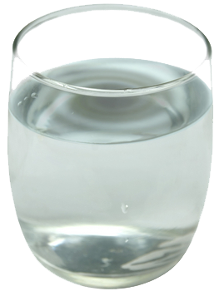

SS1
Evidence cards
A
Strong or weak evidence?
B
Strong or weak evidence?
C
Strong or weak evidence?
D
Strong or weak evidence?
Dr Hoebel found that
when rats drink sugary water, their brains release
a hormone, dopamine. This gives a feeling of pleasure, leading to addiction.
He says that this shows that sugar is addictive to rats.
University scientist Francesco Sartor asked
11 slim people to drink more sugary drinks than normal.
After four
weeks they
were 1 kg
heavier on
average.
Sugar consumption (kg/individual)
Obesity prevalence (%)
Year
The World Health Organisation says that too much food and drink overall increase body weight, not just too much sugar.
Richard Johnson of Florida University drew this graph.
The top line shows sugar intake per person. The bottom line shows obesity rates.
E
Strong or weak evidence?
F
Strong or weak evidence?
G
Strong or weak evidence?
H
Strong or weak evidence?
Magalie Lenoir of Bordeaux University gave rats the choice of sweetened water or cocaine. 94 % chose sweetened water.
She thinks this is because sweet foods trigger reward signals in the brain.
Alan Barclay of the Australian Diabetes Council said that sugar consumption in Australia has decreased by 20% since 1980.
In the same time the number of overweight people has doubled, and the number of people with diabetes has tripled.
Peter Benton of Swansea University read more than 100 scientific papers to find out if sugar addiction is a cause of obesity.
He concluded that animal addictions
do not predict
human addictions.
Robin Lustig of California University found that sugar is like alcohol and tobacco.
It acts on the brain to make you want it again.
Notes:
UK

Slide 3

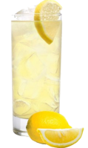


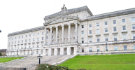

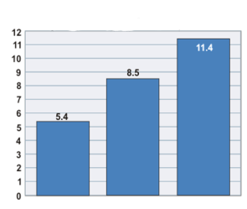
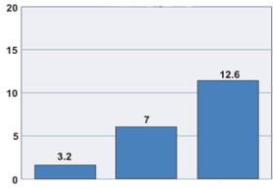

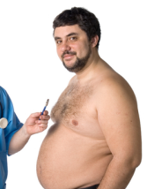


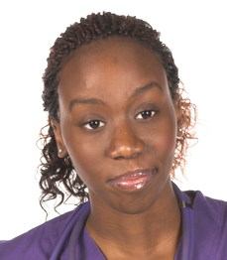

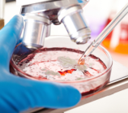

SS2
Argument cards
1
2
3
4
“Excess weight is linked to
heart disease and diabetes.”
Jessica Wright, West Virginia, USA
Heart attacks and body weight
“We got 51 students to rinse their mouths with lemonade. Some lemonade was sweetened with sugar, and some with artificial sweetener.
The students with sugary lemonade did better in concentration tests.”
Matthew Sanders,
University of Georgia, USA
Percentage who have had heart attack
“Governments control
alcohol and tobacco sales because they are hard to avoid and they have a bad impact on society.
Sugar has similar problems.”
Thomas Babor, University of Harvard, USA
“Nearly 7000 students did
a questionnaire for us.
We found that banning sugary drinks in schools did not reduce the amount they drank overall.”
Daniel Taber University of Illinois, USA
Healthy
Overweight
Obese
Diabetes and body weight
Percentage with diabetes
Healthy
Overweight
Obese
5
Weight category
6
7
8
“At our school,
behaviour used to be better in the mornings.
Then we banned sugary drinks at lunchtime. Afternoon behaviour improved.”
Sarah Sandford, headteacher
“Obesity is a complex
problem with many causes.
A sugary drink sales ban to under-18s will make no difference.”
Ahmed Hussain, British Soft Drinks Association
“Every year, more people die from diseases like diabetes and heart disease than from infectious diseases.”
Grace Mlokozi, United Nations, 2011
“The acid and sugar
in sugary drinks cause terrible tooth decay.”
Beth Bradshaw, Dentist
Notes:
UK version

