Slide 1

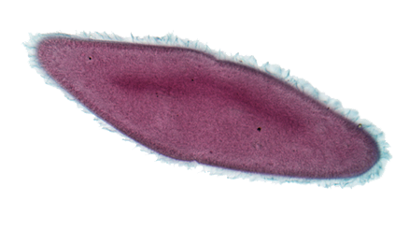
Equipping the Next Generation for Active Engagement in Science
Attack of the giant viruses

Slide 2


Objectives
To use knowledge of microorganisms to check the facts in a newspaper report.
To evaluate how trustworthy scientific reports are in the media.

Slide 3

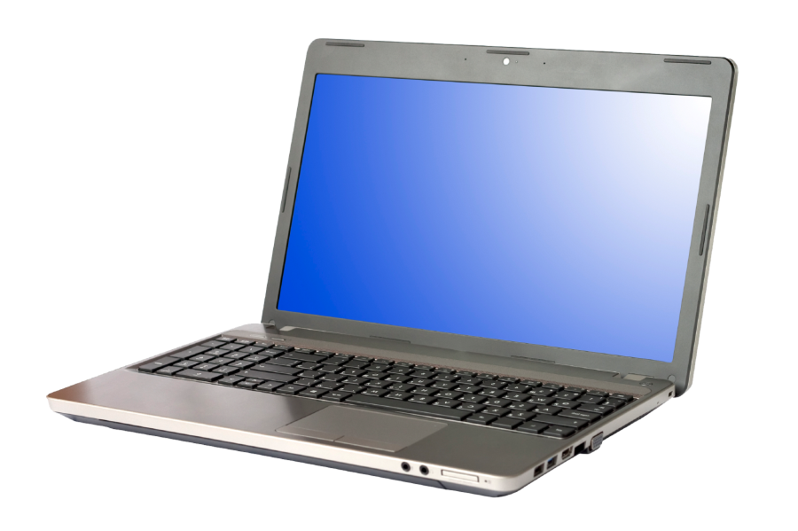
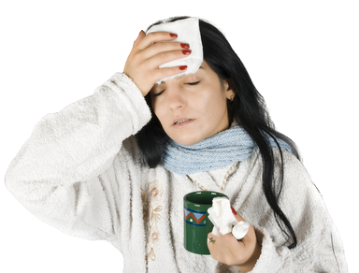

Computer virus spreads to
humans!
How could you find out?
Could this be true?
STARTER

Slide 4



Read the newspaper report about
viruses. Decide how concerned you are.
Highlight parts of the story that you
used to form your opinion.
CORE TASK

Slide 5





Level of concern
A major concern
Very concerned
Reasonably concerned
Mildly concerned
Not concerned at all

Slide 6

How do we know what to believe?
How can we decide if a media report is trustworthy?
Read the newspaper report.
Fill in the trustworthiness checklist.
Write down how trustworthy you think the report
is and why you think this.
EXTENSION

Slide 7


It is important
that media reports about science are interesting
All media reports about science should contain 100% accurate science
The reports
in the news should be written by
the scientists who did the work, not journalists
Do you agree?
PLENARY

Slide 8

Get students talking and thinking

Slide 9














Equipping the Next Generation for Active Engagement in Science
TRACES

