Slide 1

Student sheets
Attack of the giant viruses
Sheet no. | Title | Notes
SS1 | Attack of giant killer viruses | Reusable
SS2 | Giant virus brought back to life | Reusable
SS3 | Trustworthiness checklist | Consumable

Slide 2

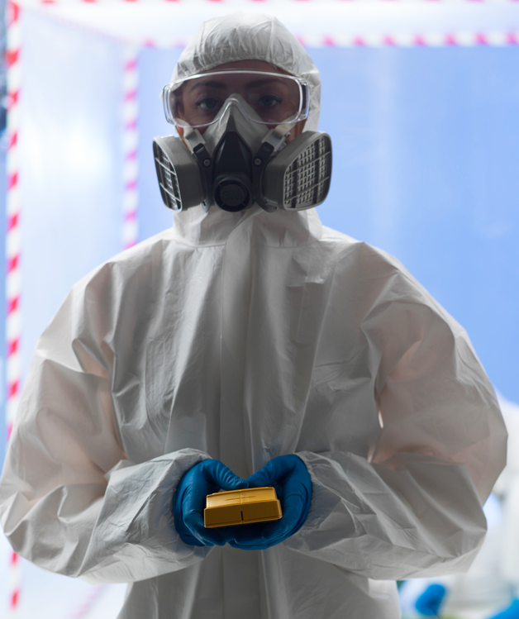
SS1
The Daily Post
Attack of the Giant killer viruses
Highly infectious giant viruses could soon infect millions of people.
Killer
The authors of the newly published research added the viruses to amoebas, which are made up of cells just like us. They saw that they rapidly infected the cells, causing them to dramatically explode.
This frightening virus is 100 times bigger than most and is
the largest ever discovered.
Scientists have dug up a 30 000 year old virus from the Arctic ice. They say that more ancient viruses may be released as global warming melts the ice.
Epidemic
We have no natural resistance to these deadly creatures so we must prepare ourselves for the possibility of them wiping out whole populations.
Alexander Witte, who works at the university where the research was carried out said, ‘I’m worried. The risk that deadly viruses could spring back to life and start the next word-wide epidemic has
to be taken seriously.’

Slide 3
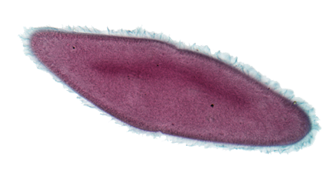
SS2
The Reporter
Giant virus brought back to life
Scientists discovered the 30 000 year old virus, which is 100 times bigger than most, in the Arctic ice.
There may be other viruses frozen in the ice that could become active by the melting of the frozen ground due to global warming.
As humans have no immunity against these ancient viruses, many warn that they could start a global epidemic.
Tests in the laboratory showed that the virus was capable of infecting single-celled organisms called amoeba, but not those made up of many cells (multicellular). The scientists published their findings this week in the journal Proceedings of the National Academy of Sciences.
Dr. Chantal Albert, a scientist who worked on the research, said that there is a risk that they could infect organisms other than amoeba and could pose a threat to human health. However, the idea that melting ice would kick-start a global epidemic is ‘extremely unlikely’.
She says, ‘I would be much more concerned about the millions of people who will be affected by rising sea levels’.

Slide 4


SS3
Trustworthiness checklist
Read the newspaper report.
Use the information to fill in the table and let us know how trustworthy you think the report is and why.
Headline of newspaper report:
If a report is trustworthy then... | Found in report? | Evidence
The headline reflects the findings of the research/event
The story is based on a recent event or research
Any research that is mentioned has been published in a peer-reviewed journal
Correct science terms are used
Speculative language is not used: e.g. 'could', 'may', 'might‘
Quotations included are from a scientist who worked on the research or is an expert in their field
The report presents different views - it is not biased
How trustworthy I think the report is...
Why
I think this...

