Slide 1

Equipping the Next Generation for Active Engagement in Science
Appliance science

Slide 2

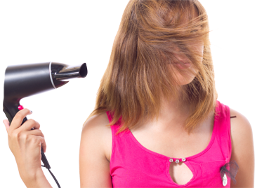


Next year’s
First they ban appliances...now THIS!
The EU has announced new strict legal limits on home electricity use.
REDUCE
REDUCE
REDUCE
Can you make big enough cuts?
2
Dilemma
Science
Decision
Notes:
Point out that the EU has already imposed limits on the power ratings of vacuum cleaners and a new draft proposal is looking at doing the same for other household appliances. Ask students to suggest why. Elicit that the purpose is to cut electricity use and greenhouse gases.
Then introduce the (fictional) future limit on home electricity use. What do students think of this restriction? How can they reduce their own use of electricity?

Slide 3


In this dilemma, you will
analyse a science issue using:
Energy: the power ratings of electrical appliances and the energy they transfer
Science in society: define a problem and work out how to solve it
Big Idea
Working Scientifically

Slide 4



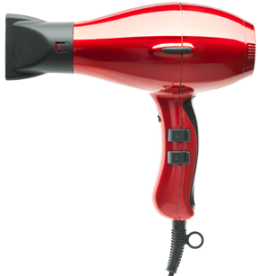
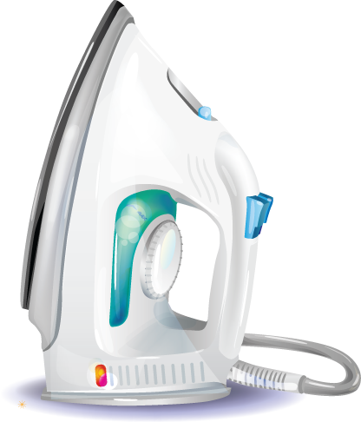
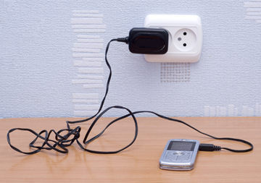
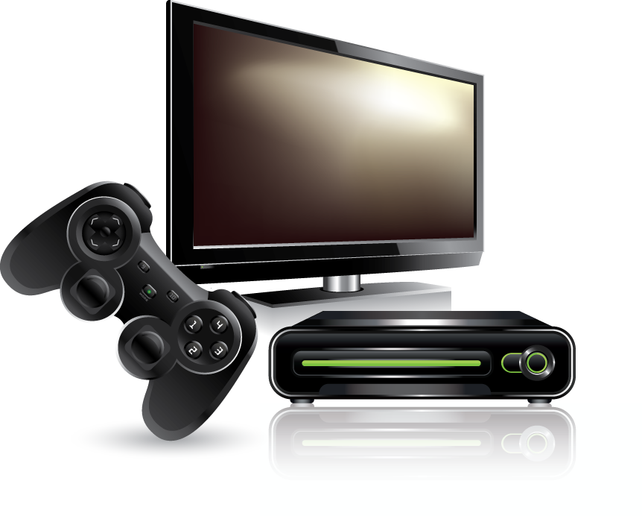

SS1
Which appliances have high power ratings?
Choose three appliances with high power ratings.
Order the appliance cards, from the highest power rating to the lowest.
Dilemma
Science
Decision
Notes:
Students identify the three appliances with the highest power ratings. The answer is those that transfer the most heat – the hairdryer, shower and iron.
Distribute copies of cards cut from SS1a and SS1b so that each group has 8 cards. Students convert all power ratings to kW (they could use whiteboard pens to write these on the cards) and order the cards from the highest power rating to the lowest.

Slide 5
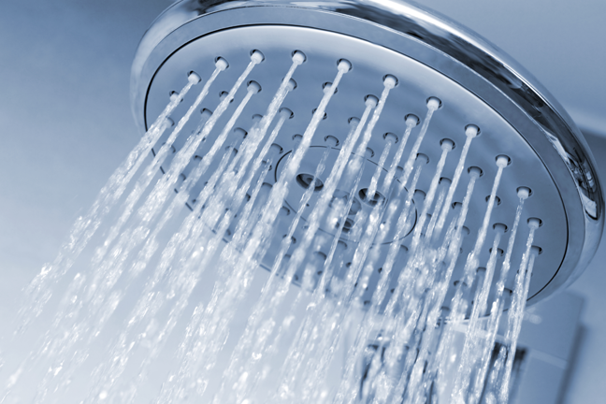


How much energy do appliances transfer?
energy transferred = power × time
kWh kW h
Q If you are in an 8 kW shower for ¼ hour, how much energy is transferred?
A Energy transferred = 8kW × ¼ hour
= 2 kWh
Make up some questions like this for your partner, and check their answers.
5
Dilemma
Science
Decision
Notes:
Go through the worked example.
Students then make up similar questions for their peers, using the power rating values given on the cards.

Slide 6
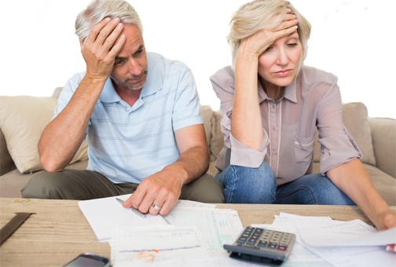
At home, the bill payers
give you a daily personal
electricity allowance of 1.5 kWh.
SS2-4
How much electricity do you use now?
What cuts could
you make, to fit
your allowance?
Which appliances will you use, and for how long?
Dilemma
Science
Decision
Notes:
Either
Students work through SS2 to calculate the energy transferred by the appliances they use in a typical day. They use SS3a and SS3b to represent this visually. They then continue to follow the instructions on SS3a to decide how to cut their appliance use so as not to exceed their daily personal electricity allowance of 1.5 kWh.
Or do the calculation-free version:
Students follow the instructions on SS4a to show the energy transferred by the appliances they use in a typical day. They then continue to follow the instructions to decide how to cut their appliance use so as not to exceed their daily personal electricity allowance of 1.5 kWh.

Slide 7


How can you get more time for your allowance?
What might make you change how you use your allowance?
7
Dilemma
Science
Decision
Notes:
Plenary questions.
Students might suggest using more efficient appliances, or installing solar panels, to get more time for their allowance.
They might point out that their heating needs change according to the season.

Slide 8

Student sheets
Appliance science
Sheet no. | Title | Notes
SS1a and 1b | Appliance cards | Reusable, cut up and laminate, one set of 8 cards for each group
SS2 | Electricity use table | Consumable, one for each student (but students who are doing the calculation free version of the activity do not need this sheet)
SS3a and 3b | Appliance energy strips | Consumable, print in colour if possible, one for each student who is doing the calculations on SS2
SS4a and 4b | Appliance energy strips (calculation-free) | Consumable, print in colour if possible, one per student who is not doing the calculations on SS2

Slide 9



SS1a
Appliance cards
Identify or work out the power rating, in kilowatts (kW), for each appliance.
Order the cards, from the highest power rating to the lowest.
Shower
TV
Power rating = 8 kW
Power rating = 300 W
Desktop computer
Hairdryer
Power rating = 200 W
Power rating = 2 kW

Slide 10
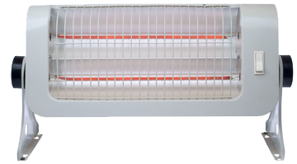
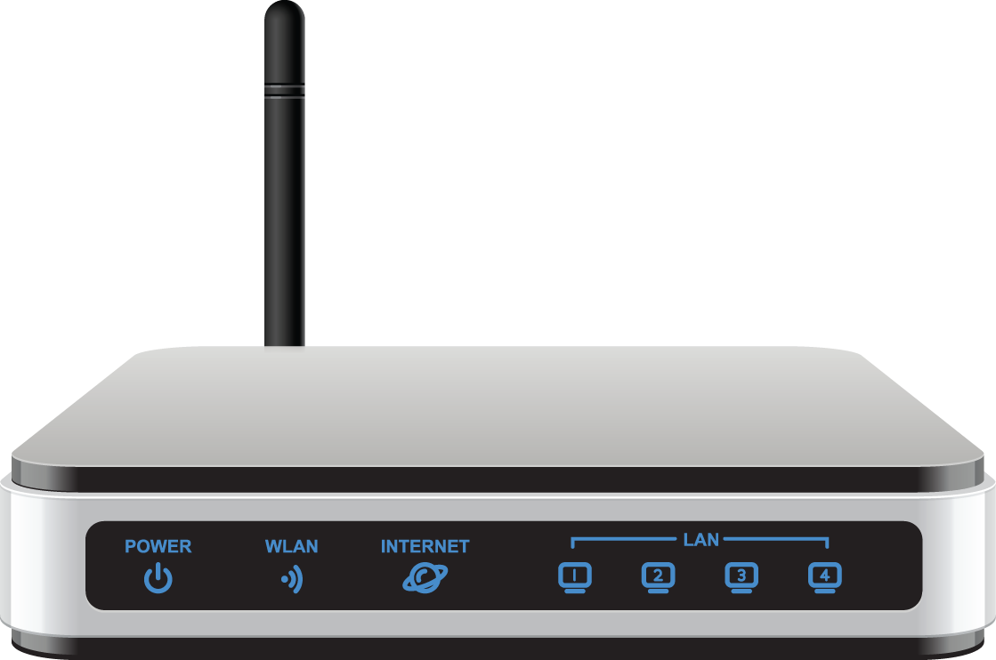
SS1b
Appliance cards
Identify or work out the power rating, in kilowatts (kW), for each appliance.
Order the cards, from the highest power rating to the lowest.
Electric heater
Mobile phone charger
Power rating = 2 kW
Power rating = 3 W
Games console
Wi-Fi router
Power rating = 200 W
Power rating = 6 W

Slide 11


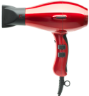
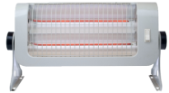



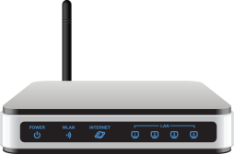
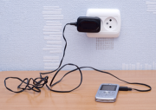
Electricity use table
SS2
Estimate how long you use each appliance on a typical day. If your estimate is in minutes, use the conversion table to write it in hours.
Calculate the energy
transferred by each appliance:
energy transferred = power × time
appliance | power (kW) | time (h) | energy transferred (kWh)
shower | 8
hairdryer | 2
heater | 2
TV | 0.3
games console | 0.2
desktop computer and monitor | 0.2
Wi-Fi router | 0.006
mobile phone charger | 0.003
 |  | Total:
conversion table
time
minutes | hours
5 | 0.08
10 | 0.17
20 | 0.33
30 | 0.50
40 | 0.67
50 | 0.83

Slide 12
SS3a
Appliance energy strips
Choose the shower strip that is closer to the value you wrote in the table on SS2.
Cut out this shower strip and place it on grey strip A (the electricity you use now) on SS3b.
Repeat for the other appliances. Place the coloured strips end to end, along grey strip A.
Decide what cuts to make in using the appliances, to fit your allowance.
Cut your coloured strips so they fit on grey strip B (your electricity allowance). Stick them down.
Shower
1.4 kWh
Shower
0.70 kWh
Hairdryer
0.66 kWh
Hairdryer
0.33 kWh
Hairdryer 0.17 kWh
Heater
1.0 kWh
Heater
0.5 kWh
Heater
1.5 kWh
Games console
0.2 kWh
Games console
0.4 kWh
Games console
0.6 kWh

Slide 13
SS3b
Appliance energy strips
TV
0.6 kWh
TV
0.3 kWh
Mobile phone charger
– the energy transferred in one hour is so small that the strip is too small to see.
TV
0.9 kwh
Desktop computer
0.2 kWh
desktop computer
0.4 kWh
desktop computer
0.6 kWh
Wi-Fi router
0.14 kWh
Wi-Fi
router
0.07 kWh
Grey strip A
The electricity you use now (go beyond this strip if you need to)
Grey Strip B
Your electricity allowance of 1.5 kWh (do not go beyond this strip)
Is your electricity use less than this? You will get 100 Euros.
Is your electricity use less than this? You will get
50 Euros.

Slide 14
SS4a
Appliance energy strips
(calculation free)
Choose the shower strip that gives the time that is closest to the time you shower for each day.
Cut out this shower strip and place it on grey strip A (the electricity you use now) on SS4b.
Repeat for the other appliances. Place the coloured strips end to end, along grey strip A.
Now decide what changes to make in using the appliances, to fit your allowance.
Cut your coloured strips so they fit on grey strip B (your electricity allowance). Stick them down.
Shower for 10 mins
1.4 kWh
Shower for 5 mins
0.70 kWh
Hairdryer for 20 mins
0.66 kWh
Hairdryer for 10 mins
0.33 kWh
Hairdryer for 5 mins 0.17 kWh
Heater
for 30 mins
1.0 kWh
Heater
for 15 mins
0.5 kWh
Heater
for 45 mins
1.5 kWh
Games console for 1 hr
0.2 kWh
Games console for 2 hrs
0.4 kWh
Games console for 3 hrs
0.6 kWh

Slide 15
SS4b
Appliance energy strips
(calculation free)
TV for 2 hrs
0.6 kWh
TV for 1 hr
0.3 kWh
Mobile phone charger
– the energy transferred in one hour is so small that the strip is too small to see.
TV for 3 hrs
0.9 kwh
Computer for 1 hr
0.2 kWh
desktop computer for 2 hrs 0.4 kWh
desktop computer for 3 hrs 0.6 kWh
Wi-Fi router for 24 hrs
0.14 kWh
Wi-Fi
12 hrs
0.07 kWh
Grey strip A
The electricity you use now (go beyond this strip if you need to)
Grey Strip B
Your electricity allowance of 1.5 kWh (do not go beyond this strip)
Is your electricity use less than this? You will get 100 Euros.
Is your electricity use less than this? You will get
50 Euros.

Slide 16

Get students talking and thinking

Slide 17














Equipping the Next Generation for Active Engagement in Science
TRACES

