Slide 1
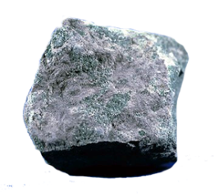
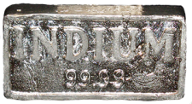
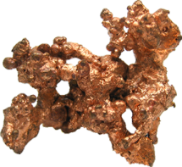
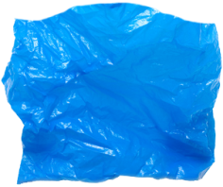
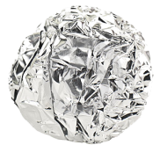

Data book extract
Data book extract
Properties of materials
currently used for mobile phone casing
Properties of materials
currently used for mobile phone casing
Material | Tensile strength¹ (Mpa) | Water absorption² (%)
Aluminium alloy 6063 | 215 | 0.001
Polycarbonate | 55 – 75 | 0.16 – 0.35
Material | Tensile strength¹ (Mpa) | Water absorption² (%)
Aluminium alloy 6063 | 215 | 0.001
Polycarbonate | 55 – 75 | 0.16 – 0.35
1 Tensile strength is the strength when pulled.
2 It is vital that any material used for mobile phone casing absorbs as little water as possible. The lower the value, the more suitable the material for mobile phone casing.
1 Tensile strength is the strength when pulled.
2 It is vital that any material used for mobile phone casing absorbs as little water as possible. The lower the value, the more suitable the material for mobile phone casing.

