Slide 1

Equipping the Next Generation for Active Engagement in Science
Exterminate

Slide 2


In this project you will:
Interdependence
Describe how a species’ population changes as its predator or prey population changes
Use the skills of:
Interrogate sources, use ethics, estimate risks, justify opinions and communicate ideas
Big Idea
Working Scientifically
Notes:
The learning objectives for this project.

Slide 3


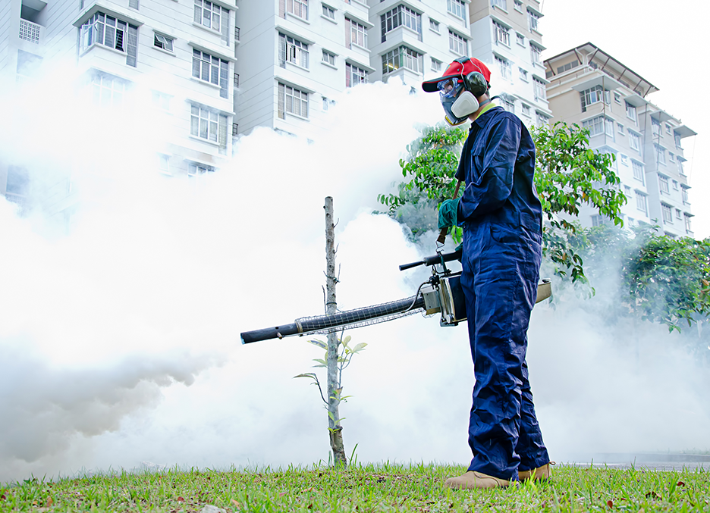
Zika panic spreads across the world
3
Notes:
Introduce the issues surrounding disease carrying mosquitoes.

Slide 4
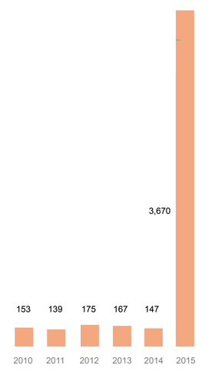
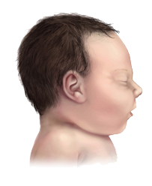
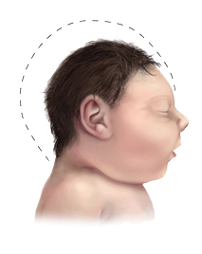

Scientists think the disease could cause brain damage in unborn babies
Cases of microcephaly in Brazil
Healthy baby
Baby with microcephaly
What does the data show?
Notes:
Introduce the issues surrounding disease carrying mosquitoes.

Slide 5
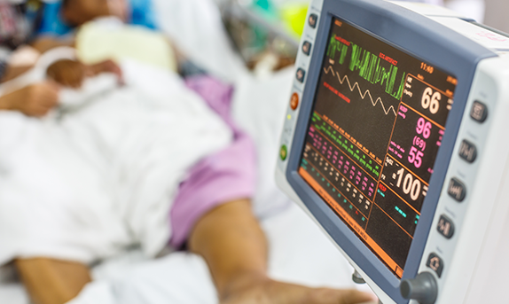
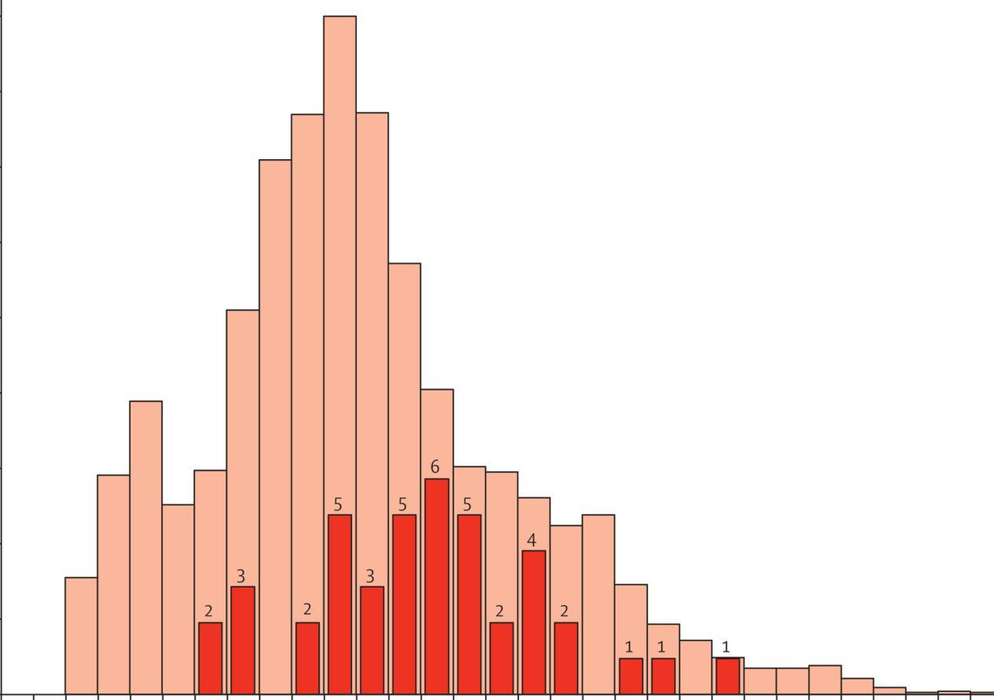
...and a dangerous
paralysing disease in adults
Zika
Paralysing disease
Number of patients
weeks
What does the data show?
Notes:
Introduce the issues surrounding disease carrying mosquitoes.

Slide 6
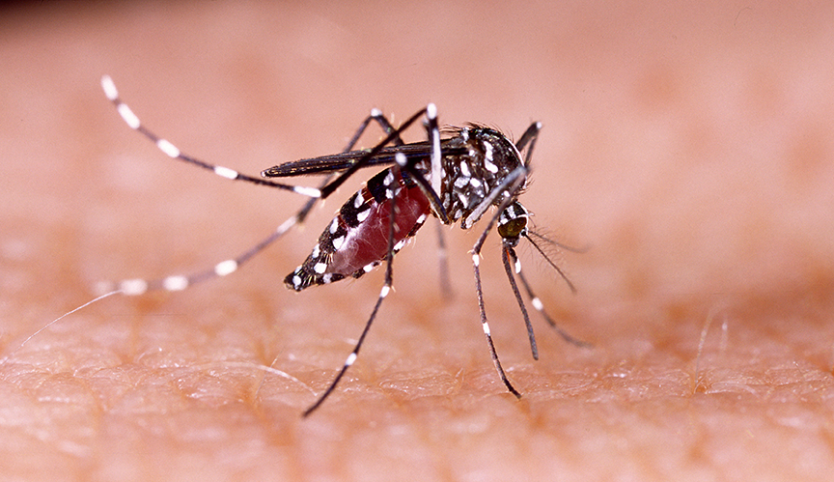
The virus that causes the disease is spread by the
Aedes aegypti mosquito.
Which also spreads other
life-threatening diseases like dengue.
Notes:
Introduce the issues surrounding disease carrying mosquitoes.

Slide 7
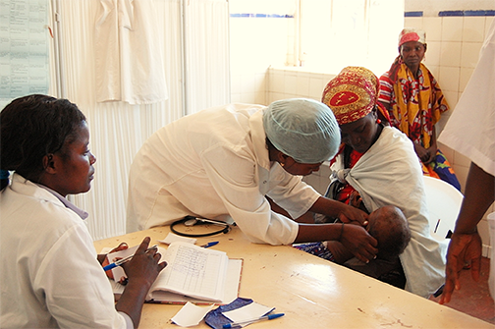
Mosquitoes also spread malaria...
...which kills around half a million people every year
7
Notes:
Introduce the issues surrounding disease carrying mosquitoes.

Slide 8
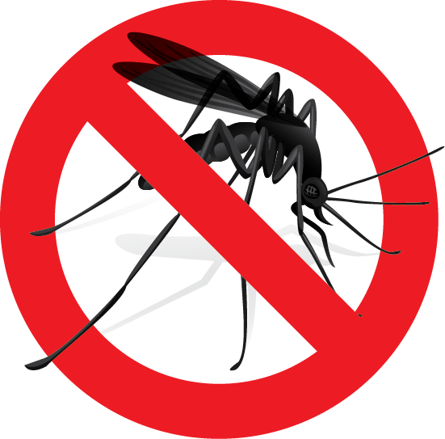
The proposal is to exterminate all species
of mosquitoes that spread disease by using a new technology – GM mosquitoes
Many people have views about this.
Should we exterminate mosquitoes?
Notes:
The dilemma that the students will be investigating. Carry out a vote by asking students to raise their hands if they think mosquitoes should be exterminated. Discuss the fact that to make an informed judgement they will need more information. Ask them to suggest what they might need to find out.

Slide 9
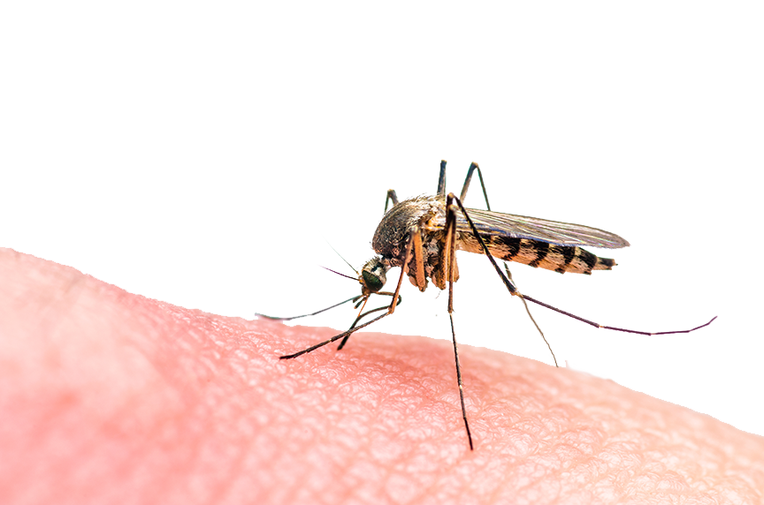

‘
Engineered insects could help control populations of mosquitoes that transmit a variety of serious diseases
‘
Emily Anthes, science writer
9
Notes:
Viewpoints from a range of people. These slides are designed to get students thinking about what research questions would be useful. For example, in this a question raised could be: 'will using GM mosquitoes work to exterminate dangerous ones?'

Slide 10


‘
The problem with this idea is whether it actually works in the wild.
‘
Professor Chelsea Smartt, Biochemist
10
Notes:
Viewpoints from a range of people.

Slide 11

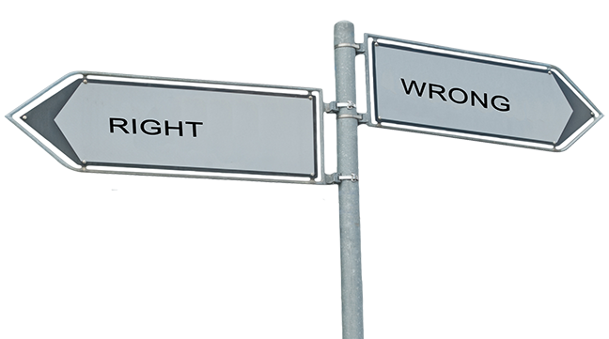
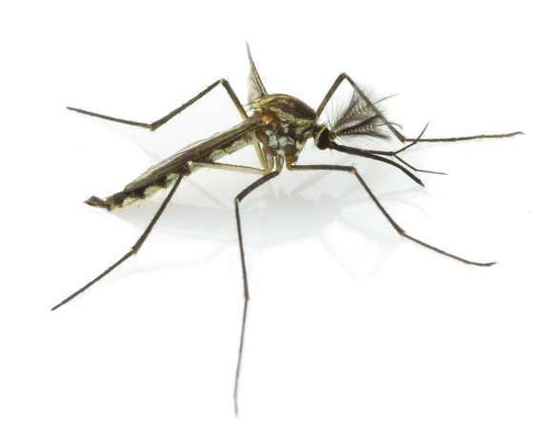
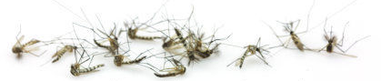
‘
It would be morally wrong to remove an entire species.
‘
Jonathon Pugh, ethics expert
11
Notes:
Viewpoints from a range of people.

Slide 12


‘
It's difficult to see what the downside would be to removal
‘
Steven Juliano, insect ecologist
12
Notes:
Viewpoints from a range of people.

Slide 13
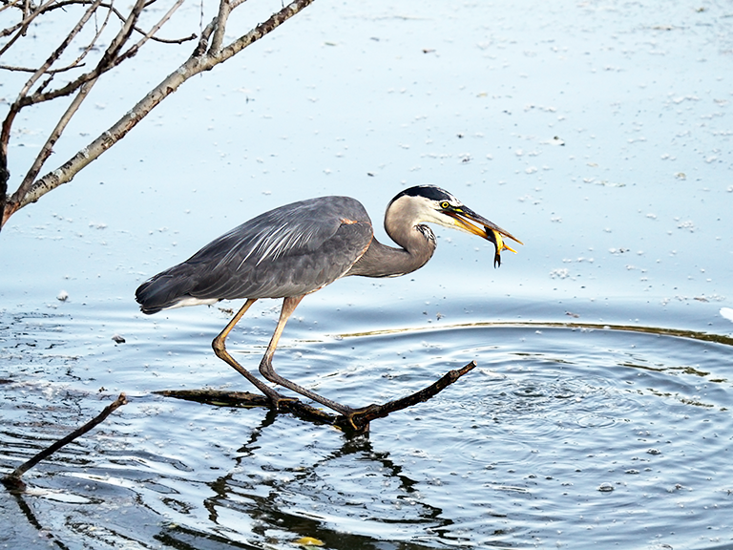

‘
Mosquitoes play an important role in a variety of ecosystems
‘
Dr Fazale Rana, scientist
13
Notes:
Viewpoints from a range of people.

Slide 14
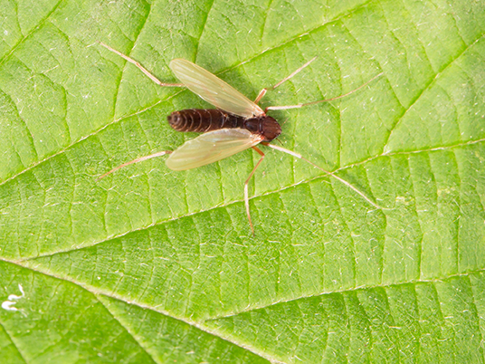

‘
If we eradicated them tomorrow, the ecosystems where they are active will hiccup and then get on with life. Something better or worse would take over.
Joe Conlon, insect scientist
‘
14
Notes:
Viewpoints from a range of people.

Slide 15


‘
There are extinction options. It wouldn’t be easy, but we shouldn’t forget about it.
‘
Dr Jo Lines, malaria scientist
15
Notes:
Viewpoints from a range of people.

Slide 16


This is insane!!!! This must be up for
public debate! No one has the
right to just do this to our ecosystem!
‘
‘
Deborah-Rose
HoneyBee McNeill
Facebook comment
16
Notes:
Viewpoints from a range of people.

Slide 17


SS1
Should we exterminate mosquitoes?
You are going to decide.
First, set the questions that will guide you.
Use the KWHL grid.
K
What I already Know
W
What I Want to know
Discuss with a partner the questions that will help you come to a decision.
Notes:
Give students a copy of the KWHL grid (SS1) and talk through how it is used. Students should work alone to fill in the K section - this is what they already know about the issue.
They then discuss in pairs possible questions that can help guide their enquiry (the W section). Ask pairs for feedback and come to a class decision on the questions that would be most useful. Suggestions for suitable questions are:
- How are organisms in an ecosystem linked?
- How can removing one species affect others?
- How do GM mosquitoes exterminate dangerous ones?
- Is the technology 100% effective?
- What are the risks and benefits of using this technology?
- What are the ethical arguments for and against?
Students then copy the questions into the W column of their grid.

Slide 18
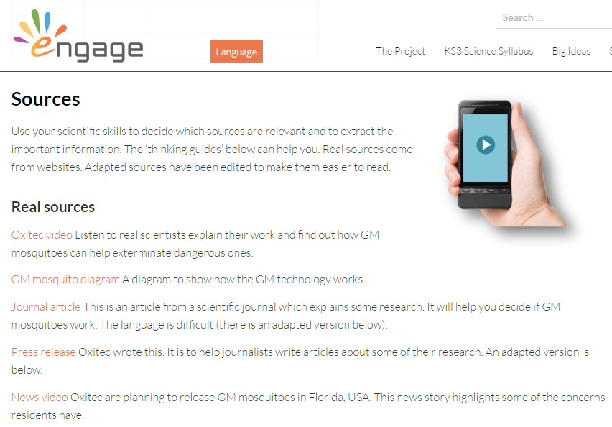
SS1
Later, you will add in which sources you will use and what you have learnt from them.
H
How I will find out Which source(s) you use
L
What I have Learnt
Notes:
Discuss how they will fill in the H and L columns later. Clicking on the image of the Engage webpage will take you to where students will access the sources. Show them the different sources: real ones, adapted ones and thinking guides. Explore a few of the sources so students begin to see the range available to them. Explain that most students should use the adapted sources but some may choose to look at the real ones as well. The thinking guides are there to help them to analyse the sources.

Slide 19


You will use what you have learnt to communicate
an opinion to
an audience.
Notes:
How they will communicate their findings later.

Slide 20

Student sheets
Exterminate
Sheet no. | Title | Notes
SS1 | KWHL | Enlarge to A3. Consumable, one per student

Slide 21
SS1
KWHL Grid
What I Know
What I Want to know | How I will find out | What I have Learnt

Slide 22

Get students talking and thinking

Slide 23














Equipping the Next Generation for Active Engagement in Science
TRACES

