Slide 1

Equipping the Next Generation for Active Engagement in Science
Game of life

Slide 2
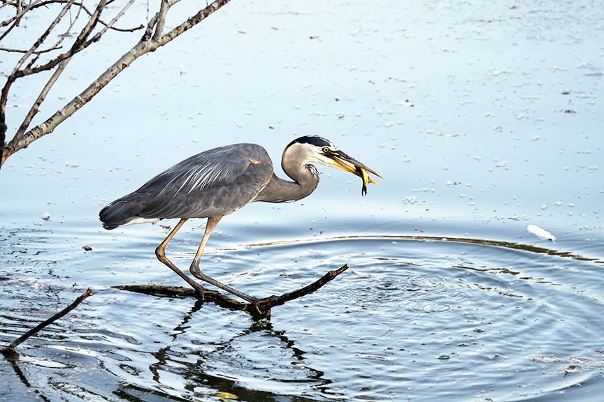


SS1/2
How are organisms in an ecosystem linked?
Use the clues to draw arrows, connect the organisms and form
a food web
2
Notes:
Introduce the first task. Students use the clues (SS1) to draw arrows to complete the food web (SS2a) which contains mosquitoes. Display the model answer (SS2b) and allow students to self-assess their answer.

Slide 3


SS3
What could happen to other organisms in the ecosystem if there were no mosquitoes?
Find out by
Game of Life
Playing the
You are an organism in a food web. You need to find food.
Will you survive?
Notes:
Set the next task, to take part in the 'game of life'. Game rules can be found at the end of the teachers guide document.

Slide 4




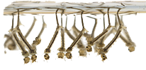
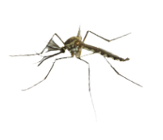



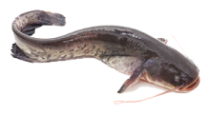



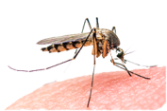
 |  | Number alive at end
Level | Organism | Scenario: | Scenario: | Scenario:
1 | algae
 | tree
 | orchid
2 | mosquito larva
 | male mosquito
 | sloth
3 | bat
 | frog
 | catfish
4 | eagle
 | human
 | crocodile
 | female mosquito
Notes:
Record which organisms had a full card at the end of the game in the first empty column on the table.

Slide 5
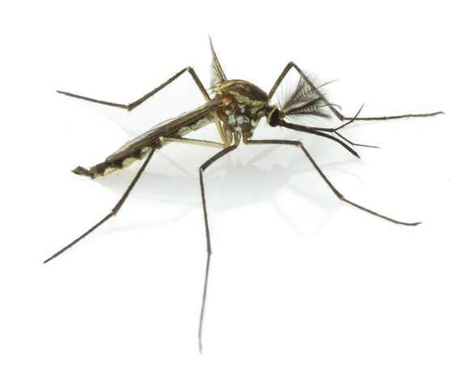

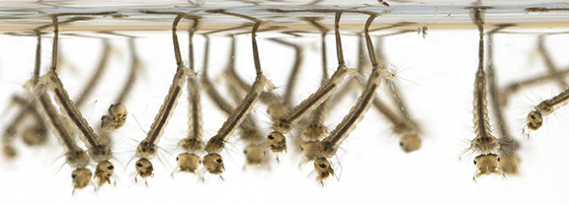
What could happen to other organisms in the ecosystem if there were no mosquitoes?
Discuss:
What happened when the population of one organism in the food web changed?
Were the results of the game the same each time? Why?
Notes:
After the game is played, display the questions to promote discussion on what the game showed them about how changing the population of mosquitoes affects other organisms in the food web.

Slide 6

Student sheets
Game of life
Sheet no. | Title | Notes
SS1 | Food web clues | Reusable, one half per pair
SS2a | Food web | Consumable, one per student
SS2b | Food web (completed) | Reusable, one per pair (optional)
SS3a | Food web game cards a | Reusable, make 5 copies (or 6 for a class over 28) and cut out cards
SS3b | Food web game cards b | Reusable, make 1 copy and cut out cards
SS3c | Food web game cards c | Reusable, make 1 copy and cut out cards

Slide 7
SS1
SS1
Food web clues
Food web clues
The producers in the ecosystem are a tree, algae and an orchid plant.
The algae is eaten by mosquito larva
– the young of adult mosquitoes.
Sloths eat nuts and fruit from trees.
They are eaten by eagles.
Eagles also eat bats.
Adult male mosquitoes pollinate orchids while they are eating the nectar
Adult female mosquitoes feed on blood from sloths and humans.
Two animals prey on both male and female mosquitoes – bats and frogs.
Frogs eat mosquito larva. Crocodiles eat frogs.
Catfish also eat mosquito larva.
Humans and crocodiles are predators of catfish.
Humans also eat fruit from the tree.
The producers in the ecosystem are a tree, algae and an orchid plant.
The algae is eaten by mosquito larva
– the young of adult mosquitoes.
Sloths eat nuts and fruit from trees.
They are eaten by eagles.
Eagles also eat bats.
Adult male mosquitoes pollinate orchids while they are eating the nectar
Adult female mosquitoes feed on blood from sloths and humans.
Two animals prey on both male and female mosquitoes – bats and frogs.
Frogs eat mosquito larva. Crocodiles eat frogs.
Catfish also eat mosquito larva.
Humans and crocodiles are predators of catfish.
Humans also eat fruit from the tree.

Slide 8
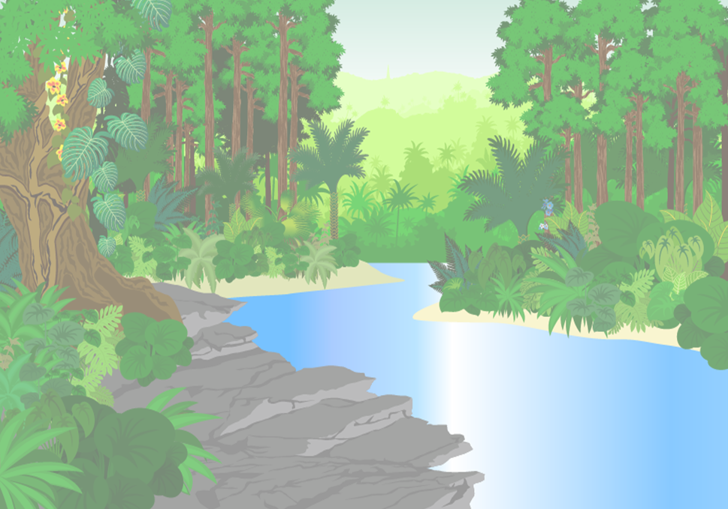
Use the clues to add arrows and complete the food web.
Food
web
SS2a
Eagle
Bat
Adult mosquito (male)
Adult mosquito (female)
Sloth
Human
Crocodile
Orchid
Tree
Frog
Catfish
Algae
Mosquito larvae

Slide 9
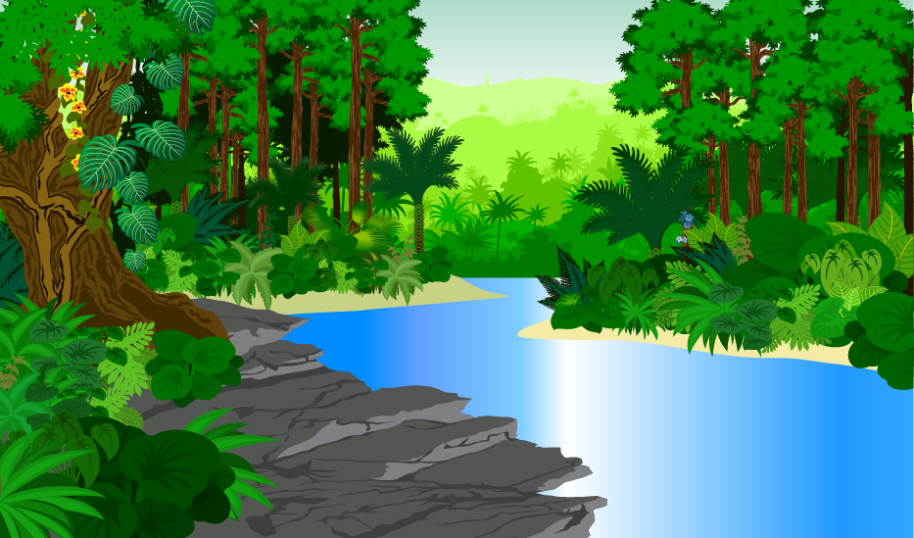
Use the clues to add arrows and complete the food web.
Food
web
SS2a
Eagle
Bat
Adult mosquito (male)
Adult mosquito (female)
Sloth
Human
Crocodile
Orchid
Frog
Catfish
Tree
Algae
Mosquito larvae

Slide 10


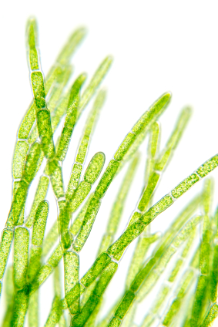
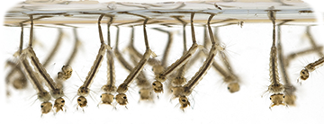
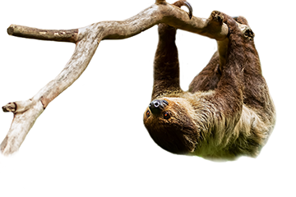
Food web game cards a
SS3a
Tree
Orchid
Level 1: Producer
Level 1: Producer
Algae
Mosquito larva
Level 1: Producer
Level 2: Primary consumer
Male mosquito
Sloth
Level 2: Primary consumer
Level 2: Primary consumer

Slide 11
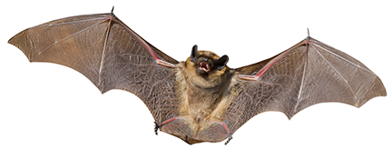
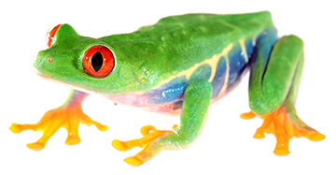
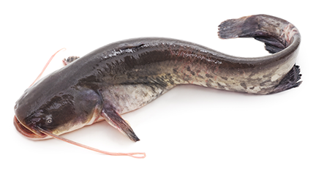
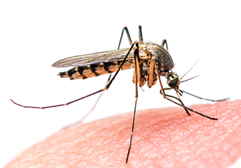
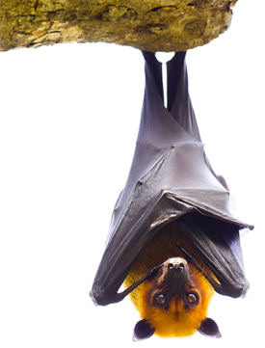
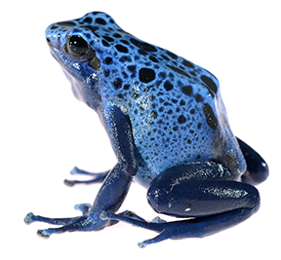
Food web game cards b
SS3b
Bat
Frog
Level 3: Secondary consumer
Level 3: Secondary consumer
Catfish
Female mosquito
Level 3: Secondary consumer
Bat
Frog
Level 2: Secondary consumer
Level 3: Secondary consumer

Slide 12
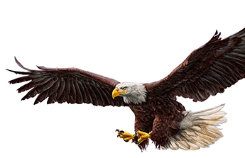

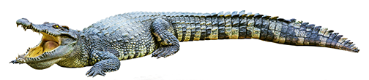
Food web game cards c
SS3c
Catfish
Female mosquito
Level 3: Secondary consumer
Human
Eagle
Level 4: Tertiary consumer
Level 4: Tertiary consumer
Crocodile
Level 4: Tertiary consumer

Slide 13

Get students talking and thinking

Slide 14














Equipping the Next Generation for Active Engagement in Science
TRACES

