Slide 1

Equipping the Next Generation for Active Engagement in Science
Exterminate
Communication

Slide 2
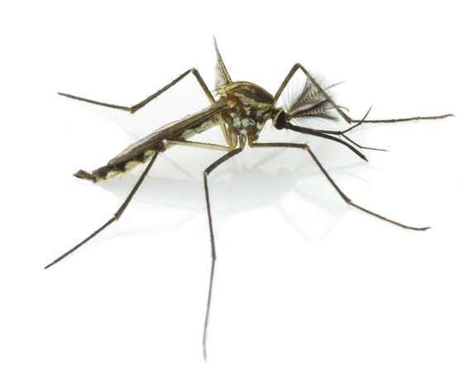



Should we exterminate mosquitoes?
Communicate your opinion to an audience.
Discuss and decide your:
Audience
Is it adults or children?
Do they live in the UK
or a country which has
diseases spread by mosquitoes?
Form of communication
What would be best? A vlog, speech, newspaper article or something else?
Notes:
Guide students through how to decide the audience they will be writing for and form of communication to use. This would best be completed as small group discussions which feed into a class discussion.

Slide 3

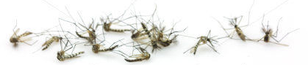
SS1-4
Your communication should include:
A scientific explanation
Design an infographic to explain how GM mosquitoes could exterminate dangerous ones.
Opinion and evidence
State what your opinion is. Support this using ideas based on the evidence you collected.
Use the Communicate ideas thinking guide
to help you plan.
3
3
Notes:
To plan their communication, students can use the information they have gathered on the KWHL grid to write down ideas on post-it notes. Each idea should support their opinion and be supported by evidence. Students can use SS1 to organise their ideas. They place all their ideas around the outside, and then move the ones that are best supported by evidence into the middle. These are the ideas that they should choose to use in their communication. Students can be supported further in organising their opinion by using the Justify opinions thinking guide (SS2) and in writing their communication using the Communicate ideas thinking guide (SS3).
The communication should include an infographic to explain more about GM mosquitoes (SS4). You may wish to share some examples of other infographics from the internet to help students design their own.
Invite students to present their communication to the rest of the class.
Now that students have been presented with opinions of different viewpoints, you can then ask students to make a decision about what they think and vote whether they think mosquitoes should be exterminated.
You can share their decision and compare it with other classes by completing the poll on the Exterminate page on the Engage website.

Slide 4

Student sheets
Exterminate
Communication
Sheet no. | Title | Notes
SS1 | Ideas frame | Reusable, one per student
SS2 | Justify opinions thinking guide | Consumable, one per student
SS3 | Communicate ideas thinking guide | Consumable, one per student
SS4a | GM mosquitoes infographic | Consumable, one per student
SS4b | Infographic images | Consumable, one per student

Slide 5

SS1
ideas
ideas
ideas
ideas
Ideas based on stronger evidence
ideas
ideas
ideas
Top ideas
ideas
ideas
ideas
Ideas based on stronger evidence
ideas
ideas
ideas
ideas
ideas

Slide 6
SS2
Justify opinions
The dilemma/issue is:
My opinion is:
Another opinion is:
Main idea:
Evidence to support this:
This evidence does not support this opinion because...
Another idea:
Evidence:
Another idea:
Evidence:

Slide 7
SS3
Communicate ideas
Checklist for effective communication
Planning your communication
Use the boxes to plan an outline.
Place one paragraph or scene in each box.
Have you made it clear?
Does the style fit your
purpose and audience?
Is it easy to understand?
1
2
Have you made it concrete?
Does it include examples?
Have you used vivid words?
3
4
Have you made it correct?
Have you included
scientific explanations?
Have you used and explained the science words?
5
6
Have you made it coherent?
Does each scene or paragraph make one main point?
Are they in a logical order?
Are they linked together?

Slide 8
SS4a
GM mosquitoes infographic
● Explain more about GM mosquitoes ● Cut out and use the infographic images ● Add your own text
How mosquitoes spread diseases
How GM mosquitoes are produced
The life cycle of a mosquito
What makes them different to normal mosquitoes
How GM mosquitoes could exterminate dangerous ones

Slide 9
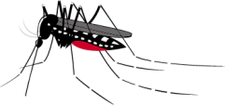

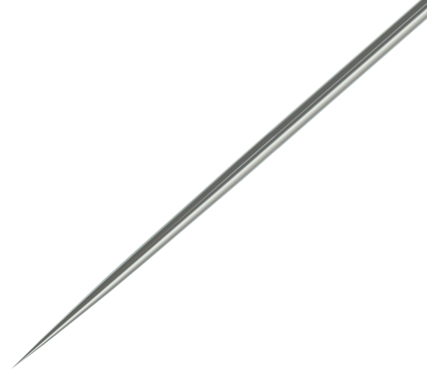

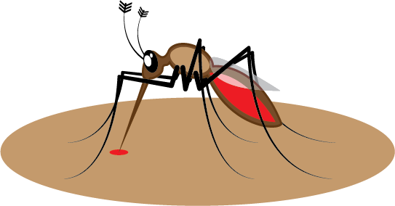


SS4b
Infographic images

Slide 10

Get students talking and thinking

Slide 11














Equipping the Next Generation for Active Engagement in Science
TRACES

