Slide 1

Equipping the Next Generation for Active Engagement in Science
eco-phone

Slide 2


Learning objectives
Earth resources
Explain why the recycling of some materials is particularly important
Use the skills of
Interrogate sources, critique claims, analyse patterns, consider consequences and communicate ideas
Big Idea
Working Scientifically
Notes:
The objectives for the lesson.

Slide 3
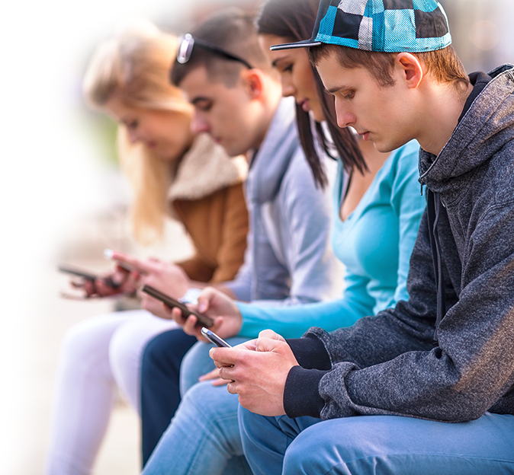
Could you
live without
your phone?
Soon,
you might have to.
3
Notes:
Ask students to suggest why they might have to live without smartphones in future.

Slide 4
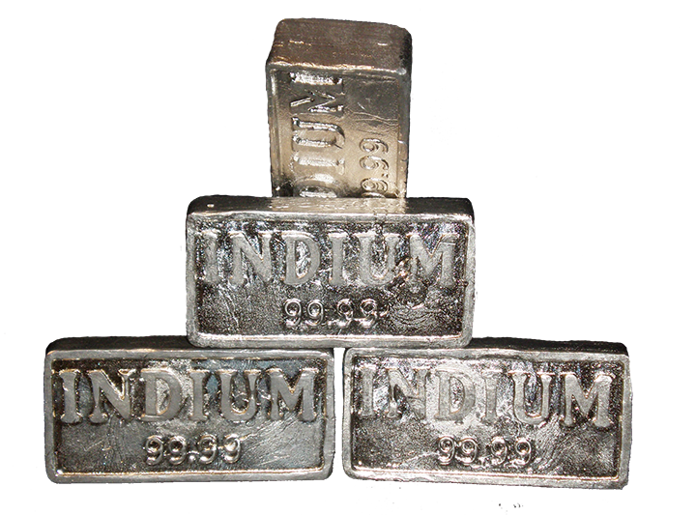
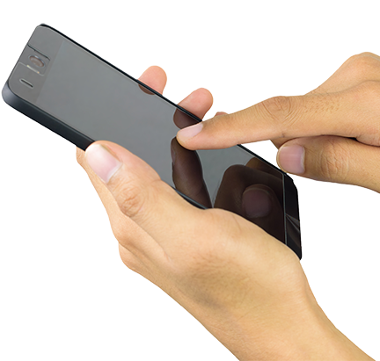
Supplies of vital elements used in smartphones...
like indium
in touch screens
© Wikimedia
... are at risk of running out.
Notes:
One reason why students might one day have to live without smartphones.

Slide 5
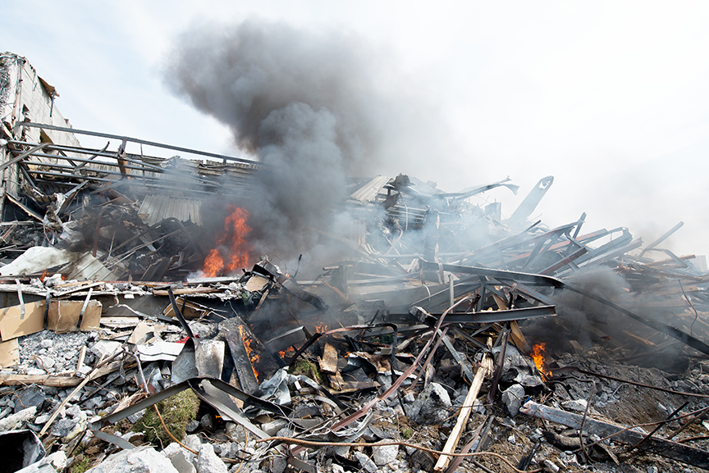
And some phone elements are so harmful to people and the environment...
...that they
might be
banned.
5
Notes:
A second reason why students might one day have to live without smartphones. For example, when electrical equipment is recycled in places such as Agbogbloshie, Ghana, the plastic of cables is burnt off to reveal the cables beneath. Burning the cables produces dioxin gas, which is carcinogenic.

Slide 6

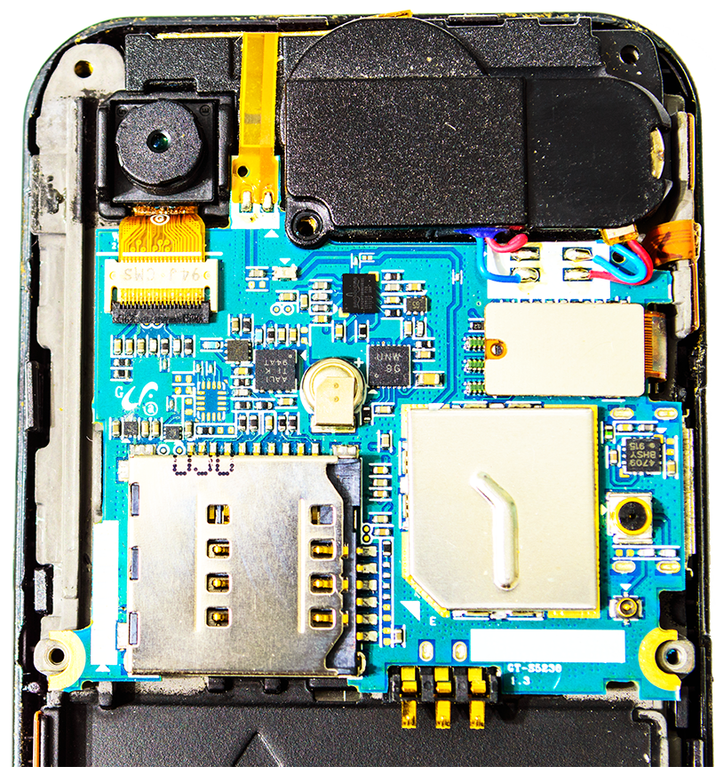

SS1– 3d
What are the
consequences of mining, using and disposing of
the 40+ elements
in your phone?
Play
Materials
Quest
to find out.
Notes:
Ask students to briefly discuss their prior knowledge in answer to this question.
Then introduce the Materials Quest game, and organise groups of four to play the game, following the instructions on SS2 and using the game board (SS1) and cards (SS3a-d).
Following the game, lead a discussion about issues arising from the game, using prompts such as:
Will smartphone materials run out?
What are the impacts of extracting and processing smartphone materials?
What are the impacts of disposing of mobile phones?
What are the advantages and disadvantages of recycling smartphones?
What solutions to the problem can they suggest?

Slide 7



SS4– 7
What are the consequences to people, the environment and money of not changing how we make, use and dispose of smartphones?
Play ‘a game of consequences’ to build on your learning from:
Materials
Work in a group of 3.
Cut out the blank cards (SS4)
Read the rules (SS5)
Play the game on the board.
Use ideas from SS7 to help you. (SS6 and 7)
Quest
Notes:
Students then play a game of consequences using SS4-7.
This will help them to summarise some of the problematic consequences associated with continuing to make and dispose of smartphones without making changes (business-as-usual).

Slide 8

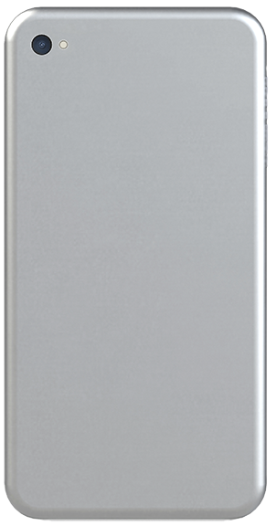
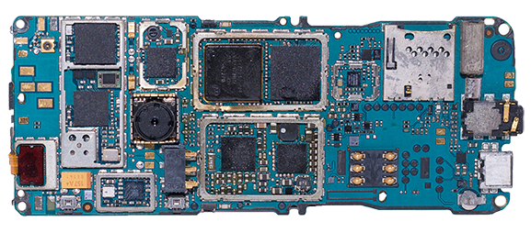
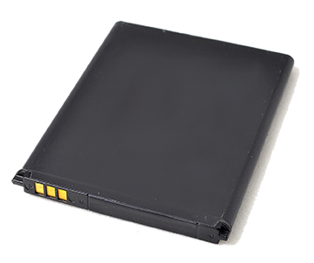
Can you convince phone manufactures to make eco-friendly phones?
Which phone parts can be made from new materials?
Choose which to research:
      the casing
      the battery
      the circuit
      board support
Notes:
The question that students will be investigating .
Point out that, in order to convince manufacturers, they will need more information.
Lead a brief discussion to elicit in outline what they might need to find out about making eco-friendly smartphones, focussing on using sustainable materials to make individual parts.

Slide 9

SS8
Can you convince phone manufactures to make eco-friendly phones?
First, set up the questions that will guide your research.
Use one KWHL grid for each phone part.
K
What I already Know
Write down the properties that a material for this phone part must have.
W
What I Want to know
Discuss the questions that will help you to find out what you need to know.
Notes:
Give students a copy of the KWHL grid (SS8) and talk through how to use it using this slide and the next slide.
Students choose one smartphone part to focus on (the casing, the battery, or the circuit board support) and work alone to fill in the K section on SS8 – this is what they know about the properties that this smartphone part must have.
They then discuss in pairs possible questions to help guide their enquiry (the W section). Ask pairs for feedback and come to a class decision on the questions that would be most useful. Suggestions for suitable questions are:
Which alternative material that scientists are investigating has these properties?
How is this material obtained?
What are the impacts on health and the environment of obtaining this material?
Is the material renewable?
What are the impacts of disposing of the material?
How acceptable will the material be to consumers?
When will the material be ready to use in smartphones?
Students then copy the questions into the W column of their grid.

Slide 10
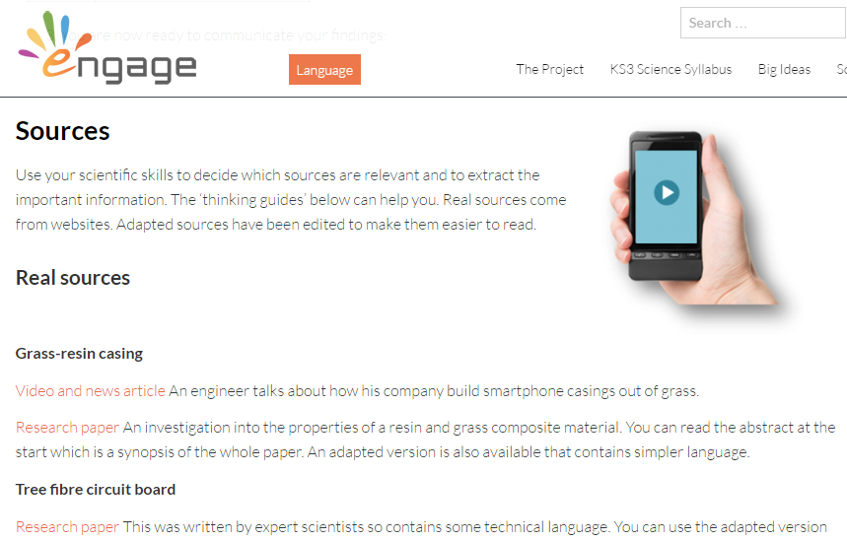
SS
Later, you will add in the sources you will use and what you have learnt from them.
H
How I will find out Which source(s) you use
L
What I have Learnt
Notes:
Explain that they will fill in the H and L columns later.
Clicking on the image of the Engage webpage will take you to where students will access the sources.
Show them the different sources: real ones, adapted ones and thinking guides.
Explore a few of the sources so students see the range available.
Explain that most students should use the adapted sources but some may look at the real ones as well.
The thinking guides are to help them to analyse the sources.

Slide 11


Finally, you will use what you have learnt to communicate
your decision to an audience.
Notes:
Tell students that this is what they will do when they have completed their research.

Slide 12

Student sheets
eco-phone
Sheet no. | Title | Notes
SS1 | Materials Quest game board | Enlarge to A3 Reusable, one per group of 4
SS2 | Materials Quest rules | Reusable, one per group of 4
SS3a – 3d | Materials Quest game cards | Cut into cards. Reusable, one per group of 4
SS4 | Consequences game cards | Disposable One per group of 3
SS5 | Consequences game rules | Reusable One per group of 3
SS6 | A game of consequences | Enlarge to A3 Reusable, one per group of 3
SS7 | People, money, environment | Reusable One per group of 3
SS8 | KWHL grid | Consumable One per student or pair of students

Slide 13
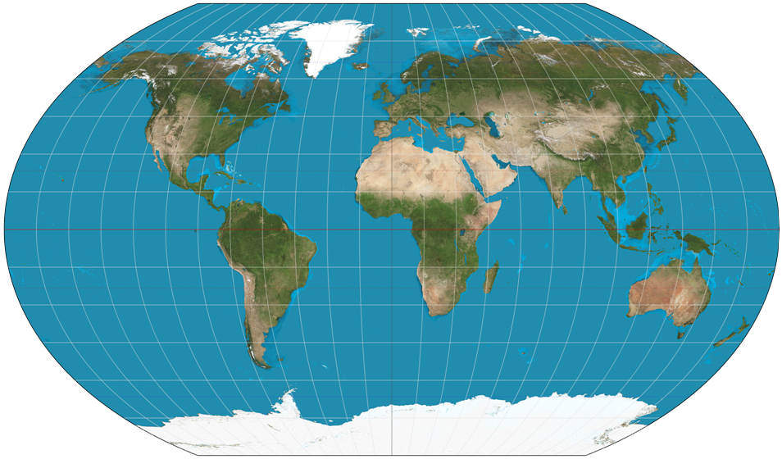
SS1
Electronic waste recycling centre in Europe
Electronic waste recycling centre in Europe
Materials
Oil well in Saudi Arabia
Copper mine in China
Quest
Zinc mine in Canada, with small amounts of indium
Lithium mine in Chile
Gold mine in South Africa
Aluminium mine in Australia

Slide 14
SS2
SS2
Materials
Rules of the Game
Materials
Rules of the Game
Quest
Quest
The object of the game is to collect 6 Materials Quest cards, including one from each mine, as well as one card from either the oil well or the recycling centre.
You collect cards by moving around the board and answering the questions on the cards when you get to a yellow square. For some questions, you will need to guess the answer.
Set up
1 Place the cards in their mines, oil well, or recycling centre, face down.
2 Place your counter on a yellow square of your choice.
How to play
1 The player on the right of the youngest player picks up
the top card from the pile nearest the youngest player’s counter, and reads out the question. The youngest player answers the question. If their answer is correct they keep
the card. If their answer is wrong they put it back, under
the pile.
2 Repeat step 1 for all players.
3 The youngest player rolls the dice. They move the number of squares shown, in any direction, towards a yellow square. If they land on a yellow square they pick up a card and, without looking at it, hand it to the player on their right. Continue as in number 1, above.
4 Repeat step 3 for all players until one player has six cards (see object of the game, above). This player is the winner.
5 Continue until all the cards are collected.
The object of the game is to collect 6 Materials Quest cards, including one from each mine, as well as one card from either the oil well or the recycling centre.
You collect cards by moving around the board and answering the questions on the cards when you get to a yellow square. For some questions, you will need to guess the answer.
Set up
1 Place the cards in their mines, oil well, or recycling centre, face down.
2 Place your counter on a yellow square of your choice.
How to play
1 The player on the right of the youngest player picks up
the top card from the pile nearest the youngest player’s counter, and reads out the question. The youngest player answers the question. If their answer is correct they keep
the card. If their answer is wrong they put it back, under
the pile.
2 Repeat step 1 for all players.
3 The youngest player rolls the dice. They move the number of squares shown, in any direction, towards a yellow square. If they land on a yellow square they pick up a card and, without looking at it, hand it to the player on their right. Continue as in number 1, above.
4 Repeat step 3 for all players until one player has six cards (see object of the game, above). This player is the winner.
5 Continue until all the cards are collected.

Slide 15
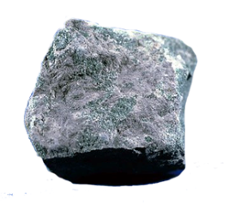
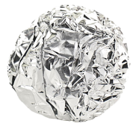
Materials Quest cards – A
SS3a
1
2
3
Lithium
Lithium
Lithium
In Chile, lithium
compounds are found dissolved in water. How is the water removed?
A Filtering
B Chromatography
C Evaporation
Where in a phone
is lithium found?
A In the battery
B In the circuit board
C In the case
Lithium metal is extracted from lithium chloride. How?
A By heating with carbon
B By electrolysis
C By burning
Li
Li
Li
4
Lithium
5
6
Aluminium
Aluminium
When aluminium oxide
is separated from the other materials in its ore, red mud waste is made. Which one statement about red mud waste is not true?
A It is alkaline.
B In rivers, it kills fish.
C Its pH is 7.
D Crops cannot
grow on it.
Why is aluminium used to make some phone casings? Choose two answers.
A It is a good conductor
of electricity.
B It has a low density.
C It is a good conductor
of heat.
D It bends.
Worldwide, what percentage of lithium phone batteries are recycled?
A 10%
B 50%
C 100%
Li
Al
Al
Notes:
Reference for 4 Graedel et al Criticality of metals and metalloids PNAS April 7, 2015 4257-4262 Supplementary information

Slide 16
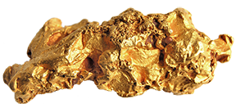
Materials Quest cards – B
SS3b
7
8
9
Aluminium
Aluminium
Gold
Which requires more energy?
A Using electricity to extract aluminium from aluminium oxide.
B Recycling aluminium cans.
Why is gold used in phone circuit boards?
Choose two reasons.
A It looks good.
B It is a good conductor of electricity.
C It does not corrode.
D It is expensive.
Which produces
less carbon dioxide?
A Using electricity to extract aluminium from aluminium oxide.
B Recycling
aluminium cans.
Al
Al
Au
10
Gold
11
12
Gold
Gold
In one tonne of gold ore there is 1 g of gold. What is the mass of gold in one tonne of old mobile phones?
A 0.3 g
B 3 g
C 30 g
D 300 g
Which one of these hazards is not linked to gold mining?
A Sulfuric acid enters rivers when mines are drained.
B Freshly mined gold is corrosive.
C Sodium cyanide solution is used to extract gold from its ore. Spilt cyanide is
toxic to humans
and fish.
A typical phone contains
0.03 g of gold. How much can you sell this gold for?
A About 10 cents.
B About 1 euro.
C About 10 euros.
Au
Au
Au

Slide 17
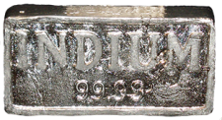
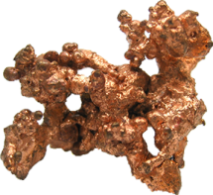
Materials Quest cards – c
SS3c
13
14
15
Indium
Indium
Indium
Why is indium tin oxide used
in phone screens? Choose two reasons.
A It conducts electricity.
B It is toxic to mammals
if eaten.
C It is transparent.
D Its density is
7 g/cm³.
Most indium is found mixed with zinc ores. Why might this be a problem?
A If companies demand less zinc in future, supplies of indium might fall.
B If companies demand
more zinc in future,
supplies of indium
might fall.
Why is China keeping big supplies of indium? Choose two possible reasons.
A In case its price goes up.
B In case scientists discover
a better material for
phone screens.
C In case world
supplies run low.
In
In
In
16
Indium
17
18
Copper
Copper
If the same amount of indium is extracted every year as is extracted this year, when will known supplies run out?
A In 2030
B In 2050
C In 2100
Why is copper used
in recharger leads?
Choose two reasons.
A It conducts heat.
B It is orange.
C Its wires are bendy.
D It conducts
electricity.
Companies obtain copper from electric cables by stripping off the plastic coating. Why is this better than burning off the plastic?
A The copper has better properties.
B It does not make
toxic gases.
In
Cu
Cu

Slide 18


Materials Quest cards – D
SS3d
19
20
21
e-waste recycling centre
Copper
Copper
In some places, people obtain copper by burning the plastic off old electric cables. This makes dioxins. Which statement is false?
A Dioxins are highly toxic.
B Dioxins cause cancer.
C Dioxins damage
hormones.
D Dioxins cannot
enter plants.
Which makes less waste?
A Recycling used copper.
B Getting copper from its minerals by heating with carbon.
In the EU in 2014, how much electronic waste (including large appliances) was disposed of, per person?
A 16 g
B 16 kg
C 16 tonnes
Cu
Cu
22
Plastic
23
24
e-waste recycling centre
Plastic
Why are scientists
looking for alternatives
to plastic for phone casings?
A Plastics are made from a non-renewable material.
B There is no plastic with suitable properties for phone casings.
Plastics in phones are made from which raw material?
A Oil
B Wood
C Plastic ore
In the EU in 2014, what percentage of electronic waste was recycled in official schemes?
A 1%
B 12%
C 40%

Slide 19

SS4
Consequences game cards

Slide 20
SS5
Consequences game rules
You will need:
A game of consequences board
Blank cards cut up
A consequence is an action that has an effect that can be negative or positive
Red and green pen/pencil
3 players
Instructions
1 Write the action (not changing how
we make, use and dispose of smartphones) on the large card
and place in the centre of the board.
2 Place the other cards in a pile.
3 The first player thinks of one consequence of the action and shares it with the other players. If they agree that it is a consequence then the player takes a small card from the pile and writes on the consequence along with their initials. This is placed on one of the boxes marked with a 1. Take it in turns so all the ‘1’ boxes are filled up.
4 Now, you must fill up the boxes marked
with a 2 only. These are consequences
of the suggestions in the ‘1’ boxes.
5 Continue until all the ‘2’ boxes are filled.
Then move onto the ‘3’ boxes.
6 When all boxes are filled, go through each
of the ‘2’ and ‘3’ boxes and decide if it is
a negative or positive consequence
(some might be both). Mark all the negative consequences with the red pen and positive with the green pen.
7 Then, count up how many consequences
are negative and how many are positive.

Slide 21
SS6
A game of consequences
3
2
2
3
1
3
3
Action
2
1
1
2
2
3
3
2

Slide 22
SS7
SS7
People, money, environment
People, money, environment
Consider people
Consider people
Identify groups who could
be affected by the action
Describe how each group
could benefit or be harmed
Predict the views that different
groups will take on the action
Describe how the issue could affect you
Identify groups who could
be affected by the action
Describe how each group
could benefit or be harmed
Predict the views that different
groups will take on the action
Describe how the issue could affect you
Consider money
Consider money
Identify individuals or organisations who
may gain or lose money from the action
Describe how it would affect
each group financially
Identify individuals or organisations who
may gain or lose money from the action
Describe how it would affect
each group financially
Consider the environment
Consider the environment
Identify possible consequences to particular habitats
Describe possible consequences to
animals dependent on these habitats
Describe possible consequences
to local air quality
Describe potential impacts further afield
Identify possible consequences to particular habitats
Describe possible consequences to
animals dependent on these habitats
Describe possible consequences
to local air quality
Describe potential impacts further afield

Slide 23
SS8
KWHL Grid
The phone part I want to find a new material for is the casing / circuit board support / battery.
What I already Know The material for this phone part must have these properties:
What I Want to know about new materials for this phone part | How I will find out | What I have Learnt

Slide 24

Get students talking and thinking

Slide 25














Equipping the Next Generation for Active Engagement in Science
TRACES

