Slide 1

Equipping the Next Generation for Active Engagement in Science
Electronic cigarettes(2 of 2)

Slide 2
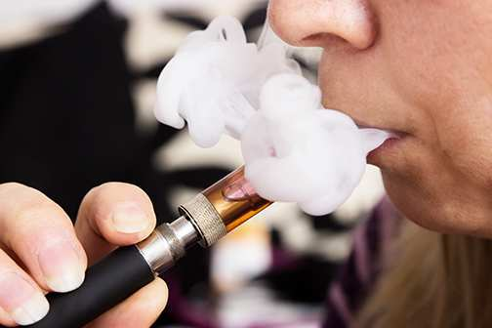
Will you support a European ban on indoor vaping in public places?
2
Engage
Play
Decide
Notes:
Remind students of the dilemma question from the last lesson, as well as the results of the class decision about the question ‘Can nicotine from vaping get to people nearby?’ (to which the answer should be ‘yes.’)

Slide 3
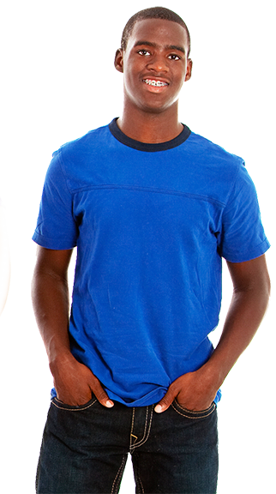

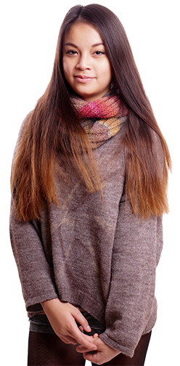
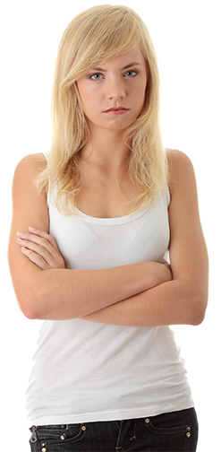
A ban on indoor vaping in public places has risks and benefits
No one will be exposed to nicotine at work.
People will vape more at home. So children will be exposed to more nicotine.
Fewer people will get heart disease.
If people have to go outside to vape, they might as well smoke instead.
So more people will get lung cancer.
3
Engage
Play
Decide
Notes:
Remind students that the EU is considering a ban on indoor vaping in public places, and allow students to read some of the risks and benefits given on this slide.

Slide 4






It is difficult to make
sense of risks and benefits.
We need to quantify the risks
and benefits, and weigh them up.
risk
risk
benefit
risk
benefit
risk
Engage
Play
Decide
Notes:
Point out that it is difficult to make sense of risks and benefits, and that we need to quantify them and then weigh them up in order to make a decision.

Slide 5

How are you going to make a decision?
Lesson 1
Lesson 2
Is there scientific evidence that nicotine from vaping can get to people nearby?
Are the benefits of banning indoor vaping in public places worth the risks?
Engage
Review
Consider
Notes:
This slide reminds students that they used scientific evidence in lesson 1 to answer the question in blue, and informs them that they will judge risks in lesson 2 in order to make a decision about the dilemma question.

Slide 6


In these lessons you will :
Lesson 1
Draw before and after diagrams
of particles to explain observations
Weigh up risks and benefits
to make a decision
Particles
Lesson 2
Judge risks
Big Idea
Working Scientifically

Slide 7



SS1
Now play WhizzQuiz to learn how to quantify risks and benefits, and how
to weigh them up.
After each round, write your score, and what you learnt about risk, on SS1.
WhizzQuiz
Engage
Play
Decide
Notes:
This introduces a quiz-style game in which students learn how to quantify risks and weigh them up. Students need copies of SS1 on which to record their learning after each round.

Slide 8

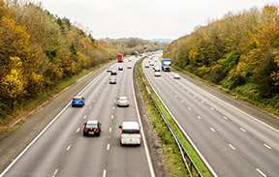
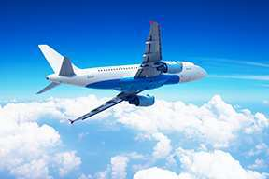
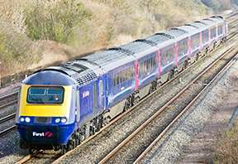
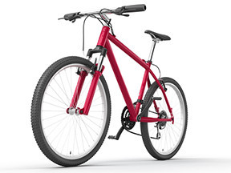
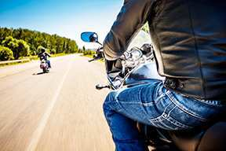
WhizzQuiz
Round 1
Which method of transport has the lowest risk of death?
Engage
Play
Decide

Slide 9

WhizzQuiz
Round 1 answers
Transport | Chance of dying per 10 billion km travelled | Your score
aeroplane 25 4
bicycle 365 2
car 24 4
motorbike 998 0
train 2 5
To compare risks you need numbers and units.
9
Engage
Play
Decide
Notes:
Make the point that you can quantify risks by looking at how frequently death occurs in a large population over a given time or distance.

Slide 10

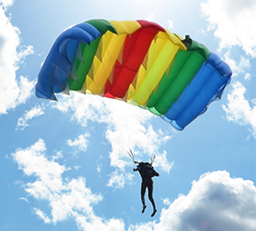
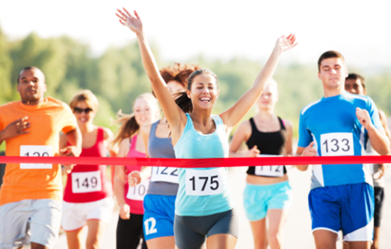
WhizzQuiz
Round 2
Which has the lower risk of death?
A parachute jump
Running a marathon
Engage
Play
Decide

Slide 11
WhizzQuiz
Round 2 answers
How you feel about a risk might not be the same as the real risk.
Activity | Chance of dying per event
Score 5 if you said the risks are similar.
parachute
jump
8 in a million
running a marathon
If not, score 0.
8 in a million
Familiar things
feel less risky than unfamiliar things.
Engage
Play
Decide
Notes:
Make the point that how you feel about a risk – the perceived risk – might be different from the real risk. Since students are familiar with running they are likely to say that the parachute jump is more risky. In fact, out of every million marathon runners, 8 people die, and out of every million parachute jumps 8 people die.

Slide 12
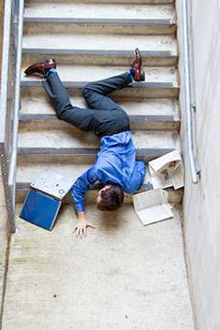
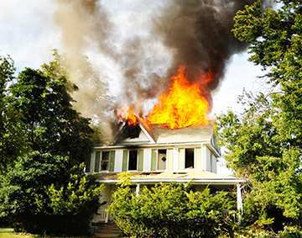
WhizzQuiz
Round 3
Which is a person
less likely to die from?
The effects of fires
Falling over
Engage
Play
Decide

Slide 13

WhizzQuiz
Round 3 answers
Again, how risky you think something
is might be different from the real risk.
Activity | Number of deaths in UK in 2009 | Your score
fires 279 5
falls 3593 0
Media reports might affect how risky you think something is.
House fire kills mum and twin sons, aged 4
Engage
Play
Decide
Notes:
Again, the real risk is often different from the perceived risk. In this case, media reporting is likely to encourage people to think that they are more likely to die in a house fire than from a fall.

Slide 14

WhizzQuiz
Round 4
The consequences of
risk-taking include death...
... but there are other consequences too.
Choose a sensible square on the grid for each activity.
G | H | I
D | E | F
A | B | C
Activity 1
Falling off your bike
on a quiet cycle path.
Activity 2
Falling off your bike on
a muddy path going down a mountain.
Seriousness of consequences if it did happen
Activity 3
Falling off your bike on
a busy city road with
lots of lorries.
increasing chance of it happening
(likelihood of risk)
14
Engage
Play
Decide
Notes:
This slide guides students in thinking about both the seriousness and likelihood of risks.

Slide 15
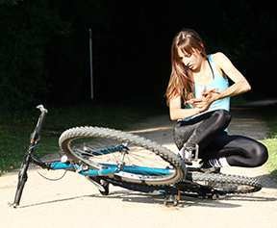
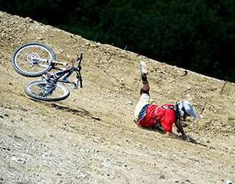
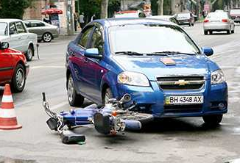
WhizzQuiz
Round 4 answer
Score 1 mark for every sensible placement on the grid.
Low likelihood, low seriousness.
A
High likelihood, medium seriousness.
F
Medium likelihood, high seriousness. H
You can estimate the size
of a risk by combining its likelihood and its seriousness.
15
Engage
Play
Decide
Notes:
Make the point that both the likelihood and seriousness of a risk are important in judging risks.

Slide 16
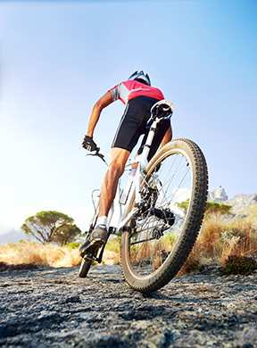
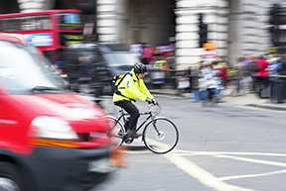
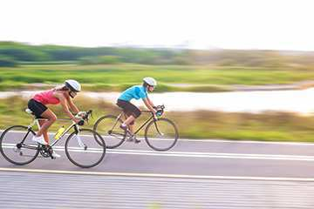
WhizzQuiz
Round 5
Every year, around 100 cyclists die in collisions in the UK.
Why do people risk cycling?
Think of five reasons.
16
Engage
Play
Decide

Slide 17
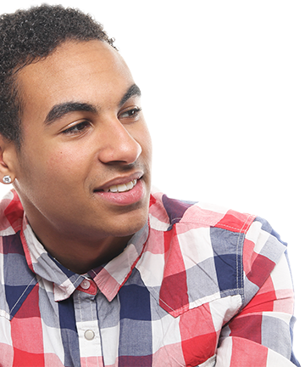
WhizzQuiz
Round 5 answers
Score one point for every sensible reason, up to a maximum of 5 points.
To relax at the end of the day.
To feel the adrenaline rush.
To keep fit.
To get to school.
There are many reasons
for doing risky activities.
These are benefits.
My friends do it.
Engage
Play
Decide
Notes:
Point out that people do risky activities because of the benefits of the activities. Of course there are many reasons for choosing to cycle in addition to those listed here.

Slide 18
WhizzQuiz
More on round 5
You can estimate
the size of a benefit by combining its likelihood and how good it is.
Then weigh up the risks and benefits.
And now,
good bye from WhizzQuiz!
Engage
Play
Decide
Notes:
Point out that for benefits, as for risks, you can estimate the size of a benefit by combining its likelihood with how good it is.

Slide 19


SS2 and 3
Back to the big question...
Will you support a European ban
on indoor vaping in public places?
  1 Decide whether each card describes
  a risk, a benefit, or neither
  2 Estimate the seriousness of each risk
  and benefit (score 1, 2 or 3).
  3 Estimate the likelihood of each risk
  and benefit happening (score 1, 2 or 3)
  4 Multiply likelihood x seriousness to decide how big each risk and benefit is.
  5 Add up the scores for the risks
  and for the benefits.
  6 Compare the totals and decide.
Engage
Play
Decide
Notes:
Students follow the instructions here to estimate the size of the risks and benefits of a ban on indoor vaping in public places. They need cards cut from SS2 and the grid on SS3. There is no ‘correct score’ for each benefit and risk on SS2. Students need to make judgements and choose reasonable scores for each one.
The table at the bottom of SS3 is for students to work out the total scores for risks and benefits in order to be able to compare them.

Slide 20

SS2
I support / do not
support the ban.
Will you support a European ban on indoor vaping in public places?
The benefits of the ban are
The risks of the ban are
Overall, I think that the risks/benefits outweigh
the risks/benefits because
20
Engage
Play
Decide
Notes:
Student groups then vote with their feet by deciding where to stand along a continuum, in which one end of the room represents ‘strongly agree with a ban’ and the other end represents ‘strongly disagree with a ban.’ Do not allow students to stand in the middle.
With the students standing in position, lead a discussion. We recommend getting students to present and justify their viewpoints by following this structure:
State your opinion
Present your evidence (science, judging risk)
Explain your reasoning (how the evidence supports your opinion)
Students then write their own responses to this task. Finish with another show of hands - has anyone changed their opinion since the beginning of lesson 1 or lesson 2? If so, what has made them think differently?

Slide 21

Student sheets
Electronic cigarettes
Sheet no. | Title | Notes
SS1 | Risk WhizzQuiz | Consumable, one per student
SS2 | Risks and benefits of a ban on indoor vaping in public places | Reusable, cut into cards, one set per group
SS3 | Weighing up risks and benefits | Consumable, one set per group

Slide 22
WhizzQuiz
SS1
Risk
Round | Score | What I learnt about risk
1
2
3
4
5

Slide 23
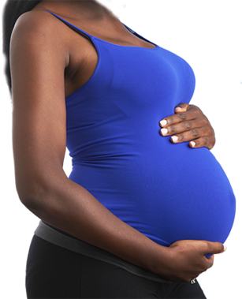
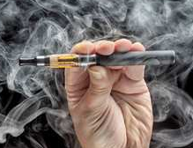
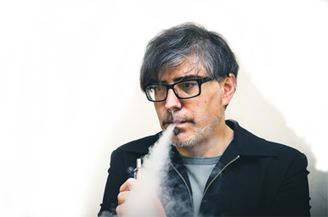
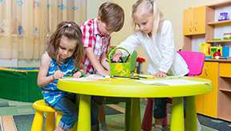
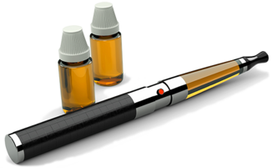
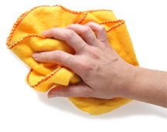

Risks and benefits of a ban on indoor vaping in public places
SS2
A | B | C
D | E | F
If people have to go outside to vape, they might as well smoke cigarettes instead. So it is possible that more people will
get lung cancer.
Since nicotine damages foetal brains, fewer babies will be born
with brain
damage.
People might vape more at home. So children might be exposed to more nicotine.
Foetal brain damage reported in
paper in the journal Nature
Lung cancer
risk of smoking reported by
the NHS
A ban might make people think that the risks of smoking and vaping are the same. This makes smokers less likely to use
e-cigarettes to help them quit smoking.
Exhaled nicotine remains on surfaces for many months. Other people can absorb this nicotine through their skin.
The concentration of nicotine in the blood of passive vapers is similar to that of passive smokers.
Association
of e-cigarette manufacturers
Priscilla Callahan-Lyon in the British Medical Journal
Reported by the World Health Organisation

Slide 24
SS3
Weighing up risks and benefits
Statement | A
Risk or benefit?
Seriousness of risk / size of benefit | 1 2 3
Likelihood of it happening | 1 2 3
risk x benefit
Statement | B
Risk or benefit?
Seriousness of risk / size of benefit | 1 2 3
Likelihood of it happening | 1 2 3
risk x benefit
Statement | C
Risk or benefit?
Seriousness of risk / size of benefit | 1 2 3
Likelihood of it happening | 1 2 3
risk x benefit
Statement | D
Risk or benefit?
Seriousness of risk / size of benefit | 1 2 3
Likelihood of it happening | 1 2 3
risk x benefit
Statement | E
Risk or benefit?
Seriousness of risk / size of benefit | 1 2 3
Likelihood of it happening | 1 2 3
risk x benefit
Statement | F
Risk or benefit?
Seriousness of risk / size of benefit | 1 2 3
Likelihood of it happening | 1 2 3
risk x benefit
Total scores for risks and benefits
Scores for risks |  | total score for risks =
Scores for benefits |  | total score for benefits =

Slide 25
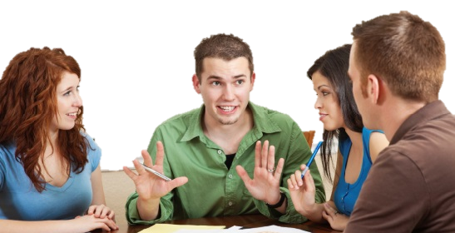
Get students talking and thinking

Slide 26














Equipping the Next Generation for Active Engagement in Science
TRACES

