Slide 1

Equipping the Next Generation for Active Engagement in Science
Electronic cigarettes(1 of 2)

Slide 2
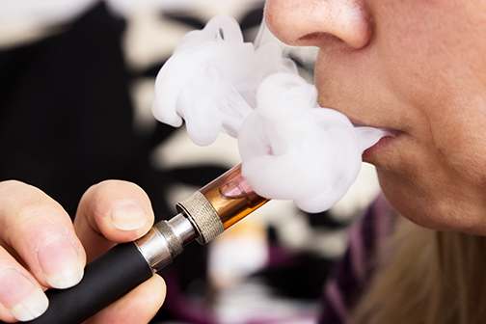

I would never smoke – it’s
far too risky.
But vaping is safe.
There’s no smoke, no tar
and so – I guess – no cancer.
Think I’ll give vaping a try. It won’t kill me.
Engage
Review
Consider
Notes:
Students discuss their initial responses – what do they know about vaping (smoking electronic cigarettes)? Is vaping safe?

Slide 3

Vaping is smoking electronic
cigarettes (e-cigarettes)
How an e-cigarette works
Solution of nicotine and other substances dissolved in propane-1,2,3-triol
heater
battery
1 The user inhales.
2 The heater switches on and warms the solution.
3 An aerosol forms.
It includes nicotine.
4 The user inhales the nicotine – just as in smoking.
Aerosol
A mixture of tiny liquid droplets
and/or pieces of solid mixed with a gas.
Engage
Review
Consider
Notes:
Point out that the cartridge in an e-cigarette is a solution of nicotine and other substances dissolved in a solvent such as propane-1,2,3-triol. The heater warms the solution, initially forming an aerosol, which the user inhales.

Slide 4







Nicotine
kills
Nicotine is addictive.
Addicts crave nicotine and need it to feel normal.
American Council on Science and Health
Nicotine damages the brain of a developing foetus.
Current neuropharmacology
Nicotine may be linked to cancers
of the lung, breast, liver and kidney.
Nature
Nicotine is linked to heart disease.
American Society
of Cell Biology
4
Engage
Review
Consider
Notes:
Point out the health impacts of one of the key ingredients of e-cigarettes, nicotine. (Nicotine-free e-cigarettes are also available.)

Slide 5




Turkey, Wales and parts of Canada have banned workplace vaping.
Now health campaigners want a Europe-wide ban.
Will you support a European ban
on indoor vaping in public places?
Passive vaping as risky as passive smoking, claims health charity.
Long-term risks of passive vaping not yet known, say scientists.
Engage
Review
Consider
Notes:
Tell students the key dilemma – should the EU follow the example of countries such as Turkey, Wales and parts of Canada, and ban indoor vaping in public places?

Slide 6

How are you going to make a decision?
Lesson 1
Lesson 2
Is there scientific evidence that nicotine from vaping can get to people nearby?
Are the benefits of banning indoor vaping in public places worth the risks?
Engage
Review
Consider
Notes:
This slide gives a breakdown of how students will use scientific evidence in lesson 1 and judge risks in lesson 2 to help them to make a decision.

Slide 7


In these lessons you will :
Lesson 1
Draw before and after diagrams
of particles to explain observations
Weigh up risks and benefits
to make a decision
Particles
Lesson 2
Judge risks
Big Idea
Working Scientifically

Slide 8


SS1-2
Can nicotine from vaping get to people nearby?
1 Read SS1 to find out about the particles in vaping
2 Draw and label particle diagrams on SS2 to show:
  the arrangement and behaviour of the particles in the solution.
  the arrangement and behaviour of the particles in the aerosol.
  how nicotine particles travel from a person who is vaping to people nearby.
Engage
Review
Consider
Notes:
The main task for the lesson is to use previous knowledge to work out whether nicotine from vaping can get to people nearby. Students read the information and behaviour of the particles in e-cigarette solution and in the exhaled aerosol on SS1. They also read about how nicotine particles diffuse. Students then work alone to translate the written information into particle diagrams using the keys given on SS2a and SS2b.
Students then peer evaluate each others’ work, suggesting improvements and coming to agreement about the features of a correct and high quality diagram.

Slide 9



SS1-2
Can nicotine from vaping get to people nearby?
Decide what you think about the question.
9
Engage
Review
Consider
Notes:
Students come to a decision. You might like to have a class vote, in which students have three options: yes – nearby people are likely to inhale lots of nicotine; yes – nearby people inhale a little nicotine; no – nicotine does not get to nearby people.

Slide 10

Student sheets
Electronic cigarettes
Sheet no. | Title | Notes
SS1 | Particles in vaping | Reusable, one per pair
SS2a and 2b | Particle diagrams | Consumable, one of for each for every student

Slide 11
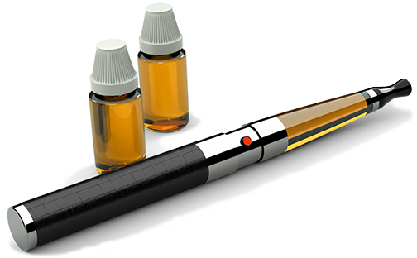
SS1
Particles and vaping
The solution
Moving around in the air
Solvent: propane-1,2,3-triol
Solutes: nicotine and water
The exhaled breath of an e-cigarette
user includes nicotine vapour.
The nicotine particles mix with the air.
The air is mainly nitrogen and oxygen. Nitrogen and oxygen particles are smaller and lighter than nicotine particles.
In the gas state, particles move randomly. They collide with each other frequently which makes them change direction.
The nicotine vapour spreads out from
a place where there are many nicotine particles to a place where there are fewer. In other words, they move from an area of high concentration to an area of low concentration. This is diffusion.
In the solution solvent particles surround solute particles.
There are more
solvent particles
than solute
particles.
The aerosol
The aerosol is tiny droplets of liquid water, liquid propane-1,2,3-triol, and liquid nicotine mixed with the air.
The air is mainly nitrogen and oxygen.

Slide 12
SS2a
Particle diagrams –1
Key
Particles in the aerosol
A droplet of liquid water (part of the aerosol)
nicotine particle
propane-1,2,3-triol particle
water particle
nitrogen particle
oxygen particle
Key
Particles in the solution
nicotine particle
propane-1,2,3-triol particle
water particle

Slide 13
SS2b
Particle diagrams – 2
Moving around in the air
1
2
3
Key
nicotine particle
oxygen particle
nitrogen particle

Slide 14

Get students talking and thinking

Slide 15














Equipping the Next Generation for Active Engagement in Science
TRACES

