Slide 1

Equipping the Next Generation for Active Engagement in Science
Animal Testing (2 of 2)

Slide 2
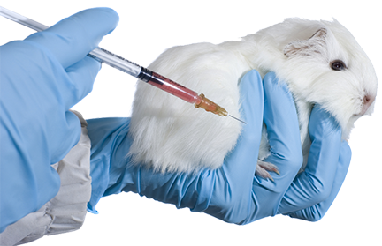


Say NO to animal testing in Europe
Test human drugs on humans
Will you sign the petition for a ban on all animal testing?
1.2 million votes for a ban – join us!
Take a stand for what’s right: Sign the petition
Engage
Play
Decide
Notes:
Review the dilemma. Ask students for a show of hands on how they would vote and ask if anyone has changed their mind after looking at the scientific evidence.

Slide 3

How are you going to make a decision?
Lesson 1
Lesson 2
Use scientific evidence
Use ethical thinking
to answer
to answer
Is animal testing essential to drug development?
Is animal testing
right or wrong?
Will you sign the petition?
Explain why.
Engage
Review
Consider
Notes:
Show the breakdown of how the students will use lesson 1 and 2 to help them to make a decision.

Slide 4


show how asthma affects the structure of the gas exchange system
learn 3 kinds of ethical thinking to make decisions:
– utilitarianism,
– rights and duties,
– virtues
In these lessons you will :
Lesson 1
Breathing
Lesson 2
Use ethics
Big Idea
Working Scientifically
Notes:
The objectives for this lesson.

Slide 5

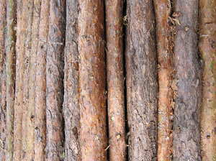

CASTAWAYS
Ethical thinking game
Two teams of strangers battle for survival
on a tropical island.
One by one, they will vote each other off until one castaway wins the grand prize.
5
Engage
Play
Decide
Notes:
Students are introduced to a new reality show that they are taking part in.

Slide 6



SS1
1.Utilitarianism
There are
3 kinds of ethical thinking about what’s right or wrong .
2. Rights and duties
3. Virtues
Choose 1, 2, or 3 to make your decisions on the island. Read about it on SS1.
See the outcome of each decision.
Discuss: How do you feel?
Did you make the right decision?
Talk in pairs
Engage
Play
Decide
Notes:
In the show, as in life, they will need to make difficult decisions but can use three kinds of thinking to help make them. Ask students to work in pairs. Each will need information on the three kinds of ethical thinking (SS1).

Slide 7

Day 5 on the Castaways island...
You are competing against a member of the other team in a blindfolded challenge. The winner receives extra food for their team.
Your blindfold slips so you are able to see.
Do you close your eyes?
YES
NO
Engage
Play
Decide
Notes:
Assign each pair one type of thinking to use and show the slides which contains the decisions. Pairs should make their decision based on what type of thinking they are assigned. The outcomes from each decision are shown. Compare the decisions made using different principles. Ask students if they feel happy with their choice now?

Slide 8

You lose the challenge.
Your hungry teammates are so angry that
they vote you off the island.
8
Engage
Play
Decide

Slide 9
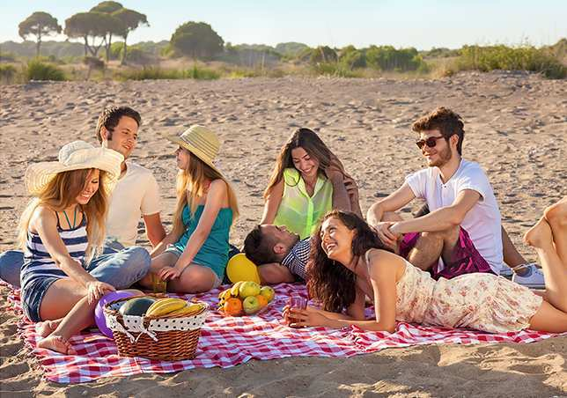
You win the challenge. You have a party with your teammates and get no votes that week.
9
Engage
Play
Decide

Slide 10
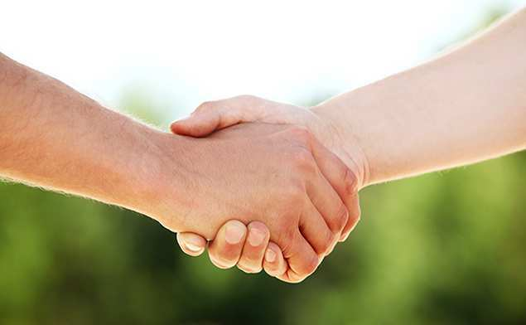
Day 12 on the Castaways island...
You promised a friend that you will never vote each other for elimination. However, they are being
lazy and not helping around the camp.
Do you vote them off?
YES
NO
10
Engage
Play
Decide

Slide 11
The rest of your
team find out you broke a promise.
They no longer trust you and vote you off
the island.
11
Engage
Play
Decide

Slide 12


Your friend apologises and starts helping out more. Their extra effort means you win the next team challenge
... a phone call home!
12
Engage
Play
Decide
Notes:
Discuss as a class that when making a decision it is not usually a case of just using one principle.

Slide 13

SS1-4
Debate the question:
Is animal testing right or wrong?
Read through the viewpoints on SS2.
Decide what type of ethical thinking is being used (there may be more than one) and if it is for or against a ban.
Discuss if you agree with the viewpoint or not.
Record the viewpoints in SS3.
Present them to the rest of the class.
Engage
Play
Decide
Notes:
Ask students to work in pairs or small groups. They read through the viewpoints on animal testing (SS2) and decide if it is for or against a ban on animal testing and what ethical thinking it is demonstrating. They record this information (SS3).
These viewpoints can now be used as a basis for a teacher-led class discussion or a specific format like a ‘Fishbowl’. If you use a class discussion, we recommend getting students to present and justify their viewpoints by following this structure:
State your opinion
Present your evidence (science, ethics)
Explain your reasoning (how the evidence supports your opinion)

Slide 14


SS4
Petition
for a ban
on animal testing
Will you sign?
Explain why
Name
Signature
Address
Engage
Play
Decide
Notes:
Students now consider the scientific evidence from lesson 1 and ethical thinking to come to a personal decision on whether they think animal testing should be banned. They should write down their decision with reasons. You may wish to provide sentence starters to support students. Finish with another show of hands - has anyone changed their opinion? If so, what has made you think differently?

Slide 15
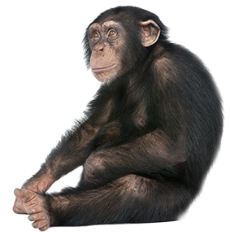
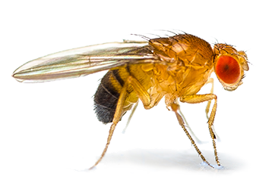
Would you make the
same decision about animal testing using:
fruit flies?
chimps?
Engage
Play
Decide
Notes:
In order to extend learning, ask students if they would make the same decision for animal testing on different species. They can discuss in their groups using the three kinds of ethical thinking to help them make a decision.

Slide 16

Student sheets
Animal testing
Sheet no. | Title | Notes
SS1 | 3 kinds of ethical thinking | Reusable, one per pair
SS2 | Animal testing viewpoints | Reusable, one per group
SS3 | Looking at the evidence | Consumable, enlarge to A3, one per group

Slide 17




SS1
3 kinds of Ethical thinking
Utilitarianism
Rights and duties
Virtues
‘Best consequence’
‘Follow rules’
‘’Be caring”
Base your decisions on rules which you believe should always be followed, like:
Do not worry about the outcome.
For each option, think about the consequences (what will happen) and how this will affect everyone.
Choose the option that provides the greatest happiness for the most people.
It is wrong to cause harm
It is wrong to steal
It is wrong to lie or cheat
It is right to keep promises
Make your decisions by taking into account other’s feelings.
Choose an outcome that is helpful for others.
Example: You are out with a group of friends. Your best friend turns up with
a new haircut which you think looks terrible. They ask you if you like it.
What do you say?
‘It looks great’
You decided that if you tell them the truth it would put them in a bad mood and ruin the evening for everyone.
‘It looks terrible’
You decided that you should never lie, whatever the consequences.
‘I wouldn’t have chosen it’
You say this with a great smile and hugging your friend. You are sincere while caring about your friend’s feelings.

Slide 18

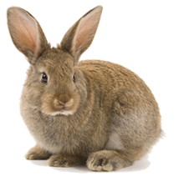
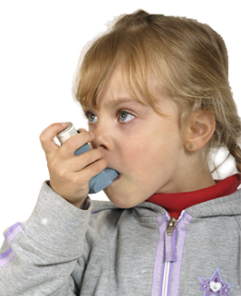
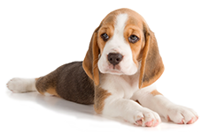
SS2
Animal testing viewpoints
Many of the experiments cause pain to the animals involved. We should never harm another animal
The good done to humans outweighs the harm done to animals
Animals deserve the freedom to run and jump and play, not be confined to laboratory cages
Banning animal
testing may cause harm to humans because they won't benefit from a cure for their disease
If we don’t use
animals to test if a drug is safe then we will have to use humans. This could cause humans pain
and suffering
Animals and
humans have equal rights

Slide 19
SS4
Using ethical thinking
We should ban animal testing
We should not ban animal testing
Viewpoint:
Ethical thinking:
Viewpoint:
Ethical thinking:
Viewpoint:
Ethical thinking:
Viewpoint:
Ethical thinking:
Viewpoint:
Ethical thinking:
Viewpoint:
Ethical thinking:

Slide 20

Get students talking and thinking

Slide 21














Equipping the Next Generation for Active Engagement in Science
TRACES

