Slide 1

Equipping the Next Generation for Active Engagement in Science
Animal Testing (1 of 2)

Slide 2
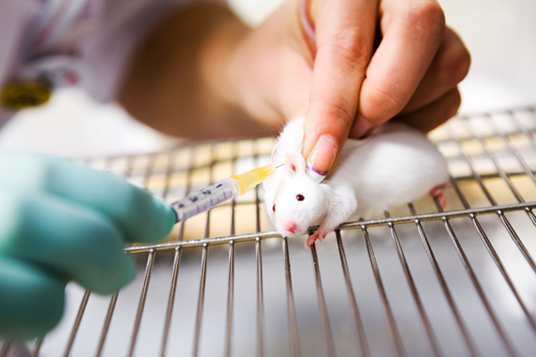
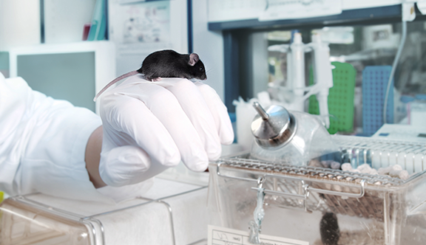
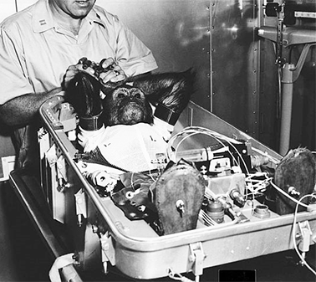

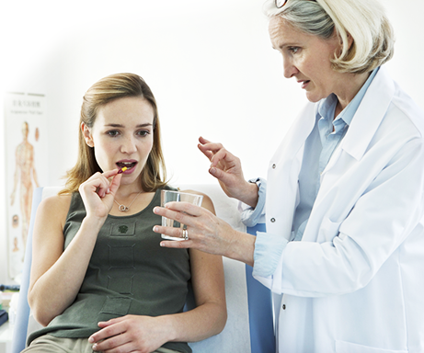
What is the issue?
2
Engage
Review
Consider
Notes:
Ask students to discuss in pairs what they think the issue is.

Slide 3
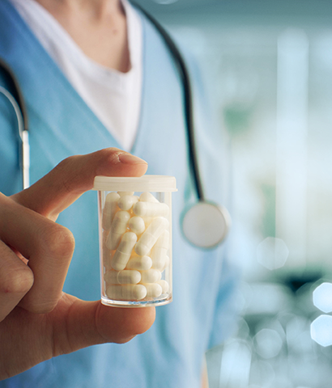
Why do scientists use animal testing?
New medicines (drugs) need to
be tested to make sure they are safe and that they work before they can be used.
3
Engage
Review
Consider
Notes:
Reveal the answer and further information . For a KS4 class you may wish to spend longer discussing the process of drug testing at this point.

Slide 4
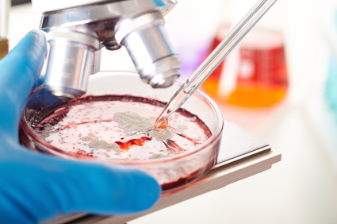
A new drug is tested on:
1 Human cells to see if it has an effect.
2 Animals to check if it safe and works in a whole organism.
3 Humans to find out if it helps the illness.
4
Engage
Review
Consider

Slide 5
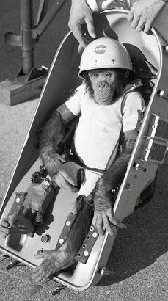


Animals are also used in other areas of research.
For example, animals were used to test if space travel was
safe for humans.
They can be used to test cosmetics. This in now banned in Europe.
SHAMPOO
NOT TESTED
ON ANIMALS
5
Engage
Review
Consider

Slide 6
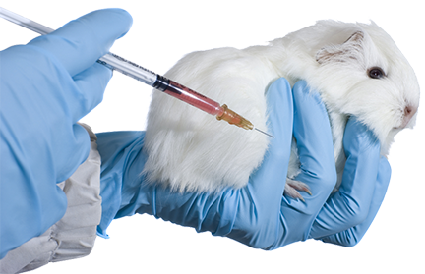


Say NO to animal testing in Europe
Test human drugs on humans
Will you sign the petition for a ban on all animal testing?
1.2 million votes for a ban – join us!
Take a stand for what’s right: Sign the petition
Engage
Review
Consider
Notes:
The decision they will be making in the activity. Ask students for a show of hands to show who would sign the petition.

Slide 7


show how asthma affects the structure of the gas exchange system
learn 3 kinds of ethical thinking to make decisions:
– utilitarianism,
– rights and duties,
– virtues
In these lessons you will :
Lesson 1
Breathing
Lesson 2
Use ethics
Big Idea
Working Scientifically
Notes:
The objectives for this lesson

Slide 8

How are you going to make a decision?
Lesson 1
Lesson 2
Use scientific evidence
Use ethical thinking
to answer
to answer
Is animal testing essential to drug development?
Is animal testing
right or wrong?
Will you sign the petition?
Explain why.
Engage
Review
Consider
Notes:
A breakdown of how the students will use scientific evidence in lesson 1 and ethical thinking in lesson 2 to help them to make a decision.

Slide 9
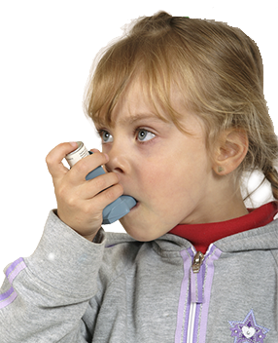

SS1
Thousands of children have asthma.
Drugs help but are not always effective. Scientists need to create more.
Is animal testing essential to asthma drug development?
Find out how asthma affects the body and how the drugs work.
9
Engage
Review
Consider
Notes:
Introduce the need to develop more asthma drugs. Students work alone to apply their knowledge of the gas exchange system to explain how asthma affects it and how asthma drugs work (SS1). This task is used to activate their background knowledge so they are able to use it when looking at evidence in the next stage of the lesson.

Slide 10

SS2–3
Some people argue that animal testing is not essential
What does scientific evidence tell us?
Look through the evidence cards and discuss:
How essential is animal testing to develop drugs?
What are the alternatives?
10
Engage
Review
Consider
Notes:
Ask students to work in small groups and give each evidence cards (SS2) and an A3 copy of the continuum line (SS3). Students read each evidence card and then discuss as a group what it tells them about how essential animal testing is for drug development. They decide where to place each card on the line. When all cards have been placed, they discuss how essential they think animal testing is.
Ask groups for feedback and compare their thoughts. For any opinions presented, ask groups to use evidence and explain their reasoning.

Slide 11

Student sheets
Animal testing
Sheet no. | Title | Notes
SS1 | All about asthma | Reusable, one per pair
SS2 | Animal testing evidence | Reusable, cut into cards, one set per group
SS3 | How important is animal testing for drug development? | Reusable, enlarge to A3, one per group

Slide 12

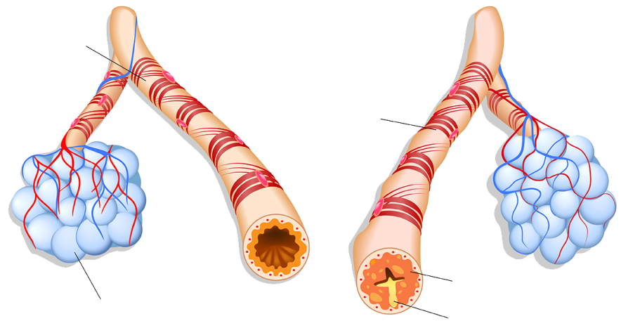
SS1
All about Asthma
What is asthma?
Asthma affects the gas exchange system. When an asthmatic comes into contact with something that irritates their lungs, such as smoke, the muscles around their bronchi tighten and become narrower. More sticky mucus is made. We are not sure what causes asthma.
Relaxed smooth muscles
Normal bronchial tube
Inflamed bronchial tube of an asthmatic
Tightened smooth muscles
Treating asthma
There is no cure for asthma
but there are treatments that control it. Asthma drugs are usually given by inhalers. The drugs are very effective and have few side effects. However, they are not good at helping all symptoms in all people. New ones need to be developed.
Swelling
An inhaler relieves asthma symptoms quickly to allow breathing to become easier and prevent
an asthma attack. Inhalers have saved millions of lives.
Alveoli
Mucus
Asthma attacks kill three people every day in the UK.
In the UK around 1 in every 11 children has asthma.
Check your understanding
1 Describe how the gas exchange of people with asthma is different
to healthy people
2 Explain why asthma can make breathing difficult
3 Suggest how the drug in an inhaler helps relieve asthma symptoms
4 Explain why asthma attacks can kill if not treated effectively.
Notes:
UK version

Slide 13
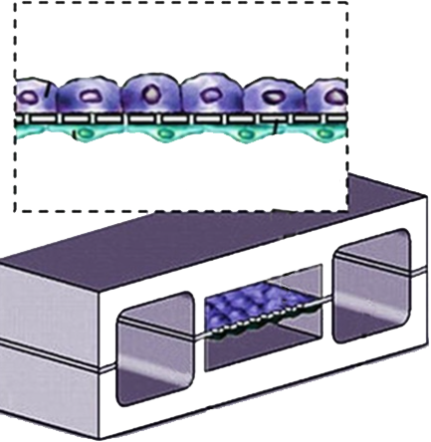
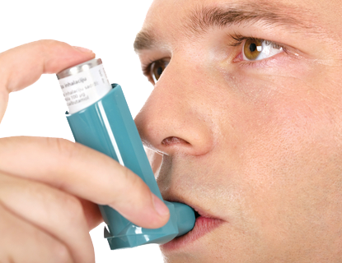
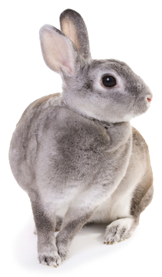
SS2a
Animal testing evidence
Organs-on-chips have been developed for some organs. They can be used to check that drugs work without using
an animal.
Inhalers, and nearly every other medical breakthrough in the last 100 years, has resulted
directly from
research
using animals.
Lung cells
Every species of animal is different.
A drug that works in an animal may not work in a human.
Computer models and human cells are also used to test new drugs.

Slide 14
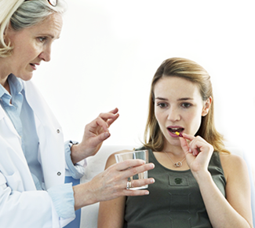
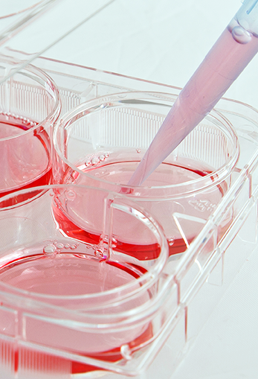
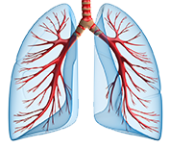

SS2b
Animal testing evidence
Without the use of animal testing we risk testing unsafe
drugs on
humans.
In 2015 researchers used testing on mice to find a substance which causes swelling in human airways.
This could lead to new asthma drugs.
Animal tests miss possible drugs. Substances which were toxic to some animal species, and so discarded, could be safe and effective in humans.
Alternatives to animal testing like computers and cells in dishes are not enough.
They don’t have
a gas exchange system so we don’t know what the effect will be on asthma.

Slide 15

SS3
How essential is animal
testing for drug development?
1 Read each evidence card.
2 Decide what it tells you about animal testing being essential or not.
3 Place the card along the line below
4 After placing all the cards discuss the question above
Not essential
Very essential

Slide 16

Get students talking and thinking

Slide 17














Equipping the Next Generation for Active Engagement in Science
TRACES

